Slide 1
Instructor Edition
69th Revision
May 2023
JB Edwards and Associates LLC

Slide 2
Leadership matters most when it is least clear what course should be followed
---- Michael Useem

Slide 3
Sense making is about contextual rationality Karl Weick, 1996
To point the way to safety in the face of surprise, leaders today need to develop resilient groups that are capable of four things:
Improvisation
Wisdom
Respectful interaction
Communication

Slide 4
The challenges facing leadership are significant and the opportunity for error considerable
Most notable public safety success and failure arises from incidents that at least start as routine events
The extraordinary is born in the routine
Strong leadership is required at all times, not just in a crisis. Drummond-Smith, (2018)
Leaders must be prepared to make informed decisions and demonstrate sound behaviors that respond rather than react in most events
Extraordinary events require extraordinary responses
Leaders must be prepared with the competence, confidence, trust, and legitimacy to act
Acumen is critical
Relationship is required
Leadership Emerges

Slide 5
3 Domains where Leadership Emerges Ibrahim, L. Y. (2016).
External
Factors
Internal
Factors
Leadership
Role
Stemming from within the leader
Arising from the nature of the leadership role
Coming from people and situations

Slide 6
The Roles of Leadership
Human Side
Empathy
Sincerity
Personal Mastery
Collaboration
Technical Skills
Domain Competency
Reasonable
Inclusive
Leadership
Skilled Expertise
Conceptual Skills
Vision, mission, values
Benchmarking
Strategic Planning
Change Management
Stakeholder Management
Motivational Inquiry
Internal & External Outreach/ Feedback
Adapted from: Ellis & Normore, (2018)

Slide 7
Optimum Organizational Performance in our Craft The three-legged stool analogy (Edwards, 2021)
Culture (Leadership)
Stakeholder Management (Relationships)
Proactively Managing the Operational Realities (Acumen)

Slide 8
The three (3) big requirements for a leader to shape culture
Character
Values
Integrity
Ability
Competence
Confidence
Commitment
Work Ethic
Passion for the Job
Traits

Slide 9
Three (3) Interrelated Dimensions The Automobile Metaphor: the essence of contemporary police leadership and management. Edwards, (2018)
Character and Behavior
Contextual Understanding
Interactions and Relationships
Engine
Drive train
Steering
LMX Theory

Slide 10
Leadership Capacity Zaccaro,Green, Dubrow, & Kolze, (2018)
Acumen Technical Skills
Cognitive
Critical Thinking
Values
Beliefs
Social
People Skills
EQ

Slide 11
It is an important part of the job for leaders to understand their ongoing responsibility to solve problems and manage messes
First, we try to prevent, mitigate, and reduce mistakes, problems, and messes by proactive management strategies
Second, we can never eliminate risk or problems, we can only manage them
Finally, it is our job to deal with problems

Slide 12
PROBLEMS NEXUS TO SOLUTIONS
DIAGNOSE
PROBLEM
CORRECT
PROBLEM
MORE DIFFICULT
MORE DIFFICULT
EFFORT
PAULS LAW
Hans Paul NASA
EASIER
EASIER
TIME

Slide 13
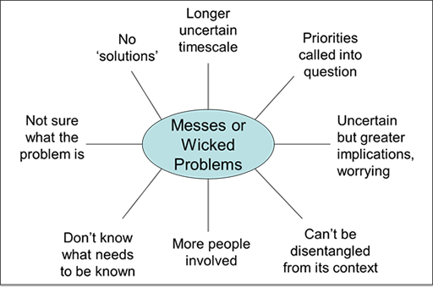
Rittel, (1972) and Ackoff, (1979)

Slide 14
The Process: Fact-finding, Assumptions and Conclusions
IGNORANCE
EDUCATION
Perspective
Factual Context
SPECIFICITY
Belief
BASIS OF KNOWLEDGE
OBJECTIVITY
SUBJECTIVITY
THE IMPORTANT QUESTION: How do you know?

Slide 15
High Performing Leaders follow a Process for Sound Decision Making
SPECIFICITY
Informed
Choice
Have an Empathetic Perspective
Critical
Analysis
Develop Contextual
Understanding
Are Specific and Objective
Are Value Driven
Edwards, (2014)

Slide 16
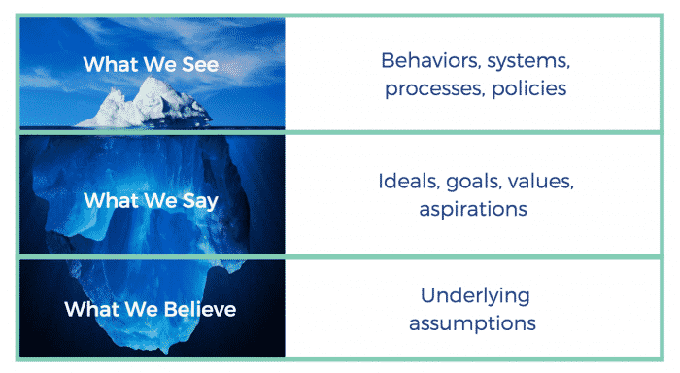
Organizational Culture

Slide 17
Culture Components D.D. Warrick (2017)
Modeling by the leader (integrity and work ethic)
How time and resources are managed
The way that Language, conversation and feedback are used
Interactions and relationships
The standards and expectations communicated, and the oversight applied
The opportunities created (growth and development)
The structures, systems, processes, roles and routines put into place
The environment created and experienced

Slide 18
This Class is about what we do
Is based on 45 years of practical and actual police experience blended into the most current academic study and empirical research
Its focus is to interpret replicated and credible leadership and management theory into the practical application to achieve effective results
Its goal is to promote the professional growth and development of law enforcement supervisors, managers, and executives in the contemporary law enforcement profession
It a blend of the academic concepts
and the practical applications

Slide 19
This morning will start with an introduction of fundamental concepts, then five (5) separate but continual interactive domains
The Burden of Self-Awareness
The Burden of Competence
The Burden of Servanthood
The Burden of Communication
The Burden of Management
“all five domains are integrated and support each other constantly”
Edwards, (2014)

Slide 20
The Burden of Command, three-day leadership and management training
Go to: www.jbedwardsandassociates.com
for our Power point slides and additional class information and resources
The Slides are Numbered at the right bottom corner for your quick reference
66th Revision November 2022
© JB Edwards and Associates L.L.C.
Consultants

Slide 21
Leadership Dynamics Complex, Complicated and Contextual
Leadership is an ecosystem involving the utility of personal traits, competence, confidence, humility, advocacy, relationships and practice
All depends on one's ability to be self-aware, self-reflective and self-managed to influence and navigate a context-rich, complex and dynamic work environment often created by the leader
The Equation of Leadership as a Social Process
Leader > Follower > Context > Leadership Emerges
Leadership occurs and evolves in an organic ecosystem

Slide 22
Modern Forces That Influence 21st Century Law Enforcement Leadership
Social
Technological
Economic
Political
Complexity that fuels a dynamic ecosystem that requires exemplary leaders and solid managers dedicated and passionate about their work

Slide 23
The Complexities of 21st Century Policing Policing, Volume 10, Number 3, pp. 163–170 Bayley, D.H. (2016)
Policing has become dramatically more complex in six ways: its tasks, public demands, strategies, technology, accountability, and resources.
Management today requires new knowledge, new choices and new skills
New thinking about what the police should do and what they should be held responsible for and how they do it

Slide 24
OUR WORLD TODAY
Complex, complicated, and contextual: (where society tends to be Intelligence lazy and contextually blind)
Public versus police perspective: (shooting guns out of hands and everybody can be de-escalated)
Video proliferation (danger as one perspective, absent additional context)
Earned media hype: (sensationalism, infotainment, reliance on the sample bias, and negative narratives)
Social media: (homogenous thought and conformity, instantaneous positions absent facts or context, ignition of rumor and propaganda)
Polarization of partisan politics
Civil unrest
Proliferation of firearms (on person carry in public and at protest)
Politicization over process (loss of faith in our institutions)

Slide 25
Critical Issues Police Executives Face From: Critical Issues in Policing 8th edition Dunham, Alpert & McLean, 2020
Police culture and training (warrior/guardian)
Police misconduct
Police use of force
Police militarization
Social disorder and mental illness
Women in policing
An Afrocentric perspective on policing
Organizational justice and policing
Technologies and policing (BWC, GPS, EIS)
Police practices and operations

Slide 26
Turbulent Social Environment
Poverty and income inequality
Citizen trust and legitimacy of police
The criminal justice system
Police interactions
with citizens
Compliance
Proliferation of Guns
Gangs
Earned media and social media narratives
Political movements and polarization
Police body camera contextual perspectives
High crime rates
De-policing
Police attrition and
staffing
Police use of force incident

Slide 27
In our craft, It is tremendously important to remember how other people see reality
Often, people see reality totally different than each other…
People can see the same things and come to entirely different conclusions
People often do not see what we see or what we expect them to see…
People see reality different based upon their different views, education or lack there of, cultures, beliefs, biases and feelings.
What really is the reality and who’s reality is it?

Slide 28
THE YALE LAW JOURNAL Will Putting Cameras on Police Reduce Polarization? Sommers, R. (2016)
Findings reported here suggest that video evidence remains susceptible to biased interpretation
In deciding factual matters about what happened—such as whether a weapon was present, whether physical force was used, whether the citizen complied with the officer’s requests—fact finders reviewing video footage brought their prior attitudes toward the police to bear on their judgments.
In deciding more subjective matters—such as whether the citizen posed a threat, was likely armed at the time, or was resisting arrest—viewers again relied on their level of identification with police.

Slide 29
Also, Important
Overall, police enjoy a majority public support over a long period (Pew & Gallup)
Police and the public hold sharply different views about key aspects of policing as well as on some major policy issues facing the country (Pew, 2017)
Faces danger and uncertainty everyday
Manages personal stress, fatigue and cynicism everyday
MUST READ: Morin, R. Parker, K. Stepler, R. & Mercer, A.(2017). Behind the Badge. PEW Research, Social & Demographic Trends
https://www.pewsocialtrends.org/2017/01/11/behind-the-badge

Slide 30
Leadership must constantly be prepared to deal with the dynamic issues of…
Perspective (attitude toward or way of regarding something; a point of view)
Context (seeing how and why all the issues fit together within a pattern of circumstances)
Facts (what truly exists or happens)
= Perception (the way someone thinks about or understands something)

Slide 31
Police learn how to behave and what to think from other police officers
Subculture: People who form a unique group with a given type culture
The difference from culture is that while sharing many values and beliefs of the larger culture, they also have a separate and distinct set of values that set them apart
The police selection process produces conformity in ideology, appearance and conduct
The homogenous group of police recruits experience formal socialization when they enter the police academy
Much of the material presented to the recruits by other officer trainers serves to reinforce the existing police view of the world

Slide 32
So, how much of the problem is defined by the fact we are:
HUMAN BEINGS
We lack self-awareness, objectivity, values, and self-discipline
The fact that often, we may be our own worst enemy and we suffer from our own bias, incompetence, lack of training, poor supervision, mentorship, and oversight
We don’t observe, study, research, and learn regarding the operational realities around us
We don’t develop, set, manage, sustain the proper Culture and hold ourselves and everyone else accountable to it

Slide 33
Criminality in Context: The Psychological Foundations of Criminal Justice Reform Haney, 2020
Poverty and racism are major structural factors that contribute to crime
Because race and poverty are so deeply intertwined in our society, people of color are more likely to confront these challenges
Addressing the terrible consequences of poverty and economic inequality is important in its own right, but also should be seen as advancing the goal of crime prevention
Kerner Report 1968
Reducing crime and poverty are part of the same social justice agenda

Slide 34
Results indicate that in disadvantaged neighborhoods crime reporting decreases following fatal police use of force incidents Sheppard & Stowell, (2022)
Results indicate that the most important predictor of police shootings are levels of violent crime
Violent crime rates, in turn, are significantly related to the built environment
The built environment, then, has an indirect relationship to the places where police are most likely to discharge their weapon which is mediated through the violent crime rate
Keller, Caplan & Kennedy, (2023)

Slide 35
Socioeconomic conditions and poverty trends in the past 30 years across many of our cities are not notably different
Public trust in the police has been declining, particularly in communities of color, while the burden of gun violence has increased, disproportionately so in these same communities
If there is a lack of support for police, residents will be unwilling to cooperate with the police and assist with investigations, and such attitudes can undermine the ability of police officers to do their jobs effectively Wolfe et al, (2016)

Slide 36
Factors associated with police shooting mortality: A focus on race and a plea for more comprehensive data Nix & Shjarback, (2021)
Deaths caused by police officers are just one outcome of the behavior in the use of lethal force
Lethal force is "physical force capable of or likely to kill...it does not always kill“
Every time police officers shoot at a person; they're using lethal force - even if they don't ultimately kill the person
Existing data may be misleading us in the evaluation of these cases
Researchers should be careful about generalizing from data that only capture fatalities

Slide 37
Revisiting the Ferguson effect: Law enforcement perception of recruitment in the post George Floyd era Copeland, Del Carmen, & Semukhina, (2022)
Confirm that the Ferguson effect on policing in the United States is real, but may not have a relatively large effect when compared with traditional factors such as limited funding and competitive job markets
Police department administrators should review these findings and attempt to further isolate the “reasons” affecting negativity among police applicants that may present a policing career as less than ideal

Slide 38
The Mental Health Perspective
Recent research has shown that crime-related police calls for service account for 20–30% of police call-related activity
Mental health calls for police service are elevated during fall/winter months and during the week
Vaughan, et al. (2019)
Mental Health call classification is consistent with the ~1% rate identified in previous research (Hodgkinson & Andresen, 2019; Koziarski, 2020; Langton et al., 2021; Livingston, 2016; Lum et al., 2021; Vaughan et al., 2018; White & Goldberg, 2018) 9,9% more accurate in global police response view Koziarski, Ferguson & Huey, (2022)
Reform efforts should not focus on who can replace the police but how the police can improve their responses to calls that may involve the mentally ill Koziarski, Ferguson & Huey, (2022)

Slide 39
Elevated police turnover following the summer of George Floyd protests Mourtgos, Adams & Nix, (2022)
There have been many assertions from police leaders across the United States that in the wake of sustained policing protests, their agencies have experienced a significant uptick in officer turnover throughout the latter half of 2020
There have also been claims that excessive criticism has hampered or even harmed police agencies and their sworn employees in previous police legitimacy crises.

Slide 40
The study suggests that with respect to police officer retention, there is cause for legitimate concern
Analysis of 60 months of data shows that while resignations and involuntary separations were not significantly altered in the post-Floyd period, voluntary resignations were
Officers resigned at a 279% increased rate relative to the expectations

Slide 41
Further, a deficit of officers may contribute to an already increased violent crime rate in the studied agency, which has already become local headline news
The potential cohort effects of a broad-based retention crisis in policing could ripple across communities for years into the future
Mourtgos, Adams and Nix, (2022)

Slide 42
3 key findings from research: PERF, (2019)
Fewer people are applying to become police officers. Sixty-three percent of agencies that responded to PERF’s survey said the number of applicants for police officer positions had decreased, either significantly (36%) or slightly (27%), over the past five years.
Agencies reporting difficulties in US 3.3% 2009 to 26.5% in 2018 (CFSLGE, Washington D.C.)
More officers are leaving their departments—and, in many cases, leaving the policing profession—well before they reach retirement age.
A growing number of current officers are becoming eligible for retirement, about 8.5 percent of current officers are eligible for retirement, and 15.5 percent will become eligible within five years.

Slide 43
Anecdotal Points
Many agencies are changing from 8 hour to 12-hour shifts (Not enough personnel to cover shift)
Trainings are being canceled because of the lack of people to fill shifts
Supervisors, managers, detectives and other specialized officers are being pulled to cover uniformed patrol shifts
Mass experience drain
Promotions being postponed (not back filling important positions)
Overtime budgets are in the red
Service interruptions and service terminations
Lack of resources, lowering of standards, and poor supervision

Slide 44
Cost of Turnover
Loss of investment (recruiting and training)
Impact on staff (Additional work, time compression, expanded call status, open positions for promotion, and officer safety)
Impact on agency (service interruption, overtime budget impact, program halts, training withheld, shift changes, and experience drain)
Impact on public (call response, crime prevention and reduction, lack of service, reactionary instead of proactive policing, and increase budgets)
Takes years to catch up and rebound

Slide 45
Good policing requires good police officers Adams, Nix, and Mourtgos, (2023)
Jurisdictions across the U.S. are experiencing significant changes to the three main variables in police staffing: recruitment, resignations and retirements.
These changes are likely to deteriorate the quality of policing and may give rise to more incidents of officer misconduct, increased violent crime, decreased policing services and a failure to meet community and professional standards.
Most officers are not leaving the profession, but instead are leaving for other nearby agencies that offer better pay and a more positive work environment.

Slide 46
Attorney Eric Daigle
My experience has led to the conclusion that supervision is the key ingredient to ensure effective constitutional policing
The challenges in recruitment and retention are multiplying the risk faced by the law enforcement industry
Just ask yourself: Are your supervisors properly trained to handle their responsibilities?
There were many suggestions to fix some of the supervision issues within law enforcement, but the overarching themes are simple.

Slide 47
There needs to be more consistency in supervision, better training for future supervisors, and the need to slow down the promotion process so that supervisors have time to be properly trained before rushing through the ranks
Many entities, including Daigle Law Group, provide supervisory training to enhance the skillsets and capabilities of those we rely on to ensure officers are doing things correctly
Have you invested in ensuring your supervisors are ready for the challenges they face daily?

Slide 48
It is all about Leadership, Acumen, Awareness, and Proactive Management
Professional Culture Sustained by Professional Standards, Vision, Conduct, and Oversight that Prevents:
Negligent Hiring
Negligent Retention
Failure to Train
Failure to Direct (policy)
Failure to Supervise (enforce policy and provide oversight)
Failure to Discipline
Failure to Intervene/intercede

Slide 49
Beware of Grey Rhinos and Black Swans
Grey Rhinos: Obvious dangers we ignore, highly probable, high impact yet neglected threat: kin to both the elephant in the room and the improbable and unforeseeable black swan. Gray rhinos are not random surprises but occur after a series of warnings and visible evidence
Black Swans: The unknown, unforeseen event that is extremely low in probability and high in impact. They tend to be not fully explainable until after the fact

Slide 50
Same story over the years
Rarely ever are these incidences a one-time thing
They represent a culture of improper behavior
Usually, there will be a history of complaints that resulted in a perfunctory investigation (a superficial inquiry, done without care or interest or merely as a form or routine)
OR just ignored

Slide 51
Leadership and Management must have a “Zero-tolerance” for misconduct and unprofessional behavior
Managers, Supervisors, and Officers remain aware, responsible, and held accountable to stay above the RED LINE

Slide 52
Public and Political Demands for Reforms and Training
Loss of qualified immunity, Cease traffic stops, New UOF continuum with de-escalation, Ban choke holds, Duty to intervene, Citizen review boards, Warning shots, No shooting at vehicles, Ban no-knock search warrants, defund police, etc.…etc.…etc.…
When the key is…
Leadership
and
Management

Slide 53
Our Police Culture
Very ingrained in our beliefs
Paramilitary (authoritative) paradigm
Skeptical of others and fraternal (Them and us paradigm)
Difficult to adapt and resistant to change
Never satisfied with the status quo
Think concretely and not abstract
See everything as black and white, can’t see the gray
Assumptions and beliefs that guide behaviors and communicate to officers how to perceive and think about people and things
Informal rules and regulations and tactics
Bravery, autonomy and secrecy.

Slide 54
Often, we promote people without any leadership training
Often, we don’t hold our managers accountable
We don’t integrate the best practices into policy
We don’t capture and analyze feedback
Our supervisors and managers do not invest in the development and production of credible and fair performance appraisals

Slide 55
What does good mean in the context of leadership Four distinct meanings: Gandz, (2007)
Effective Leadership: Influencing followers to commit to and obtain goals that were agreed upon
Purposive Leadership: Providing vision and purpose that inspires followers
Ethical Leadership: Doing the right things in the right way
People feeling well regarding the leadership provided: To never lose sight of the wants and desires of the followers

Slide 56
Police Leadership is largely focused around the following: Karp, Filstad, & Glomseth, (2019)
Working toward mastering the leader role(s)
Dealing with organizational tasks
Operating the organizational unit, they are responsible for
Making choices and setting priorities
Caring for and developing interpersonal relationships
Managing themselves

Slide 57
Influencing the standard conditions
Being committed to the social mission
Doing a job that is formed by a very specific leadership culture

Slide 58
New Psychology of Leadership Haslam, Reicher, & Platow, (2020)
Non-individualistic: shaped and transformed by engagement in group activity
Context-sensitive: exerting influence over others is determined by the context in which their collective relationship is defined
Perspective sensitive: If one has identified the right person for a particular leadership position (e.g., based on his or her personality) then this suitability will be recognized by all

Slide 59
Inspirational and transformative character: an emotional and intellectual force that allows people to feel that they are not only witnessing history but making it
Empirical validity: the convergence of different types of evidence that provides confidence in the analysis

Slide 60
Six Primary Competencies: Conscious leadership competency framework: Kubátová & Kročil,(2022)
Virtues: pursuit of wisdom and building healthy relationships.
Consciousness: of their higher purpose and the ability to foster meaning.
Personal conduct: ethical behavior and humility that supports continuous personal growth.
Mindset: involves rational optimism and the ability to plan for the organization's short-term and long-term needs
Strategy: capability that simultaneously supports a higher purpose
Leading: capabilities, such as effective communication and positive cultural development to create a healthy work culture/environment

Slide 61
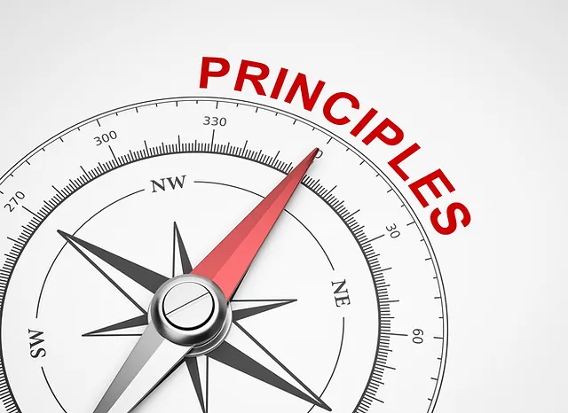
Values
A values-based leader aims to
motivate and inspire others to
pursue the greater good –
When you truly know yourself and what you stand for, it is much easier to know what to do in any situation ` Kraemer, (2011)
Our values are “internalized attitudes about what’s right and wrong, ethical and unethical, moral and immoral” (Yukl, 2010)
EG: Fairness, honesty, equality, humanitarianism, loyalty, progress, pragmatism, excellence, and cooperation

Slide 62
Followers' moral judgments and leaders' integrity-based transgressions: A synthesis of literatures Krylova, Jolly, & Phillips, (2017)
Behavioral integrity defines an individual’s trustworthiness through the extent to which promises are kept.
It represents whether target persons do what they promise, and whether those persons adhere to their espoused values.
More precisely, a leader's behavioral integrity is “the perceived pattern of alignment between the leader's words and deeds” (Simons, 2002).

Slide 63
Moral Integrity does, indeed, preclude immoral or amoral ideals and values.
It is judged on the basis of one's beliefs about the purity of the agent's motivation.
Word and action alignments are still important, but moral integrity also considers whether an actor's values and moral principles are congruent with the values and principles of the observer in question
Remember: In leadership off the record is NEVER off the record

Slide 64
Three important characteristics of leadership and citizenship in our contemporary times
As Leaders we must embrace:
Curiosity: Be unsettled enough in our assumptions to be interested in other’s views
Humility: Know we don’t know it all. Acknowledge our mistakes and learn from them
Empathy: See the world through the eyes of others
(Meacham, 2020)

Slide 65
Curiosity A strong desire to know or learn something
If we are not curious, we can become fixated on ourselves
Curiosity disarms suspicion
Suspicion leads to distrust
Allows for space

Slide 66
How do we increase our capacity for curiosity?
Open mind (keep values and convictions)
Don’t take things at face value (bias)
Look past ourselves
Ask questions

Slide 67
Humility Freedom from pride or arrogance
Self-awareness or the ability to be able to understand one’s own strengths and weaknesses from a more objective and external standpoint
Openness or a willingness to explore and take on new ideas, thinking, knowledge and behaviors in the light of external evidence
Transcendence or the ability to be able to move away from one’s subjective perspective and take on an inclusive and more objective perspective of both themselves and the context
Oxford Review (2021)

Slide 68
Empathy Ability to understand and share the feelings of another
Awareness (Be present and paying attention)
Aggressive listening
Mindfulness (understanding of content)
Dialogue
Process that allows an individual to experience feelings that are congruent with the situation of another person
KEY IS Perspective taking: the mental act of perceiving a situation from another individual’s point-of-view

Slide 69
Five Main Skill Sets Understanding context, integrating perspectives, suspending judgement, forming questions and drawing objective conclusions
Sensitivity to environmental and social stimuli: The situational awareness that enables us to proactively understand issues (Demand Specificity)
The Prism: Our perspective
The Filter: Critical thinking and objective evaluation (Metacognition)
The Reality: Accurate interpretations from “feedback” and fact/evidence-based conclusions
The Response: Refined, tempered, and empathy-related responses essential to prosocial behavior, interactions and relationships

Slide 70
Responding Appropriately
Moral and just
Crosby, B. (2017)
Behavioral
Emotional and Social
Intelligence
Leadership
Capacity
How we think
Cognitive
Socio-Emotional

Slide 71
Bill George: Authentic Leadership
Passion
Purpose
Compassion
Heart
Behaviors
Values
THE
AUTHENTIC
LEADER
Consistency
Self-discipline
Connectedness
Relationships

Slide 72
The Cost of Leadership
Responsibilities
Leadership
*John Maxwell
21 Irrefutable Laws of Leadership
Rights
As you rise in leadership, responsibilities increase, and rights decrease.
“You lose the right to put yourself first.”

Slide 73
Your Values
Your Behavior
YOUR
INTEGRITY
Role modeling is critically important

Slide 74
Embedding leader character into HR practices to achieve sustained excellence Seijts, Crossan & Carleton, (2017)
Four aspects of character — integrity, responsibility, forgiveness and compassion
Character is a combination of virtues, personality traits and values that enable excellence
Virtues refer to situationally-appropriate behaviors that are widely seen as representative of good leadership
Virtues encompass personality traits such as resiliency and openness
Virtues can also be seen in an individual’s values, such as behaving equitably

Slide 75
We contend that organizations need to pay as much attention to leader character as they do to competencies
This is because a shortfall in one of the pillars of good leadership — competencies, character and commitment — will undermine the other pillars and, ultimately, lead to performance problems for leaders, their organizations and related stakeholders

Slide 76
Relational power Soga, et al. MIT Sloan, (2022)
Relational power differs from hierarchical power, which is derived from the formal position that a manager holds, and the authority embedded in that position
Relational power is derived from the ability of a [leader] to wield influence on others without necessarily being in a formal hierarchical role

Slide 77
Everything is built upon a “ROCC” of Trust Mishra & Mishra, (2013)
Reliable: you can be counted on
Openness: honesty, integrity, and complete transparency
Competence: able to perform to meet or exceed the job expectations
Compassion: genuine interest in
the needs of another and
unselfishly working to fulfill
those needs

Slide 78
Human beings must be seen as individuals within their own complex context
Biological considerations (from hormones to health issues)
Sensory input (intuitive and rational)
Intelligence
Personality and character
Emotional considerations
Environmental cues
Culture cues (Beliefs and values)
Life experiences (social and/or phycological)
Capacity (specific competencies) versus Capability (ability, confidence and commitment)
REMEMBER
We must Describe Behavior NOT Judge the person

Slide 79
Important Perspectives
Identity: the concept you develop about yourself that evolves over the course of your life.
Agency: the capacity, condition, or state of acting or of exerting power
Psychological Capital: hope, efficacy, resilience, and optimism
Psychological Ownership: territoriality, ease of belonging, accountability, self-efficacy, and relational identity

Slide 80
Social Identity makes leadership and organizations possible
The Sense of Shared Identity
Mutual interest
Trust
Engagement
More effective and meaningful communication
Meaning and purpose (Feeling good about your work)
Basis to coordinate everyone's efforts together
Develop the foundation to work together toward identified outcomes

Slide 82
The Practice dynamics of leadership Filstad, C. & Karp, T. (2020)
Producing refers to the ongoing everyday activities of policing and the common and collective achievements in leadership practices
It is about the ‘doing’ of police leadership practices
Relating and social interactions in policing seem to be based on informal relations between leaders and employees while working
The importance of the collegial and social environment is often emphasized by the leaders themselves

Slide 83
Interpreting and sensemaking are integrated in social, cultural and contextual relations and ongoing practice dynamics
Different interpretations lead to sensemaking when individuals construct their own sense of self as interdependent and dynamic within leadership practices
Negotiating refers to power and politics, which, according to a practice-based perspective, are integrated and embedded in leadership practice

Slide 84
Mission
Structure
Strategy
Learning
Change Management
4. Activities
1. Strategy
Leadership
As
Practice
3. Participation
2. Community
Culture
Identity and
Belonging
Knowing
Sensemaking
Maneuvering space
Power and politics
Filstad, (2022)

Slide 85
Meta-analyses that aggregate the results from hundreds if not thousands of leadership studies Three Evidence-based Generalizations regarding common attributes of effective leaders Chamorro-Premuzic, (2019)
Intelligence Capital: Domain specific expertise, experience and good judgement
Social Capital: Network and connections that leaders have at their disposal
Psychological Capital: How leaders lead based on their personality and character
Leaders must behave as life-long learners
and continually develop their skills Page, Kramer & Klemic, (2019)

Slide 86
George Mason University integrative review of leadership studies over the last 20 years found Zaccaro,Green, Dubrow, & Kolze, (2018) Oxford review, (2019)
In terms of leadership development there is considerable scope for helping leaders develop the ability to control their outcomes by working with them on their:
Cognitive capacities
Social capacities
Core values and beliefs
Knowledge and skills (including emotion regulation skills)
Additionally, the research found leaders that:
Acquire a more developmental mindset, (as opposed to a fixed mindset)
Understand and develop their foundational traits in leadership capacities
Increase situational flexibility and awareness

Slide 87
Management and Leadership
Require unnatural thinking and acts
Management: is about processes, systems, and functions
Leadership: is about influence and motivation
Leadership roles: emphasize tasks to be carried out
leadership styles: emphasize behavioral modes and approaches in carrying out those tasks
Managing is "what" a leader does, and leading is "how" they do it
Alimo-Metcalfe & Alban-Metcalfe, (2008)

Slide 88
Manager Leader
Status Quo
Short Term
Means
Builder
Problem Solver
Change
Long Term
Ends
Architect
Motivator
Do Things Right
Do The right Things
* From Warren Bennis

Slide 89
Management is…
Organization
Planning
Staffing
Directing
Controlling

Slide 90
Management is about functions process and “control.”
Managers control systems, processes, time, costs, quality, and efficiency.
Some good managers have a difficult time making the paradigm shift to leadership.
Leading isn’t about controlling; it’s about “releasing.”
- John Maxwell

Slide 91
When to step out
When to step in
THE MANAGEMENT PARADOX
The context of discretion versus
developmental maturity and type task
Autonomy
Control
Freedom
Power

Slide 92
Good leaders empower by giving their power away and providing:
Vision and direction
Setting the standard
Training to the standard
Enforce (supervise) the standard
Culturizing the standard
Provide specific unambiguous expectations
Give constant and ongoing mentorship and feedback
Provide oversight
= Development and Capacity Building
+ Delegating the task and authority = Performance

Slide 93
What about our Subordinates
Public Service Motivation Theory: a prosocial motivation to serve the public interest and thereby help others
Public service motivation is as a predisposition to “respond to motives grounded primarily or uniquely in public institutions and organizations” Perry & Wise, (1990)
(OCB), Organizational citizenship: behavior is a person's voluntary commitment within an organization or company that is not part of his or her contractual tasks. (Wants to go the extra mile)

Slide 94
Herzberg Two-Factor Theory (1959)
Growth and motivator factors Intrinsic to the job
Dissatisfaction-avoidance or hygiene factors Extrinsic to the job
Achievement
Recognition for achievement
The work itself (purposeful)
Responsibility
Growth
Advancement
Organization policy
Administration
Supervision
Interpersonal relationships
Working conditions
Salary
Status
Security
Improving helps to
decrease
job dissatisfaction
Helps to increase job satisfaction

Slide 95
Contextual, Nuanced, and Blended
Extrinsic values: typically involve pay, occupational status, and opportunities for advancement (Chen, 2014; To & Tam, 2014)
Intrinsic motivation: involves performing a work activity because intrinsically is inherently interesting, pleasurable, satisfying, positive work environment, employees are heard and respected, and the most self-determined form of motivation (Deal, et, al., 2013; Stinchcomb & Leip, 2013). Kooij, De Lange, Jansen, Kanfer, and Dikkers (2011)
Work-life balance: has become an important issue for both employees and organizations (Madipelli, Veluri-Sarma, & Chinnappaiah, 2013). Gursoy, et al., (2013) described work-life balance as a separation of work and personal life. Work-life balance is defined as a person balancing the demands of work with personal, family, domestic, and social responsibilities (Kumar & Chakraborty, 2013; Sundaresan, 2014).

Slide 96
Psychological empowerment as a form of intrinsic motivation reflects in four cognitions: Dust, Resick and Mawritz, (2014)
Meaning: represents the extent to which personal values and beliefs fit the demands of a job
Impact: degree to which an individual believes he or she can influence the strategic direction, operational processes, and outcomes of the unit or organization
Self-determination: involves a sense of autonomy and control over the initiation, regulation, and continuance of work behaviors
Competence: refers to beliefs about the extent to which one possesses the proficiencies needed to be successful at work

Slide 97
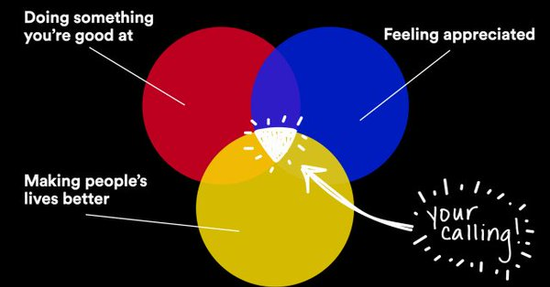
Purpose x Passion x Optimism = Motivation and Meaning
https://ideas.ted.com/7-lessons-about-finding-the-work-you-were-meant-to-do
People don’t buy what you do, but why you do it. ----Simon Sinek

Slide 98
Meaningful Work
Meaningful work refers to the degree in which a person sees their own work as being significant, important for themselves and the society; meaningful work is a fundamental human need
Represents the clear knowledge and understanding of the purpose, intention, value, direction and logic behind the work of the individual
The most powerful motivators are not financial incentives or threats of layoff or other punishment, rather a continual reinforcement of the notion that work has meaning and is a joyful experience Schultz, (2015)

Slide 99
Reynolds, (2022) and Harrison, (2022)

Slide 100
Sept. 2021

Slide 101
WHAT DOES THE MODERN WORKFORCE SEEK IN A CAREER?
EMPLOYEES’ TOP NEEDS
FROM EMPLOYERS
EMPLOYEES’ TOP NEEDS
FROM MANAGERS
Opportunities to learn and grow
A good manager
High-quality management
Interest in type of work
Opportunities for advancement
Job clarity and priorities
Ongoing feedback and communication
Opportunities to learn and grow
Accountability
Wigert & Harter, (2017)

Slide 102
“I read some exit surveys; interviews conducted by the military to find out why people are leaving. I assumed that low pay would be the first reason, but in fact it was fifth…”
The top reason was not being treated with respect or dignity; second was being prevented from making an impact on the organization; third, not being listened to; and fourth, not being rewarded with more responsibility.
Further research disclosed an unexpected parallel with civilian life.
“As a ship’s captain I didn’t have the power to influence pay raises at number five, but I could sure influence the other four.”
– D. Michael Abrashoff

Slide 103
The 3 elements for motivation Pink, D. (2009)
Autonomy (self-governing, self-directed with freedom and independence)
Mastery (knowledge and skills that allow someone to perform well)
Purpose (the feeling of being determined to do or achieve something meaningful and important)

Slide 104
Elements | Job You Love | Job You Hate
Autonomy | Feel in Control | Feel controlled
Mastery | Feel like using full potential for growth and development… Being competent and confident | Feel like not using full potential. No growth or development…No competence or confidence
Purpose | Feel like work matters and you make an impact in life (Meaning) | Feel like work does not matter and you don’t make a difference

Slide 105
Hackman and Oldham’s five core dimensions of the immediate work environment on Job Satisfaction among frontline officers.
Skill variety, task identity, task significance, and autonomy were the strongest predictors of Job Satisfaction among police officers Zhao et al. (1999)
Identified autonomy as the strongest predictor of Job Satisfaction among Police Officers Johnson, (2012)

Slide 106
According to research performed over the last decade, some of the key essential factors that have been studied include 44 aspects of job satisfaction and 38 factors related to employee engagement
Key findings, including treating employees respectfully at all levels regardless of their title or role was a contributor towards job satisfaction, benefit packages, trust between employees and management, opportunities based on skills, and positive relationship with the boss
For organizations to be successful in motiving a multigenerational workforce, strategies will need to be designed, developed, and implemented to accommodate the specific needs (intrinsic and extrinsic) for each employee Cote, (2019)

Slide 107
Role Strain and Role Overload
Role strain (i.e., role conflict) used as a framework to examine the challenge of balancing work and home roles (e.g., Duxbury & Halinski, 2018; Griffin & Sun, 2018; Joseph & Nagarajamurthy, 2014; Karaffa et al., 2015; Youngcourt & Huffman, 2005)
Role ambiguity: when the information about expectations related to an employee’s role is ambiguous or deficient
Role overload is defined as circumstances in which an individual does “not have enough time or energy” to meet organizational demands Duxbury et al. (2015)
Occurs when an individual lacks the resources or capacities necessary to successfully and confidently fulfill a role Creary & Gordon, (2016)

Slide 108
Results in adverse physical and mental health, decreased satisfaction with family and work lives, and poorer professional outcomes
There are only two possible solutions to mitigating experiences of work-role overload— either by:
Reducing the demands placed on officers or
Increasing officers’ capacities and resources to confidently meet those demands Hofer, (2022)
These issues demand effective leadership

Slide 109
Identifying Organizational Stressors That Could Be a Source of Discomfort in Police Officers: Acquadro, Magnavita & Garbarino, (2022)
Four main themes in organizational factors, the presence or absence of which could influence police officers’ well-being as follows:
Social support from the organization
Leadership
Organizational culture
Bureaucracy

Slide 110
Social support from the organization
Social support is the provision by an organization of psychological and material resources that can improve a person’s ability to cope with stress
In other words, social support can act as a stress buffer by eliminating or reducing the impact of stressful experiences by promoting fewer threatening interpretations of negative events and effective coping strategies

Slide 111
Social Support From Organization
The lack of social support from supervisor is the major source of stress in police officers
Mediates the indirect causal effect of both organizational and operational stress on job satisfaction
In response to the lack of support, police officers’ PTSD symptoms increase
The lack of social support from the organization increases the risks of depression and of suicidality

Slide 112
Organizational support is crucial in helping officers deal with stressful and traumatic events
Police officers who perceive organizational support are more willing to use stress intervention services
Management training for senior staff could develop a supportive environment among co-workers

Slide 113
Organizational culture
A pattern of shared and basic assumptions
Invented, discovered, or developed by a given group, as it learns to cope with its problems of external adaptation and internal integration
Taught to new members as the correct way to perceive, think, and feel in relation to those problems
In organizations, values and norms that constitute the culture could affect the perception of a good or bad climate or environment, of psychological strain and could lead to failures in communication

Slide 114
Organizational Culture
Determines the strategies for coping with stressful situations
Diligence culture and team culture seem to be protective factors against maladaptive coping
Norms and values oriented to masculinity provoke the greatest risk of resistance, harassment, and isolation, particularly in female police officers

Slide 115
For the development of long-lasting police-specific stress prevention, treatments and initiatives, a change in organizational culture is essential
A culture of wellness helps to fight the stigma of seeking support
Could be useful to rethink traditional practices in selection, training, and performance evaluation

Slide 116
Leadership
Is the process of influencing others to understand and accept the decisions to be made and the actions to be taken
Thereby facilitating individual and collective efforts to achieve a common goal
This process could have an impact on perceived workplace stress and work outcomes such as job satisfaction, turnover intention, and job performance

Slide 117
Leadership
A negative leadership climate constitutes a job demand
Negative leadership style is associated with the experience of psychological strain, emotional exhaustion, and depression and anxiety symptoms

Slide 118
Leadership could be addressed as a valuable resource with regard to organizational health
By educating police leaders in the principles of health-oriented leadership and by promoting health-oriented awareness
Authentic leadership, participation options, supportive management, and regular feedback help to improve cohesion in teamwork

Slide 119
Bureaucracy
Represents the administrative apparatus for the exercise of legal power
A system of precise rules and regulations to be applied in a manner that tends to be impersonal and impartial through systematic, precise, and rational procedures
Bureaucracy could be evaluated both instrumentally, on the basis of its expected contribution to realization, and deontologically, on the basis of the validity of the codes of conduct and the principles of reason, morality, organization, and governance on which bureaucracy as an institution is based

Slide 120
Bureaucracy
This is an important source of stress for police officers
Increases somatization (the production of recurrent and multiple medical symptoms with no discernible organic cause), anxiety, and depression
Affects perceived well-being.

Slide 121
Management has to redesign the work, increasing flexibility, autonomy, and discretion for arranging work
Could be useful to offer a different shift system with stipulated working hours
Necessary to rewrite tasks and work routines
The need to increase the number of police officers on staff

Slide 122
Work interference with personal life (WIPL) Gim & Ramayah, (2019)
Has been found to influence higher turnover intention
Employees who perceive having received equitable salary and respectful treatment are more likely to report lower WIPL because the perceived justice nurtures a positive psychological state among employees
Whereas injustice fuels negative emotions which are carried home impairing individuals’ functioning at home

Slide 123
In the same way, employees who feel their workplace to be highly competitive are more likely to experience the encroachment of such pressures into their personal life
As a result, employees who suffered from such interference from work are more likely to consider leaving their employers

Slide 124
Other Factors
Uncertainty: occurs in the workplace in a number of ways, such as whether one’s job performance is adequate, or uncertainty regarding one’s job security due to operational conditions
Task autonomy: refers to a feeling of control over the outcomes of one’s work. An acceptable degree of task autonomy is important for psychologically healthy work

Slide 125
Self-efficacy: the belief that one can successfully execute a desired course of action. (Employee Confidence)
Congruent expectations: Psychological contracts that refer to employees’ perceptions of what they owe to their employers and what their employers owe to them
Morale: the effect of a work environment on employees, and how well a group can hold up under hardship. Good morale is likely to be contagious, helping to shield individuals in the work group from negative mental states

Slide 126
Social support: There are different types of social support, including tangible (i.e., instrumental) support, appraisal support, and informational support, emotional support, which includes empathy, listening, and showing that you care
Organizational just supervision: treating people with dignity and respect, giving people an opportunity to voice their questions or concerns, explaining judgments and decision-making process, and being truthful, transparent, fair and impartial (free from self-interest, bias, prejudice, or favoritism)

Slide 127
Differences among supervisors: and their style of supervision can have major effects on employees’ emotional well-being
A supervisor whose behavior effectively reduces the anxiety of employees essentially relieves them of the need for coping and frees their minds for more productive and enjoyable activities
Supervisor behavior takes on added importance because its effects may not be confined to the workplace. A stressful supervisor–employee incident in the afternoon is likely to be taken home
A supportive supervisor may break the chain of stress at work and unpleasant consequences at home, resulting in the maintenance of systems of social support and resistance to stressors

Slide 128
Analysis of the Survey’s Findings Reynolds, (2022)
Officers wanted their leadership to:
To communicate, to be consistent, to care
Creating a workforce that is optimistic about the future
Be proud of the work it does
Create an environment where officers feel they are cared for by their supervisors and managers

Slide 129
Study after Study
Confirms that basic leadership skills are needed now more than ever:
Provide constructive feedback
Explain department decisions and seek answers where they are not readily apparent
Be a role model and remember that role models don’t need to be perfect
Be fair and consistent in your words and actions
Praise your subordinates' efforts and demonstrate appreciation for their work

Slide 130
Engagement
Engagement is the extent to which employees commit to something or someone in their organization and how hard they work and how long they stay as a result of that commitment
Two types of commitment were identified:
Rational, which is “the extent to which employees believe that managers, teams, or organizations are in their self-interest (financial, developmental, or professional)
Emotional, which is “the extent to which employees value, enjoy and believe in their jobs, managers, teams or organizations.”

Slide 131
Emotional commitment was four times as powerful as rational commitment
72% (36) of the top 50 commitment drivers were based on managerial characteristics, such as “commits to diversity,” “demonstrates honesty and integrity,” “adapts to changing circumstances,” “clearly articulates organizational goals” and “cares about employees.”
Council, (2004)

Slide 132
3 different forms of organizational commitment Meyer and Allen, (1991)
Officers with strong affective commitment (Affection for the job) remain because they want to
Those with strong continuance commitment (fear of loss) because they need to
Those with strong normative commitment (Sense of obligation to stay) because they feel they ought to do so’

Slide 133
Employees leave an agency when one or more of four fundamental human needs are not being met: Branham, (2005)
1. The Need for Trust: Expecting the agency and management to deliver on its promises, to be honest and open in all communications, and to invest in the employee, treat them fairly, and to compensate them fairly and on time
2. The Need to Have Hope: Believing that they will be able to grow, develop their skills on the job and through training, and have the opportunity for advancement or career progress

Slide 134
3. The Need to Feel a Sense of Worth: Feeling confident that if they work hard, do their best, demonstrate commitment, and make meaningful contributions, they will be recognized and rewarded accordingly.
Feeling worthy also means that they will be shown respect and regarded as a valued asset, not as a cost, to the organization
4. The Need to Feel Competent: Expecting that they will be matched to a job that makes good use of their talents and is challenging.
They also want to receive the necessary training to perform the job capably, and see the end results of their work, and obtain regular feedback on your performance

Slide 135
Reasons employees voluntarily leave:
Unmet job expectations
Poor job fit
Lack of coaching and performance feedback
Lack of professional development and promotional opportunities
Not feeling valued or recognized
Workplace stress due to job demands and work-life balance conflict
Lack of trust and belief in senior leadership.

Slide 136
The majority of turnover is voluntary and, among those who leave, about 70% of contributing factors could be controlled by the immediate supervisor or manager
To repeat an old adage,
“People quit bosses, not organizations.”

Slide 137
Voluntary resignations from the police service: the impact of organizational and occupational stressors on organizational commitment. Charman and Bennett, (2022)
Once a police officer decides that they no longer have the necessary affective commitment to the organization, their path to turnover may begin
This affective commitment has the potential to be irreparably damaged

Slide 138
Noteworthy
Officers with the fear of loss will remain within the organization until presented with a more favorable alternative
Officers with a sense of obligation to stay will remain within the organization for the duration of that organizational identification
However, a perceived breakdown in the delicate reciprocal working relationship might be enough to fracture that social contract

Slide 139
It is therefore those employees with diminishing affection to their job who are most of interest when trying to analyze and mitigate the factors relating to an individual’s decision to leave the police service

Slide 140
Important Points
Improvements in welfare, better career opportunities and an improved work/life balance are important to police officers
Police officers who resign voluntarily from the police service value highly the occupation they have joined
They appreciate the nature of the work they are involved with, the opportunities that that work holds for fulfilling ambitions for public service and the satisfaction of working with policing colleagues as part of a team

Slide 141
They are ultimately frustrated by the perceived inability of the organization to manage the demands upon them and by a sense of organizational ‘injustice’ emanating from perceptions of a lack of ‘voice’, a lack of leadership, a lack of autonomy and a lack of support
These factors have a negative personal impact upon their own individual physical and mental health
These factors impact upon their caring responsibilities and personal relationships outside of their working environment

Slide 142
While there are also relevant external factors, particularly in relation to ‘excessive’ workloads, which do clearly impact on levels of dissatisfaction, the focus for change would appear to be in a consideration of how the social exchange factors [evolve]
Crucial to an enhanced sense of affective organizational commitment can be rebalanced equitably to take account of both the individual needs of staff in addition to organizational demand.

Slide 143
Turnover Culture and Context Perspective Bolt, Winterton, & Cafferkey, (2022)
Turnover theories validated empirically can provide conceptual underpinning for management interventions to address dysfunctional turnover and promote skill retention
Turnover research should be viewed in the context of changing employment relationships and flexible careers

Slide 144
Two approaches to understanding turnover:
Focusing on who quits and why (context and process)
Why do some leave while others stay (job embeddedness)
Context is key, especially in relation to relative skill levels and time to achieve competent performance

Slide 145
The practical value of studying turnover at establishment and organization level is in identifying factors over which managers have more influence, including the ways they manage
Often, employees leave their managers rather than their companies’ Reina et al., (2018)
Management can influence turnover and retention by adopting, or failing to adopt, good practice in people management, which could prove far more important in practice than individual factors

Slide 146
Perspectives
Turnover should also be evaluated from three perspectives:
The individual officer (micro) level APPLE
The agency, management, and supervision (meso) BARREL
Environment impacted by the wider societal, political, and economic (macro) factors ORCHARD
ALL of the three domains are impacted by the quality of leadership

Slide 147
Organizational Just Work Environment “How we perceive treatment with fairness”
We all steer behavior according to personal priorities
Those priorities themselves can have sources independent of the desire for self-interested benefit alone
CROPANZANO, GOLDMAN AND FOLGER (2005)
People do not care about the outcomes as much as they do about the process they experienced
The blend of procedural and organizational justice process with servant and transformational leadership is central to the perception of fairness
Fairness is a feeling
Justice is a process

Slide 148
Fairness is a Bedrock Standard The three (3) Key features “The Issue of Fairness”
OPENESS: Everyone knows the rules for playing at the very beginning (up front put on notice)
CONSISTENCY: The rules are enforced consistently in the same situations
IMPARTIALITY: The rules are applied equally, no matter the relationship to the person administering the rules

Slide 149
Respect in Leadership Rudolph, Katz, Ruppel, & Zacher, (2021)
Attitudes, values, and/or actions directed toward others that convey appreciation
Expressed through high levels of consideration (i.e., affording special attention to others)
Esteem (holding others in positive regard)
Concern for others’ feelings, wishes, and rights, which are assumed to influence their feelings of being respected (Fairness)

Slide 150
Contribution to the group
Perceived fairness
of leaders and
authorities
Sense of
being
respected
Compliance with
rules
Organizational citizenship
behavior
Commitment
Tyler & Blader, (2000) replicated time and time again into 2022

Slide 151
The Expendables: A Qualitative Study of Police Officers’ Responses to Organizational Injustice. Reynolds, Fitzgerald, and Hicks, (2018)
Organizational events linked to fairness assessments among participants included disciplinary actions, citizen complaints, blocked career aspirations, and officer–supervisor conflicts
Overwhelmingly, officers reported these events made them feel angry
These events fostered feelings of increased skepticism and not being supported or feeling expendable

Slide 152
One of the primary causes of negative behavior is higher stress levels caused by a range of factors including: Labrague, Lorica, Nwafor, & Cummings, (2021).
High levels of responsibility that exceed the individual’s capabilities / experience
Competitive work environments
A sudden increase in workloads
Short-staffed work teams, a situation which forces managers/leaders to simultaneously engage in work operations and managerial duties
Lack of experience
Lack of job security and increases defensiveness about decision-making

Slide 153
Toxic Leadership is destructive, abusive, and ineffective Milosevic, Maric & Lončar, (2020)
Toxic leaders conceal their lack of relevant competence and maintain a position of control, at the exclusion of other organizationally relevant objectives
Toxic leaders engage in upward and downward directed influence attempts that create ambiguity and confusion
Toxic leaders increase the toxicity of the job context and interfere with others’ ability to perform their work

Slide 154
Long-term and regular contact with toxic leaders cause strain and reduced well-being among their subordinates. Hobman et al. (2009)
Toxic leadership is related to the high level of withdrawal in subordinates. Carlson et al. (2012)
Toxic leaders reduce employee self-confidence, self-worth and self-efficacy. Harvey et al., (2014).
In sum, three major outcomes in terms of psychological distress due to toxic leadership reported in the literature are loss of self-worth, agitated and withdrawal (Hobman et al., 2009).
With a Toxic Boss you must become the Island of faith, optimism, and organization in a sea of dysfunction for those under your charge to depend upon Keenan, (2007)

Slide 155
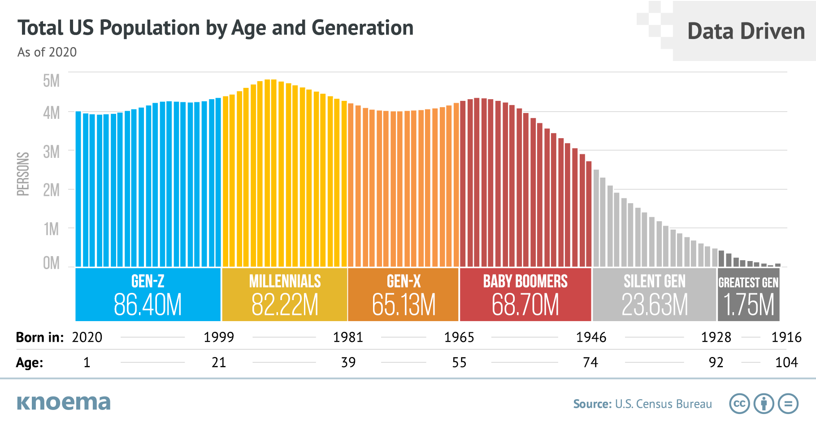

Slide 156
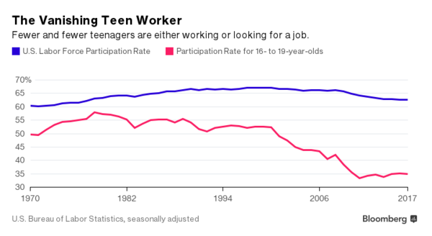
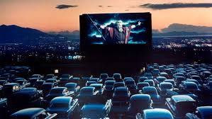
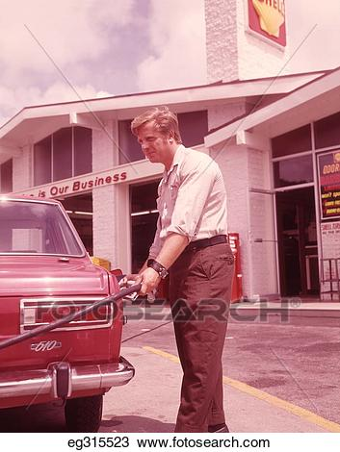
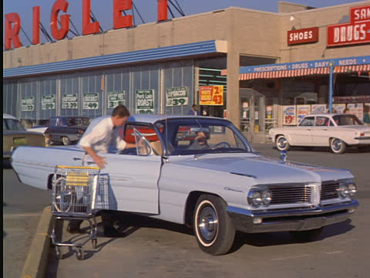
Another Perspective…Everything is Contextual
Y
Z
Could this factor into the equation?

Slide 157
A Different Perspective
We encourage people to adopt a lifespan developmental perspective on aging at work, which considers age along a continuum rather than in terms of discrete generational categories Rudolph & Zacher, (2022)
From this perspective, learning and development is seen as a lifelong process for every individual, regardless of when they were born
The important difference here is that any generational differences are seen to emanate from experience and knowledge
Henry, Zacher & Desmette, (2015), Pinelli, Sease, Nola, Kyle, Heldenbrand, Penzak, & Ginsburg, (2018), Rudolph & Zacher, (2018) and Wilkerson, (2018).

Slide 158
RESEARCH POINT Five Motivators (NOT PERSONALITY TRAITS BUT INFLUENCES) for Generational Employees David Wilkinson, of the Oxford Review.
They desire feedback
Comfortable lifestyle
Knowledge sharing
Task orientation and autonomy
Development opportunities
Organizational Justice

Slide 159
Common Questions about THEM
How do we motivate them
Some have no real-life experiences (their different perspectives, ability to manage frustration, poor people skills etc.)
Why do they question authority and ask why?
Why do they lack patience? (they want everything now)
What about US?
Such frames the requirement for supervisors to be able to adapt, evolve, influence and ensure organizational justice while mentoring and holding them accountable to agency standards

Slide 160
“The task of an executive is not to change human beings. Rather, as the Bible tells us in the parable of the Talents, the task is to multiply performance capacity of the whole by putting to use whatever strength, whatever health, whatever aspiration there is in individuals.” – Dr. Peter Drucker
“…each according to his ability”
Diversity is woven into the fabric of creation.

Slide 161
At whatever level you function as a leader, your ultimate ability to succeed will in large part depend on the support you receive from your superiors…You must “lead up”
Leading up: is about loyalty, dedication, and work ethic; putting the organization ahead of yourself.
Sucking up: is about doing what you can, when you can to put yourself ahead of everything; and to create an opportunity to “short cut” or obtain your ambitious goals “free.”
From John Maxwell’s 360-degree leader

Slide 162
Leading up greatly assists you in leading your subordinates
Your reputation in the agency
Your credibility with the bosses
Your strength in issues
Your ability to help them
Your ability to obtain resources
Ability to make change
They inherit your influence and power.

Slide 163
Principles
Lead yourself exceptionally well.
Manage your emotions
Manage your time
Manage your priorities
Manage your energy
Manage your thinking
Manage your words
Manage your personal life

Slide 164
Lighten Your Leader’s Load
Do your own job well first
When you find a problem, provide a solution
Tell leaders what they “need” to hear, not what they “want” to hear
Go the second mile
Stand up for your leader whenever you can
Stand in for your leader whenever you can
Ask your leader how you can lift the load

Slide 165
Be willing to do what others won’t
Take on the tough jobs
Pay your dues
Work in obscurity
Succeed with difficult people
Embrace change
Admit fault and never make excuses
Always do more than expected
Be the first to step up to help
Do the task yourself when necessary
Take responsibility for yourself and those under your command

Slide 166
Be Loyal
Listen to your leader’s heartbeat
Know your leader’s priorities
Catch your leader’s enthusiasm
Support your leader’s vision
Connect with your leader’s interest
Understand your leader’s personality
Earn your leader’s trust
Learn to work with your leader’s weakness

Slide 167
Be prepared every time you take your leader’s time.
Invest 10x the time you spend with your leader on a subject in preparation in that subject.
Don’t make your boss think for you.
Bring something to the table.
When asked to speak, don’t wing it.
Learn to speak your boss’ language.
Get to the bottom line.
Give a return on your leader’s investment.

Slide 168
Know when to push and when to back off.
When to push
Do you know something your boss doesn’t, but needs to?
Is time running out?
Are your responsibilities at risk?
Can you help your boss win?
When to back off
Are you promoting your own personal agenda?
Have you already made your point?
Must everyone but you take the risk?
Does the atmosphere say “no?”
Is the timing right only for you?
Does your request exceed your relationship?

Slide 169
Become a go-to player
Go-to players produce when there’s pressure
Go-to players produce when the resources are few
Go-to players produce when the momentum is low
Go-to players produce when the load is heavy
Go-to players produce when the leader is absent.

Slide 170
Be better tomorrow than you are today.
Today
Learn your craft today
Talk your craft today
Practice your craft today

Slide 171
Other Important Principles in leading up From Vernon Keenan, Retired Director, and 40 year career with GBI
Finalize projects you are responsible for managing. (The boss should never have concerns about a projects status or completion) and provide regular updates
Provide executive briefings or summaries
Define issues and outline problems
Be objective, specific and concise
Provide viable options and realistic solutions

Slide 172
Concentrate your efforts in areas you can influence
Do not waste time or foster discourse in matters that you have no control
Do not argue after the final decision is made, understand the importance of being committed to the execution and implementation of the decision
Understand the final decision may not be final (unanticipated influences, the discovery of new information may come into play)
Understand “most” every boss has a boss
A global (Agency Team) perspective of war and theater of battle over just a battlefield mindset (strategy and Stakeholders)
When asked provide truthful input
Never compromise your personal integrity

Slide 173
Respect the process
Faith in institutions
Reliance on structures, functions, and processes
Established roles and responsibilities
Civility and protocol
Leaders tend to get into trouble when they disrespect and/or skip the processes

Slide 174
“It’s important that you not undermine your superiors. In any organization, your people need to know that you support your chain of command.
If they see you freelancing, they will feel free not to support you when they disagree with your policies.”
- Captain Michael Abrashoff
Loyalty is our willingness to sacrifice our own interest for the benefit of our organization and people know it when they see it… Loyalty is both a virtue and an asset in todays world.

Slide 175
What does the Science Say What do we expect in a good leaders?
Treat us as individuals with dignity and respect
Promote meaning and purpose in our work
Cast vision and provide direction
Embrace our ideas and want our feedback
Admit mistakes and never hold grudges
Demonstrate caring and empathy for us and our job responsibilities
Are fair and organizationally just
Are competent and confident in their job
Are candid and speak truthfully in a respectful way
Show us that they appreciate our efforts

Slide 176
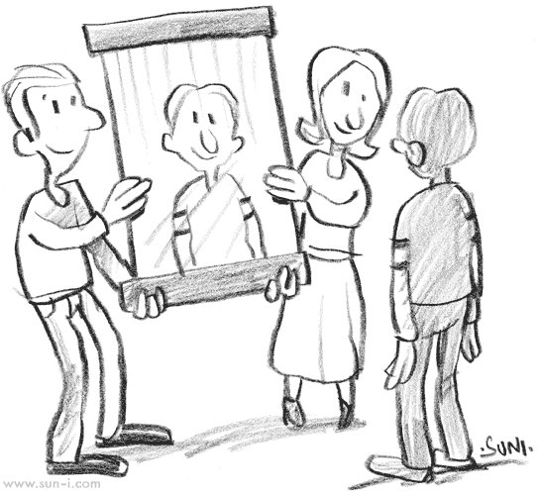
The Burden of Self-Awareness

Slide 177
Cognitive Process Leadership Model McClellan, (2021)
Awareness – the brain naturally scans the environment for information to allow individuals to make decisions and achieve goals
Leadership development processes that enhance and develop self-awareness, as well as the awareness of followers, about their environment (including the cultural environment) tend to lead to better leadership outcomes

Slide 178
Attention – it is important that leadership development processes help leaders understand what they are (and aren’t) paying attention to
What we pay attention to tends to be what we are aware of and what we focus on
Programs that help leaders purposefully direct their attention and the attention of their people to more systematically important issues tend to work better

Slide 179
Decision-making – leaders use the important information to make decisions that will help followers, work teams and/or organizations reach their goals
Understanding how decisions are made in different contexts can be vital
Relationship building – emotional and behavioral responses between individuals during social interactions determine the quality of interpersonal relationships between leaders and followers
The factors that count as a good relationship differ in different contexts

Slide 180
Communicating – leaders influence their followers, which includes activities like the interpretation, evaluation and monitoring of how information flows
Communication styles can have a significant impact in different cultural settings
Action – how leaders act and get people to take action will be interpreted in very different ways.

Slide 181
THINKING ABOUT THOUGHT Nisbett, (2015)
The world is always a matter of construal— of inference and interpretation
Our judgments about people and situations, and even our perceptions of the “physical world, rely on stored knowledge and hidden mental processes and are never a direct readout of reality
We navigate the future, based on our past
The situations we find ourselves in affect our thoughts and determine our behavior far more than we realize

Slide 182
Social Construction Dugan, (2017)
Does not naturally exist
It is identified, named and understood based on the social interactions among people
[experiences that are shaped by social interaction]
It is concreated in terms of meaning
Social constructs often represent the taken-for-granted beliefs that function as powerful frames of reality
Can be very difficult to change [forms mindsets]

Slide 183
Social Reality Barrett, (2020)
We mistake social reality with physical reality
We (as humans) vary tremendously
We organize some of this variation into little boxes with labels (race, gender, nationality)
We treat these labeled boxes as if they’re a part of nature when in fact we build them
We, as a culture, choose the features of discrimination and draw dividing lines that magnify the differences between the group we call “us” and “them”

Slide 184
Leaders must start by looking in the mirror before looking out the window…
Our Culture
Our Beliefs
Our Attitudes
Our Desire and Comforts
THE WAY WE THINK AND ACT
We must have the ability to be objective and see things in a different way…

Slide 185
Perspective and Perception
Perspective: Your point of view. The opportunity and ability to see and be aware of your surroundings. The way you look at something.
Perception: How you perceive and understand the world; your interpretation from your perspective. Experience, knowledge, and biases may factor into the overall equation

Slide 186
Emotion's factor into the equation
Emotions are predictions (they are guessing your brain constructs in the moment)
Emotions are built, not built in.
(Lewis, Haviland-Jones & Barrett, 2010)
Feelings have direct nexus to our emotions
First come feelings…Second, is thought
We think what we feel
Feelings are not grounded in facts
Feelings take away our ability to become rational
We must strive to achieve and sustain objective reasoning over subjective feelings…

Slide 187
Our beliefs can
Promote Subjectivity
Cause Bias
Create Assumptions
Develop Mindsets
Filter, downplay, or slant the information
Promote intolerance
Result in a closed-minded state

Slide 188
“We see through the prism we already have”
We only know what we know and don’t know what we don’t know
Who we are, where we have lived and who have been around shapes and molds our beliefs
Practice is often guided by experience and what we have been able to “get away with”
As a result, we must discipline ourselves to be able to see things in a different way
Contextual understanding is an ABSOLUTE requirement in today’s leadership

Slide 189
Therefore, our Angle of View or perspective is critical in our ability to lead
It all starts with us…
How we see
How we decide
How we act.
Ongoing self-introspection and self-discipline is required to accomplish this process of objective assessment
Driven by a servant mindset where the leader is as much or more concerned about their subordinates and agencies situation as they are about their own situation

Slide 190
So, why is self-awareness so important to a leader?
It’s more common to see leaders fail in the area of every day self-management — and the use power in a way that is motivated by ego and self-interest
Warrick, (2017)
When summarizing the literature on why leaders fail, it is not what leaders know or how bright they are that leads to success or failure; [rather] it is how well they work with others and how well they understand themselves. Burke, (2010)
Most leaders and organizations fail to understand that 85 to 90 percent of all organizational problems are, in fact, largely due to dysfunctional systems and poor leadership Deming, (2000)

Slide 191
Internal and External Self-Awareness
Internal self-awareness: how clearly, we see our own values, passions, aspirations, fit with our environment, reactions (including thoughts, feelings, behaviors, strengths, and weaknesses), and impact on others
External self-awareness: Understanding how other people view us, research shows that people who know how others see them are more skilled at showing empathy and taking others’ perspectives

Slide 192
The Human Dilemmas of Leadership Harvard Business Review July-August 1963 By: Abraham Zaleznik
The main source for the dilemma's leaders face can be found within themselves, in their own inner conflicts
Most of us are accustomed by virtue of our training and inclinations to externalize conflicts and dilemmas
If we become immobilized in the face of a difficult problem, we tend to look to the outside for an explanation
Subordinates not sharing information
Confused positions by subordinates
Mixed signals provided by subordinates
Frustrations on subordinate incompetence
This generalized tendency to place conflicts in the outside world is part a mechanism of the mind called projection

Slide 193
If there is a problem, adverse issue or failure under your watch
“The first place you better look is at yourself…
(look in the mirror, not out the window)
Because the majority of the time, that’s where it started.”
Don’t look for fault, seek understanding
Such illustrates the importance of self awareness and listening to objective feedback and constructive criticism.

Slide 194
Drivers of a Leaders Self-Development Nesbit, P. (2012)
Three interrelated meta-skills (skills which either apply broadly to a wide set of problems, or help you acquire other more specific skills) that enable the gaining of more skills
Self-awareness
Self-reflection
Self-regulation
The way we think informs the thinking we do.

Slide 195
The brain spends 99.999+ % of its cycles on perception and understanding and less than 0.001% on reasoning. (Monica Anderson IA Research)
Conscious
Unconscious
REASONING
UNDERSTANDING

Slide 196
“MEMORY” Tavris & Aronson, (2015)
Memories are reconstructive and subject to confabulation (fabricated, distorted or misinterpreted memories about oneself or the world, without the conscious intention to deceive)
Recovering a memory is not like retrieving a file or playing a recording
We experience “source confusion” where we can’t distinguish our actual memory from subsequent information that crept in from elsewhere
To compound this fact, Brain science suggest our memories often alter or change each time we pull them up for reference. Accuracy problems develop

Slide 197
The brain recreates the past from Memory
Your memory is a critical ingredient in what you see
Our experiences, culture, and expectations cause us to view issues through different lenses
Your brain searches through a lifetime of past experiences, issuing thousands of guesses at once, weighing probabilities, trying to answer the question…What is this most like?

Slide 198
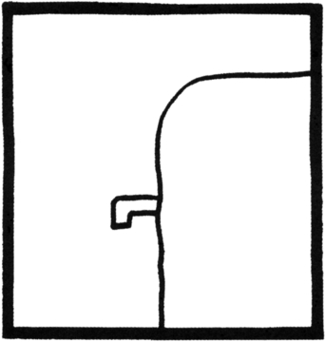
What do you see?
71/2 lessons about the brain, Lisa F. Barrett

Slide 199
The sub, the spider, and skier Dr. Lisa F. Barrett
You now see familiar objects instead of lines and blobs
Your brain is assembling memories from bits and pieces of past experiences to go beyond the visual data in front of you to make meaning
Objects you have never seen before leap from the page
The lines and blobs have not changed---you have

Slide 200
Perception is based in both awareness and understanding.
“We often perceive what
we expect to perceive.”
“Sometimes we fail to see things as they are…we tend to see them as we are.”
---Screen play from none but the brave
Premature conclusions can be dangerous and froth with inaccuracies

Slide 201
Social action, like physical action is steered by perception Cabrera, Cabrera, & Powers, (2015)
Perceptions: consist of a point (the vantage point or the “looker”) and a view (that which is seen or “looked at”)
Parts and wholes: may have different meanings from different points of view
Perspectives may be used to expand our thinking and include more option or to restrict our thinking and cause greater focus when necessary
When we change the way, we look at things, the things we look at change

Slide 202
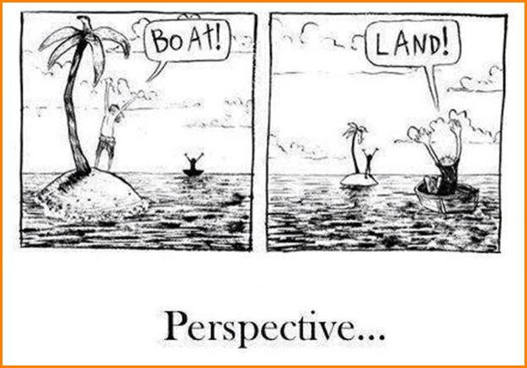

Slide 203
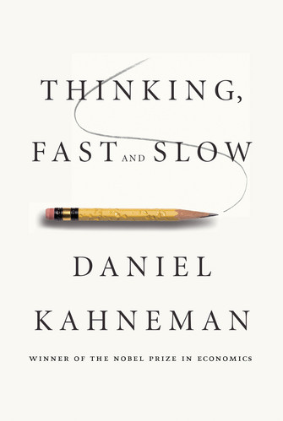
Pay Close Attention, GET READY

Slide 204
Dual Process Theory (Stanovich,1999, Kahneman, 2011)
System 1 - effortlessly originating impressions and feelings…main sources of the explicit beliefs and deliberate choices of System 2
System 1 is fast, intuitive, associative, metaphorical, automatic, impressionistic, and it can't be switched off
System 1 is the "secret author of many of the choices and judgments you make"
Notes:
They are a bit like the characters in a drama! You can do several things at once, but only if they are easy! (e.g. talking to a passenger in your car while you are driving, but you could not compute 19 x 26 when navigating a busy junction)

Slide 205
Dual Process Theory Continued
System 2 is slow, deliberate, effortful
System 2 Requires attention & is disrupted when attention is taken away. We tend to identify with System 2 as our conscious reasoning self

Slide 206
System 1
System 1 is where our expert skills are
Intuition is recognition without knowing that you know
Skills begin to happen automatic
Expertise grow in environment where we pick up on regularities, feedback and associations
Creates a giant network of ideas in the mind
Stimulus occurs and activates subsets, spreading activation prepares us for what comes next
Associative machinery looks for causes

Slide 207
Dual Process Theory Comparison and Contrast
Understanding (S-1)
Reasoning (S-2)
Fast and automatic
Rapid and parallel
Associative
Intuitive
Subconscious
Involuntary
Effortless
Slow and controlled
Step by step and often serial
Rule based
Reflective and logical
Conscious
Voluntary
Effortful

Slide 208
Interacting “Hot” and “Cool” systems in our brain (Metcalfe & Mischel, 1999)
COOL (KNOW) System
HOT (GO) System
Emotional
Simple
Reflexive
Fast
Amygdala-centered (fear and reward)
Develops early (birth)
Intensified by stress
(flight or fight)
Stimulus-control
Cognitive
Complex
Reflective
Slow
Frontal lobe/Hippocampus
(rational and logical)
Develops late
Weaken by stress
(increases spur dysfunction)
Self-control

Slide 209
When one goes up the other goes down
HOT
COLD

Slide 210
System 1 and 2
System 1 guides our immediate understanding of things (impulsive and intuitive)
Provides initial impressions that guide our beliefs (Banana and Vomit---instinctual reaction)
Links associations that provoke other ideas it (prefers simplicity)
Focuses on immediate environment (looks for patterns decides what to find surprising and what to find normal…it also identifies dangers)
System 1 creates a coherent story, even if one doesn’t exist. Thus, we arrive at conclusions without even realizing it
System 2 is cautious and relies on reason (agent of choice prefers logic and reasoning)
When system 2 is busy or depleted, system 1 reigns over reason

Slide 211
Personalities of Systems 1 and 2
System 1 is extremely complicated, has innate qualities and learned…also can become highly skilled. Difficult to get control over
System 2 can be educated to take over. However, system two only knows what we know
The current theory is that these different systems were developed through human evolution over our history

Slide 212
NOTE
We have only so much System 2 thinking available over the course of the day
We naturally spend as much time in System 1 thinking as possible
Many studies indicate that 90% to 95% of our decisions are made unconsciously
Birnbaum, J. (2022)

Slide 213
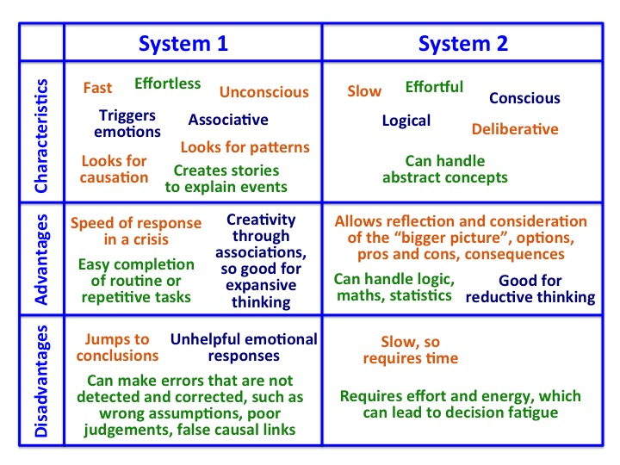

Slide 214
The interactions and relationship of system 1 and 2
Our brain has evolved short-cut mechanisms especially in the context of complex situations, where there is incomplete information and risk
The brain samples what knowledge is available and then focuses on the bits most relevant to the task
Then makes quick decisions based on “short cuts” or rules of thumb…(Heuristics) Kahneman, (2011)
The brain is wired to know what’s going on by recognizing patterns in our world, formulating assumptions and developing mental models then predicting

Slide 215
Heuristics = “Mental Short Cuts”
When we use heuristics, we are using substitution (we substitute a “close enough” easy question, for the original hard one)
They provide immediate answers, but may allow for serious errors

Slide 216
These mental processes can create, produce, and develop
Blind spots
Misjudgments
Biases

Slide 217
In the highly complex and uncertain environments in which many political and business leaders operate, reﬂex reliance on such compelling markers, without checking their validity, can have negative consequences Bonabeau, 2003; Miller and Ireland, (2005)
As critical thinkers we need to be aware of the processes that influence our judgements
Especially if they Bias us to be prone to errors
By accounting for bias when evaluating a situation or someone's retelling of an event, we can make more accurate decisions, not so influenced by the mind’s confirmation-seeking expectancies Kahneman, (2011).

Slide 218
Research has Identified Several Conditions in Which Individuals are Most Likely to Rely on System 1
Situations that involve ambiguous or incomplete information
The presence of time constraints
Circumstances where our cognitive control may be compromised such as fatigue or having a lot on our minds
Kirwan Institute Cheryl Staats 2016

Slide 219
Intuition is Recognition and Expertise
Recognizing associations with patterns
Cues > Trigger > Sense making from contextual features to past patterns of experience and knowledge
The Brain predicts and constructs assumptions and realities from your experiences to make meaning
Evaluating the likely quality of an intuitive judgment requires an assessment of the predictability of the environment in which the judgment is made and of the individual’s opportunity to learn the regularities of that environment Kahneman & Klein, (2009)

Slide 220
“One way of looking at this might be that for 42 years, I’ve been making small, regular deposits in this bank of experience, education and training,” and one day, “the balance was sufficient so that I could make a very large withdrawal.”
---- Captain Chesley Sullenberger

Slide 221
The Utility of System One and System Two as a Team Colonel Hal Moore
Trust your instincts
Instincts and intuition give you an immediate estimation of a situation
Then, ask yourself, what am I doing that I should not be doing
And what am I not doing that I should be doing
[Be disciplined to be focused and objective, to respond rather than react]

Slide 222
PRACTICAL EXERCISES

Slide 223
The primary types of bias that individuals engage in:
Simplification biases, or tunnel vision, which tends to come about as a direct result of an individual’s lack of cognitive resources or ability to collate and understand the context and environment and to process complex data
In effect, these individuals tend to have trouble understanding the reality of the situation in all its complexity and paradoxes and, therefore, create a simpler version of reality based on their own wishes and values

Slide 224
Verification biases, or group think, occurs when an individual or individuals wish to remain in harmony with their peers and to be part of the group or team
Regulation biases, ignoring or downplaying information that is perceived as a threat to themselves, their self-concept or their ego or others’ perceptions of them
Regulation biases are largely assumed to stem from behavior that moves towards providing pleasure or comfort and away from pain or discomfort

Slide 225
Availability: The easier the information is to recall, the more weight you will give it. (personal “anecdotal” experiences)
Anchoring: The tendency to anchor on an initial estimate and fail to adjust for actual uncertainty
Representative: Whether or not the object or person seems typical of a category (just because something is plausible doesn’t mean it’s probable)

Slide 226
Many of our important beliefs are not derived from the contextual facts or evidence
We are especially prone to ignore information that doesn’t coincide with our worldview

Slide 227
The Conformation Bias
Is a tendency to search for or interpret information in a way that confirms one's preconceptions, ideas or assumptions
Actively seeking out and assigning more weight to evidence that confirms your assumption or theory, while ignoring or underweighting the evidence that could disconfirm your assumption or theory
Favoring information that confirms previously existing beliefs or biases.

Slide 228
The Sample Bias
When we make assumptions about how things are perceived, function or results of limited information
These assumptions are based upon the sample of information analyzed being too narrow and failing to represent the whole or entire facts as they relate to the issue
Results can be erroneously attributed to the phenomenon under study

Slide 229
THE NEWS MEDIA 60 second sound bite
What Actually
Happened
What's Reported in the News

Slide 230
Explicit and Implicit Bias Explicit bias is infrequent while implicit bias is pervasive
Assumptions/attitudes slant how we see, remember, reason and judge
Attitude is your evaluation of some concept about a person, place, thing, or idea
An explicit attitude is the kind of attitude that you deliberately think about and report
Implicit attitudes are positive and negative evaluations that occur outside of our conscious awareness and control.

Slide 231
Implicit Attitudes Greenwald and Banaji (1995)
Beliefs developed from past experiences activated without conscious awareness that influence judgements and actions.
Stereotypical beliefs associated with certain group members automatically trigger a set of associations related to our attitudes
Automatic associations connected to a group act as implicit biases that influence judgements, perceptions and actions toward a group.

Slide 232
Stereotypes
Are acquired effortlessly and take special effort to discount
Are all partly true and partly false
Everyone uses stereotypes
Valuable to our mental processes
Allows us to categorize appropriately, are necessary for us to learn, understand, detect and recognize
They undermine our ability to perceive strangers as distinct individuals
Cause discrimination by acts of omission and commission

Slide 233
Dangers of Stereotypes
Robbing people of their individualism and dignity
Unfair treatment of people
Self-fulling prophecy: Behavior in which one’s inaccurate expectations about a person’s behavior prompt stereotype consistent behaviors
Stereotype threat: When people are aware of a negative stereotype about their social group, then experience anxiety that might confirm the stereotype, undermining their performance

Slide 234
Cognition
Our attitudes, values, beliefs and emotions
Filter our perspective, perception and interpretation
Fact
Illusion
Cause Bias that
“The birth of an expectation”
Due to lack of specificity in information and incomplete frame of reference
Can cause subjective treatment

Slide 235
What we observe (O), we react emotionally to what we have observed (R), we analyze, process, and make judgments based on your observations and feelings (J), and we behave overtly in order to make something happen—we intervene (I).
FILTERS
AND
BIASES
The ORJI Cycle, Schein, (2013)
OBSERVATION
REACTION
INTERVENTION
JUDGEMENT

Slide 236
Economists, Sociologists, and Psychologists have confirmed time and time again that the social group to which a person belongs can be isolated as a definitive cause of the treatment he or she receives
We fail to perceive individuals as individuals, they are often viewed as representatives of social groups
Race, ethnicity, age, gender, religion, class, sexuality, disability, physical attractiveness, profession and personality are all stereotyped

Slide 237
Ignorance and “unintentional” bias can shape how we interact, predict, judge and react to people
Such creates mindsets, develops attitude and shapes thought that translates into behavior and conduct
Its all about how we:
Frame: See, process, interpret and understand
Name: Describe, identify and label
Blame: Hold responsible and culpable
We then tend to amplify, magnify, distort or disregard information

Slide 238
“Often, we don’t see things as they are, we see things as we are.”
Motivated reasoning: refers to the tendency of people to conform their assessments of information to some existing pre-existing belief or ideology
Naive realism: to attend to and interpret information differently from individual experience and perceptions as singular truths
Bias

Slide 239
THE QUESTION ?
Why is it important for Leaders to learn about Dual Process Cognition and Implicit Social Cognition (Implicit Biases that Result)

Slide 240
The influence on our three (3) primary roles Mintzberg, H. (1973). The Nature of Managerial Work. New York: Harper & Row.
Processing Information: monitoring the internal and external environment for important and new information, much from staff members and the dissemination of information (mostly informal)
Interacting with others: interpersonal skills
Making Decisions: handling disturbances and conflicts, allocation of resources and negotiations

Slide 241
Impact on Managers Decision Role, Chugh, (2004)
The manager’s decision-making role has a impact on social justice
Resolving conflicts, negotiating agreements, matching people with opportunities, and allocating scare resources
Managers depend on their ability to make wise decisions
Studies find that decisions can be influenced by Implicit biases
Conditions of distraction, time pressure, high ambiguity or low need for cognition are more likely to generate biased decision making, in ways that are similar to the effects on “spontaneous” behaviors

Slide 242
Interaction and Education are key factors
To eliminating the ignorance is at the core of implicit, or explicit biases, racism, sexism and any other prejudice
To promote objectivity and questioning subjectivity
To see the world through a more accurate lens, factoring in the dynamics of complexity, context, and change
The ability for adaptation and utility of credible forecasting
To formulate an objective and credible response instead of a subjective reaction

Slide 243
NOW…LET'S TALK ABOUT LEADERSHIP Daniel Goleman
Great leaders move us
They ignite our passion and inspire the best in us
When we try to explain why they are so effective, we speak of strategy, vision, or powerful ideas, BUT…
It is much more primal, great leadership works through the emotions.

Slide 244
Emotional Intelligence and Social Intelligence
Emotional Intelligence focus is on a crucial set of human capacities within an individual, the ability to manage our own emotions and our inner potential for positive relationships.
Social Intelligence the picture enlarges beyond a one-person psychology—those capacities an individual has within—to a two-person psychology: what transpires as we connect.

Slide 245
Social Intelligence Daniel Goleman
Social intelligence can be organized into two broad categories:
Social awareness: what we sense about others—
Social facility: what we then do with that awareness.
Being fully present
Getting “In Synch”
Understanding how people feel and why
Interacting smoothly to move people toward a positive state

Slide 246
Social intelligence Knowing, feeling, and responding compassionately
Working to understand another's perspective
Perspective taking: the mental act of perceiving a situation from another individual’s point-of-view.
“Putting yourself in another person’s shoes”
Empathy is Key
Leads to maintaining the appropriate mindset that informs the way we judge, engage, and treat people
Provides a secure base for subordinates

Slide 247
The Tremendous Importance of Empathy
Empathy is defined as an individual’s ‘‘sensitivity to the emotional experiences of another’’
McNeely & Meglino, (1994)
It emerges when we accept, acknowledge, and feel how others are feeling
Empathy makes people feel they are seen, understood, and connected
And refers to the psychological process that allows an individual to experience feelings that are congruent with the situation of another person Hoffman (2000)
Empathy allows rapport between people, as a property that emerges from their interaction

Slide 248
Specific evidence-based interventions for practitioners and organizations to promote empathy enhancing antidotes to toxic leadership practices Nowack & Zak, (2020); DeCremer et al. (2018); Riess, Neporent, & Alda, (2018); Zak, (2017)
Evidence supports a positive and significant set of associations between leadership empathy and employee retention, engagement, physical health, psychological well-being, and job performance

Slide 249
Scientists have classified three distinct types of empathy: Waldman, Wang, & Fenters, (2016)
Empathic distress (reactive and aversive feelings such as, worry, anxiety, and discomfort that are focused on the self and reaction to others Affect
Empathic concern (compassion) More Cognitive
Perspective-taking (the process of inferring the mental state of others and sometimes referred to as “theory of mind”) Cognitive

Slide 250
The Importance of Understanding the Value of Empathy for Leaders
There is a significant set of associations between leadership empathy and employee retention, engagement, physical health, psychological well-being, and job performance
Leaders who demonstrate caring and empathy contribute to positive outcomes on employee engagement, performance, and retention
Specific individual and organizational interventions are suggested for enhancing empathetic concern, perspective taking, and caring in leaders at all levels
Interventions aimed at leaders to enhance empathy and caring may indeed be important antidotes for observed destructive and toxic leadership practices
Nowack & Zak, (2020)

Slide 251
Developing the three elements of rapport
Mutual Attention
Shared Positive Feelings
Well, Coordinated Non-verbal Duet
Promotes feeling of connection, understanding and genuineness

Slide 252
Mood a sense of feeling that comes from your body “affect”
A barometer for how your doing (hormones, organs, immune system, your brains budget, etc.)
Affect is not emotion
Your brain produces affect all the time, whether your emotional or not
Affect is the source of all your joys and sorrows
It makes some things profound or sacred to you and other things trivial or vile

Slide 253
Emotions
Emotions operate at the sub-conscious level and are far quicker than the conscious “rational” mind. They spring into action with out considering what it is doing.
Actions that spring from the emotional mind carry a strong sense of certainty.
Emotions overtake us before we know it (impulsive)
First come feelings. Second, thoughts.
Emotions produce non-verbal expressions, gesture and movements along with verbal differences in tone, volume, rate and pitch.
Powerful emotions, result in an individual being more likely to remember.
Research demonstrates how crucial feelings are when it comes to one's memory.

Slide 254
Emotions are like families or dimensions with a basic nucleus at its core, with its relatives rippling out from there in countless mutations.
In the outer ripples can develop Moods, which are more muted and last far longer than an emotion.

Slide 255
The more positive the overall moods of people - the more cooperatively they work together
Moods can become contagious and spread throughout the workplace
(Positive or Negative)
A leader skilled in collaboration can keep cooperation high and thus ensure the groups decisions will be worth the effort of the meeting
Such leaders know how to balance the groups’ focus on the task at hand with its attention to the quality of members relationships that create an effective climate.

Slide 256
Brain Science, The Mirror Neurons
Are brain cells that fire when you do an action, and also when you simply watch someone else doing the same action
The neuron "mirrors" the behavior of the other, as though the observer were itself acting
They are important for understanding intentions as well as actions and could help explain how and why we "read" other people's minds and feel empathy for them
It is involuntary and automatic, we don't have to think about what other people are doing or feeling, we simply know
They are key in our ability to empathize and socialize with others

Slide 257
Leadership is about the relationship between the leader and the people around him or her Boyatzis, (2012)
The best leaders build or rebuild resonant relationships
These are relationships in which the leader is in tune with or in sync with the people around him or her
Resonant leadership is common sense, but not common practice
The key lies in the leaders' competences of “emotional and social intelligence” - how leaders handle themselves and their relationship.
Good leaders drive the emotions of those they lead in the right direction

Slide 258
When leaders fail to empathize with or to read the emotions of a group accurately, they create “dissonance.” (off key, lack of harmony)
When leaders are attuned to people’s feelings and move them in a positive direction speaking authentically from their own values and resonating with the emotions around them - creates “resonance.” (in sync, in tune, in harmony)
Resonance comes naturally to an emotionally and socially intelligence leader… their passion and enthusiastic energy resounds through out the group.

Slide 259
The Emotionally Intelligent and Socially Intelligent Leader not only empathizes with emotions but expresses them reinforcing synchrony and leaving people feeling understood and cared for.
By evoking positive resonance, a leader will have a lasting path to motivation: rallying people around a worthy goal.
“The music of leadership is emotion.”
Goleman, (1995 & 2006), Boyatzis & McKee, (2005)

Slide 260
Key Concept Power and Control
When you interact with others in a reactive mode, you give up control to other people's words and actions
You have power over how you view situations, what information you seek about them, and how you choose to respond

Slide 261
ABC Model Ellis, A. (1962, 1991, & 2000), Beck, JS (2011)
Activating Event
The Trigger
Beliefs
Causes and Implications
Consequences
Emotional reactions
And Physical reactions

Slide 262
Emotional Intelligence Brackett & Salovey, (2006)
Emotional intelligence is defined as the result of an adaptive interaction between emotion and cognition
that includes the ability to perceive, assimilate, understand, and handle one’s own emotions and the capacity to detect and interpret the emotions of the others.
In other words, it is ability or competency based, as opposed to being rooted in personality attributes
It’s a mark of emotional intelligence to avoid internalizing every feeling that enters your heart
Grant, (2021)
KEY

Slide 263
Emotional intelligence is a complex construct consisting of four factors: Well-being, self-control, emotionality, and sociability: (Khan et al., 2021)
The factor of well-being: encompasses one’s positive self-evaluations, as well as feelings of happiness, and optimism
The factor of self-control: includes the ability to regulate one’s feelings, including emotions, stress, and impulses

Slide 264
The factor of emotionality: involves relationship skills such as one’s ability to accurately perceive one’s own as well as others’ feelings and one’s capacity to experience empathy
The factor of sociability: includes one’s ability to communicate effectively, exert influence over others, and build social networks

Slide 265
The four trait factors of emotional intelligence: Brooks, (2018)
Self emotional recognition. This refers to the ability of the individual to accurately identify and recognize their own emotional states as they are happening
Self emotion regulation. This refers to the ability of the individual to change their own emotional state at will
Others’ emotion recognition. This refers to an individual's ability to accurately identify and recognize the emotional states of others, often from behavioral cues, such as body language or facial expressions
Other's emotion regulation. This refers to the ability of an individual to have a predefined impact on another's emotional state. For example, the ability to work out what actions or behaviors may make another individual angry, sad or happy, for example, and then to carry out that action.

Slide 266
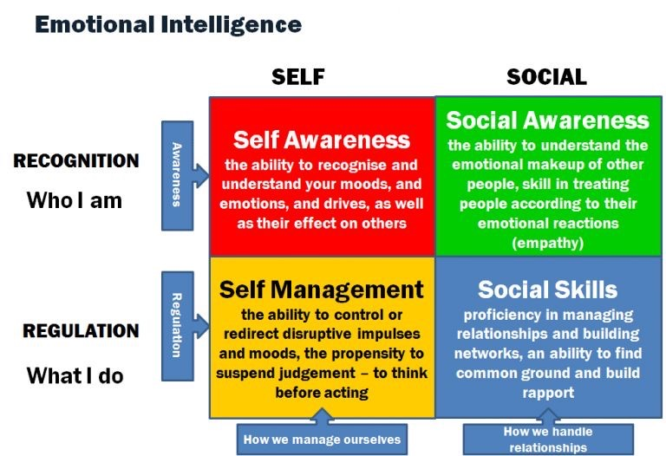

Slide 267
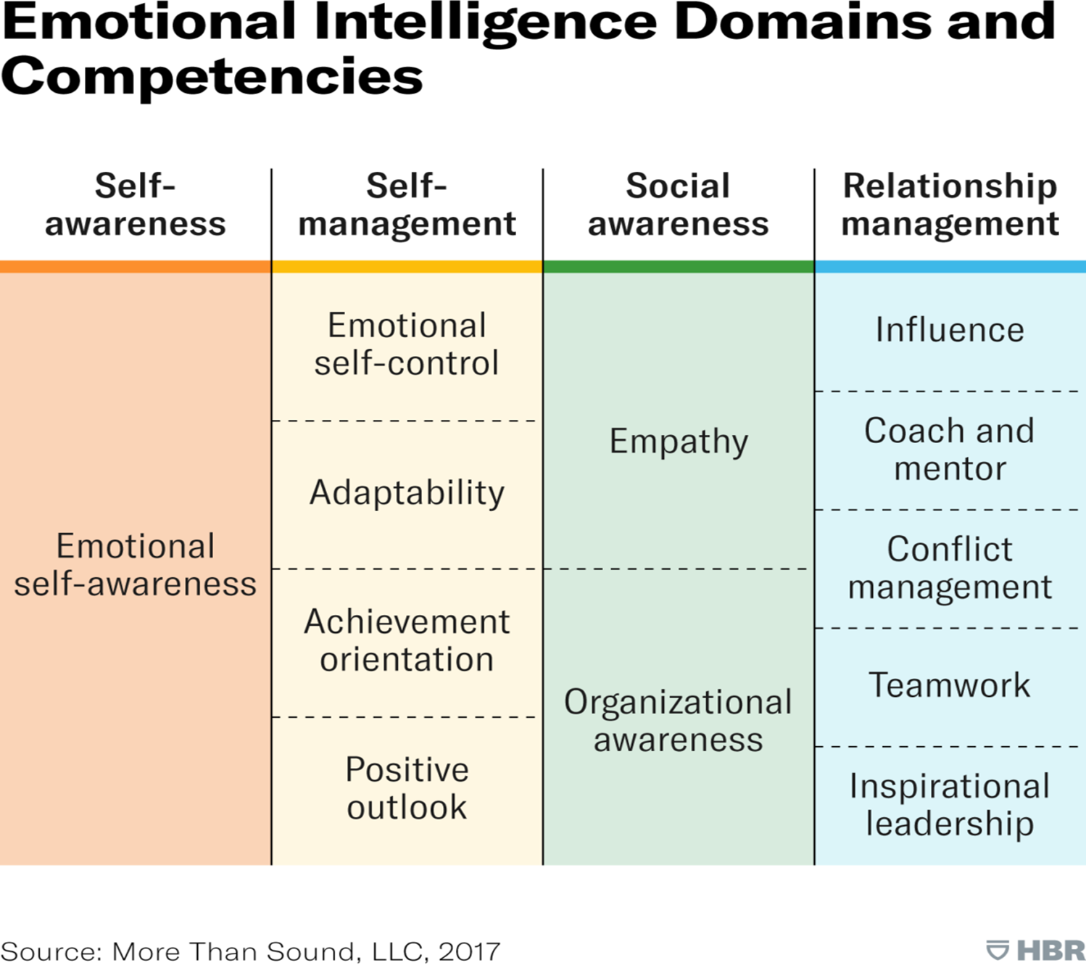
Daniel Goleman and
Richard E. Boyatzis
Goleman & Boyiazis, (2017)

Slide 268
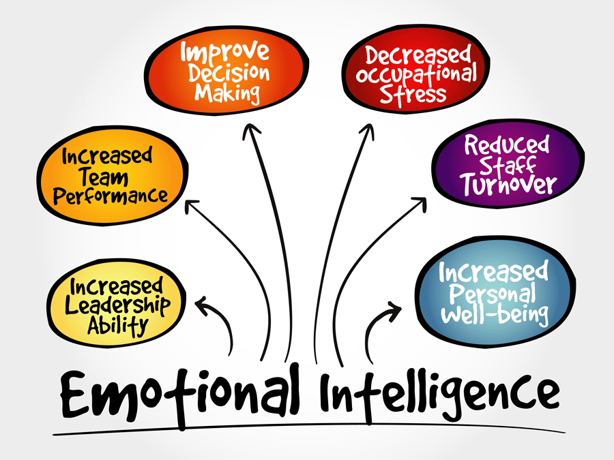
www.Oxford-review.com

Slide 269
3 traits help leaders continuously improve By: Gerard Beenen
Leader Characteristic
Self Awareness
Seeking Feedback
Description
Having an accurate view of how others perceive you
Exercising control of emotions and impulses
Benefits
The foundation to effective leadership and development
Establish one’s self-development and improvement agenda
Self Regulation
Proactive Search for information about leadership assets and liabilities
Provides intrapersonal information and clearer decision-making

Slide 270
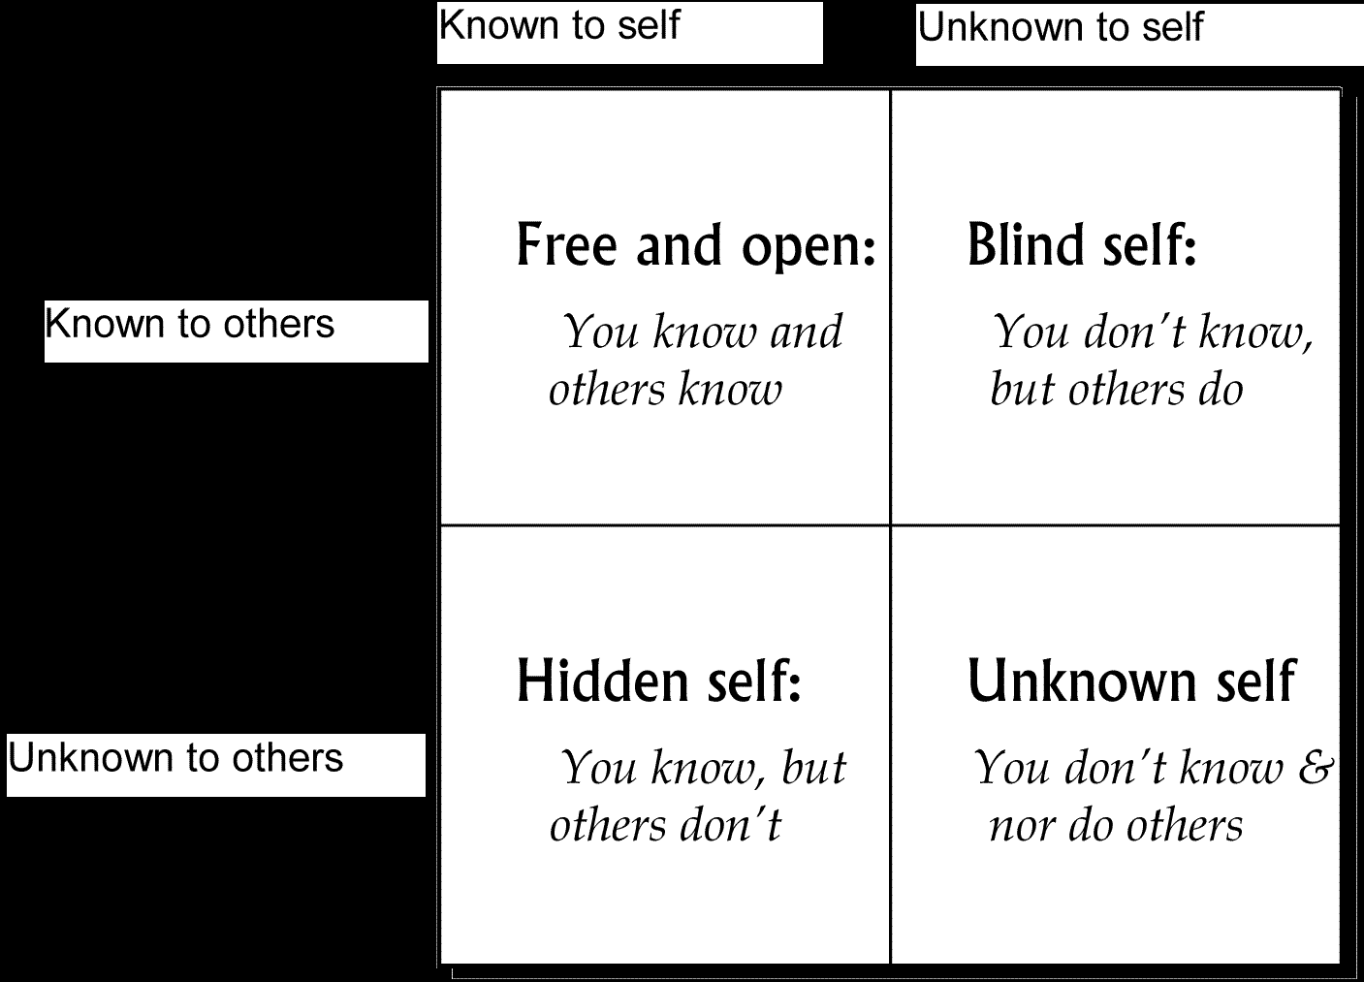
TRANSPARENCY
The Johari Window
A disclosure and feedback model of self-awareness

Slide 271
Psychological safety Edmundson, A.C. (2019). The Fearless Organization. N.J.: Wiley
The need for people in the organization to feel safe to offer suggestions and opinions without fear of punishment, ridicule, or embarrassment
A psychologically safe environment is one in which people feel free to voice their concerns, ask questions, be inquisitive and curious, and share ideas freely
Leaders must acknowledge their own mistakes, ask for feedback and to encourage and welcome questions and suggestions from subordinates
Fear, punishment or other repercussions from speaking freely or taking risks, being Interrupting and being blamed are counterproductive to psychological safety

Slide 272
Creates and sustains a culture of awareness, objectivity, and operational reality
Increase the probabilities of making good decisions
Enhances the quality of relationships within the work unit
Disagreement must become the source for curiosity and learning
People must understand their obligation to you to speak up and share their point of view, especially on a sensitive subject
Promote constructive friction through the integration of perspectives, suspension of judgement and a portfolio of ideas and alternatives

Slide 273
KEY
When someone offers feedback, you don't like, the ideal response isn't to ignore it
It's to seek more perspectives
One person's reaction is an opinion
If multiple people make the same point, it's a pattern
The best way to grow is to find the recurring signal in the noise
Grant, (2023)

Slide 274
Psychologically Safe Work-Place
Encourages speaking up
Enables clarity of thought
Supports productive conflict
Mitigates failure
Promotes innovation
Removes obstacles to pursuing goals for achieving performance
Increasing accountability
Make a Note: “About Understanding Power Distance”
And [Delphi method= Collected opinions before you give yours]
Prevents Group Think

Slide 275
Are setting the example by making it safe for your people to admit making a mistake?
Role modeling is the most effective method:
Own it…take responsibility for the mistake
Objectively reflect on it
Learn from it
Share your experience by talking about it
Share what you have learned and provide your expectations regarding preventing it from happening again

Slide 276
Within a blameless culture, leaders focus on understanding why something happened, not who is responsible.
Reframe incidents as opportunities: the best way to learn is through experience. Instead of basing performance metrics on incident avoidance, it’s essential to incentivize employees to learn.
Reward people for sharing knowledge: incentivize and congratulate those who share their institutional knowledge with others
Review what went wrong to move forward: use post-incident reviews as learning moments, not inquisitions. Laker, (2023)

Slide 277
Employees who use voice more often tend to display higher levels of job engagement over time Weiss & Zacher, (2022)
When employees feel appreciated by co-workers and supervisors for speaking up, they tend to contribute more effort and remain connected to the organization
Positive behaviors that benefit the organization, such as voice and job engagement, are more common when employees feel that their contributions are valued by leaders and co-workers

Slide 278
How to Foster Psychological Safety
Demonstrate engagement
Show understanding
Be inclusive in your interpersonal settings
Be inclusive in your decision-making process
Show confidence and conviction without appearing inflexible
Edmondson, (1999), Kinsey, (2011), and
Edmondson & Lei (2014)

Slide 279
DeLong & Hill, (2012)
Harvard Business School
Person
Style
Situation
Self-awareness
Self-regulation
Situational Awareness
Who we are
Influences
How we lead
Influence
Situational
demands
Leadership
Style

Slide 280
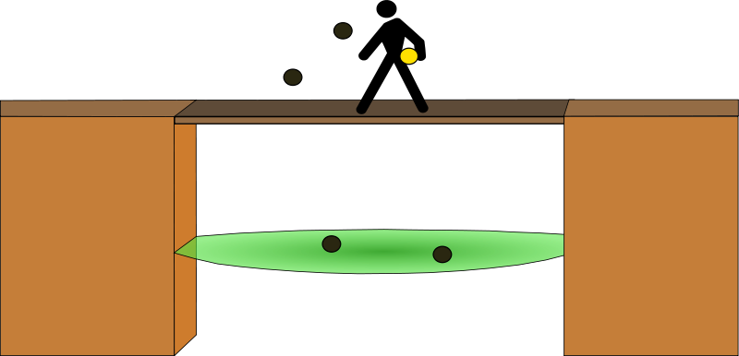
Crossing the Bridge from Staff to Management
SOME BASIC EXAMPLES

Slide 281
The Commander must be separate and detached, Remember you have “crossed the bridge to the management side”
There are two (2) sides to the desk
You now represent and are a part of management
When you see, are told, then management knows
Supervisors not holding officers accountable, looking the other way, or more concerned about being liked than representing management create an environment for agency problems, leadership problems and individual officer problems, risk and liability
The Role of Identity

Slide 282
You represent agency leadership and organizational management. You are the Boss not the Buddy
You are responsible for those under your charge. It is not a Democracy because you are responsible for the ultimate consequence of any decision.
BUT
You have an obligation and duty to provide and promote exemplary leadership with safe, effective and fair management to your people
Central to this function is the capacity and ability to develop constant feedback loops to utilize in your decision-making process and mentor regarding those decisons
There will be times that will result in you saying no, or your decision not being in concert with such feedback
Provide story line explanations to create vision, develop buy-in, and shape direction
This is central to a leaders relational engineering

Slide 283
“The employees run at the speed of the boss”
Your people are always watching you!
Set the example, model work ethic
“Be a Beaver”
BECAUSE BEAVERS ARE WORKERS AND BUILDERS

Slide 284
Examples
Running toward work to go the extra mile
Demonstrating joy in your job
Describing meaning, purpose, and optimism about the work
Sharing work-related knowledge
Helping with work problems
Explaining a regulation or procedure
Helping a subordinate or colleague after they were absent

Slide 285
Model Roles and Responsibilities Mindset
Teach them to ask…
Do I have the authority?
Is this my responsibility within my role?
I’m I the best suited to make this call?
Who are the other stakeholders with the same jurisdiction?
Is there an obligation or professional responsibility to notify to coordinate
“Stay in your lane.”
How can you manage others to stay within their roles if you deviate from yours?

Slide 286
SUPPORT YOUR PEOPLE
By Holding them accountable and making them successful in their jobs, while being empathetic toward their personal life responsibility.
Support them in their burdens from the mixture of their responsibilities from work and family
FORMULA: Factor in…
“THE PRAGMATIC BALANCE” BETWEEN
MISSION AND PERSON AND LEAN
TOWARD THE PERSON

Slide 287
Empathetic Leadership Perspective
One in four employees say work-life balance is the number one reason they would job hunt
Workforce Achievers Institute Study (2021)
Leaders can intentionally create a culture where empathy, compassion and respect are central to the way we engage with each other Myles, (2014)
Seeing employees as whole people with responsibilities and obligations outside of work is a prerequisite for empathetic leadership Kruse, (2021)
Expectations might need to shift, flexibility might need to be given, communication might need to be heightened

Slide 288
PRAGMATIC BALANCE EVALUATION
RULES/ETHICS/FAIRNESS
The Practice and Patterns
Operations
Person
The Context
The Perspective of Empathy and Duty to Problem Adoption

Slide 289
Problem Adoption Do you Adopt your subordinates' problems and make them yours?
THE VALUE OF PROBLEM ADOPTION
Demonstrates care and sincerity
Develops trust and relationship
Fosters communication and collaborative work
Builds credibility and influence
Promotes chances for better results
Provides learning and organizational maturity while mitigating chances of future risk
Insulates agency, management and staff from additional problems

Slide 290
The Edwards Theory of Problem Adoption
“When a subordinate has a “LEGITIMATE” problem identified through their perspective and in concert with moral, legal and ethical principles, within the scope of professional standards and policy and affecting or potentially affecting the work unit, the supervisor should adopt the problem to solve on behalf of the subordinate.”

Slide 291
Rationale for the Adoption
Its your JOB
If it’s your problem, instead of their problem you will frame it as such, and work harder to solve it.
The subordinate will recognize and appreciate the efforts of the supervisor, and such will build credibility (for the boss doing their job as they see it) and develop relational currency because it was done for them
Benefits to the organization as a whole
Deposits emotional currency into your people’s accounts that you may later need to draw on

Slide 292
Dedicated Priorities Do you proactively plan and devote the time (up-front) to shape the future for your people?
When you Identify an issue regarding your people:
Work backwards from your goal to find the resources, develop a plan, and create a means to achieve that goal if practicable and possible
Proactively press forward with your efforts keeping them on the “front burner” where they are a focus and narrowly tailored toward completion in a timely and meaningful fashion
Promise little, deliver a lot

Slide 293
Develop opportunities for exposure for your people to the people of magnitude:
First Rule: Demonstrate sincere joy and pride in your subordinates when they accomplish something
Second Rule: Take responsibility when things go wrong, NEVER BLAME
Give Subordinates Credit/Never take credit
Highlight their ideas/Never steal them
Promote their talents/Never hide them
Praise their efforts/Use specific articulation to highlight performance and result

Slide 294
It ain’t about you!
Build people, grow people, and make them better than you.
EGO + AMBITION = SELF-CENTERED IGNORANCE
Purpose and organization over self-interest “Be loyal to the cause - not self.”

Slide 295
Motives
You can’t hide, distinguish, or cover up your motives.
Words, non-verbal’s, actions, and conduct patterns will reveal them.
You broadcast cues that generate from your affections (emotions) and translate into signals
Maintain genuine, authentic, credible, professional, responsible
“non-selfish” motives. No hidden agenda
The higher duty - not about you!

Slide 296
People can see when a Commander is all about him or herself…“Positioning for their boss’ eye.”
Whether the motive is “hopes for a future promotion” or “tail coverage” for themselves, when the Commander’s priority is “themselves,” the people will know it and act accordingly.
However, if the Commander is all about the mission and the people doing it
If the Boss actively supports their people in the job, never taking credit, but giving it to their people
When the Boss never blames people but takes responsibility
Then subordinates will “die” for their boss!

Slide 297
Suitcase Supervisors
Steppingstone mindset (focus on their next assignment or promotion)
No ownership in office (lack of sacrifice for or buy-in to their office)
No investment in future outcomes (decisions rooted in their self concerns over the good of office, loss of investment and sense of pride in the office)
Loss of authentic leadership

Slide 298
Accountability
You are the Commander. You are responsible for what occurs or does not occur.
Have the courage and fortitude to
“take responsibility.”
You will always be held accountable.

Slide 299
Walking the walk
The rules apply to you more.
“Do as I say not as I do” is a recipe for disaster
Follow the rules.
Model the ethical and professional conduct
Respect the rules.
“Zero tolerance for unprofessional conduct.”
“Create a professional culture in the work unit.”

Slide 300
An Example: make it a priority not to be late…
It promotes disrespect
It demonstrates carelessness
It signals others that they are not important to you
It signals to others the meeting or subject matter is not important to you
It destroys your opportunity to role model for those under your command and set the standard to enforce

Slide 301
The Commander must stay above the red line and hold everyone else accountable to stay above the red line.
As a result, the “culture” of the work unit will be to respect those “red line standards.”

Slide 302
Managers need to ensure a Supervisor is always on call to respond immediately to crisis
Available (ensure subordinates have immediate assistance and on scene access if needed)
Involved (aware, curious, and mentoring)
Restrained (empowerment to subordinates)
Connected (establish feedback loops and incorporate oversight)
Growth and Development oriented

Slide 303
“You are the boss, not the buddy.”
You're not one of the “boys” or “Girls” anymore…
No jokes on people.
No tricks on people.
No playing with people’s minds.
They see you different and hold you to a different standard

Slide 304
Its good to create and participate in wholesome good humor - but not on or about those under your charge.
A laugh is a productive tool for a comfortable atmosphere in a work unit.

Slide 305
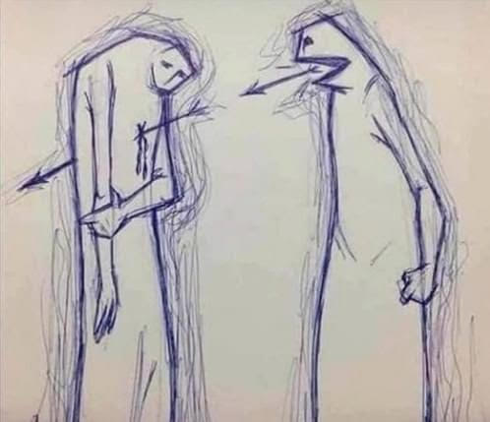
Think with your head not your heart
A sharp tongue response, rude answer, or sarcasm toward a subordinate will create a huge issue.
You are the boss - act like it!
Temper and tailor your directions
and responses to subordinates
appropriately
Many contemporary internal affairs cases begin as a result of a supervisor who cannot control his or her mouth
WORDS MATTER!!!
You can’t take back what you have already said…

Slide 306
We do not live in a Vacuum We live in a real world of human interaction and fate
Domestic Issues and Financial Issues are natural occurrences in our craft…
From troubled relationships to secondary employment issues all must be evaluated through an empathetic and pragmatic lens.
Management must incorporate guidance from policy, grounded in objectivity and motivated toward improving the employee's situation if possible.

Slide 307
Work versus Homelife Dilemma
Work interference with personal life (WIPL) Gim & Ramayah, (2019)
Be alert to the boundary conditions where work engagement can become detrimental: those conditions where overly engaging work ends up ‘swallowing’ an employee’s personal life.
The line between work engagement and the work family interface is a thin one
Leaders should reflect on where their organization’s focus lies, considering all related benefits and costs, in terms of employee energy and mental resources, in the short as well as the long run.
Byrne and Canato, (2017)

Slide 308
Be sensitive
Hints, suggestions, or innuendos are the functional equivalent of orders when coming from the boss.
“Will no one rid me of this meddlesome priest”
--- Henry the 8th regarding Thomas Becket
From soliciting a $10 donation, fundraising to a wedding gift, to who should do a particular extra curricular activity.
Outreach and Consent, before dictating office fellowships, parties or social gatherings or better outline the perimeters and delegate

Slide 309
When you are wrong… ADMIT IT!
Take responsibility and apologize if such is required.
An Apology Needs to Be Framed and Viewed as Growth
Take the appropriate steps to learn from problems/mistakes, then “FIX” them “upfront” in a “proactive” and transparent fashion.

Slide 310
Six Key Components to an Apology Roy Lewicki, Ohio State University
1. Expression of regret
2. Explanation of what went wrong
3. Acknowledgment of responsibility
4. Declaration of repentance
5. Offer of repair
6. Request for forgiveness
The first most important component is an acknowledgement of responsibility. Say it is your fault, that you made a mistake, the second was an offer of repair.

Slide 311
Supervisors never have the right to hold a grudge!!!
Demonstrate forgiveness, temperance, sincerity, care, and concern.
Don’t alienate yourself and others
Don’t give your power away to another to haunt you
Don’t set your agency, others and yourself up for lost opportunities
When its over…its OVER!!!
Cao, Van der Wal, & Taris,(2021). When work
relationships matter: Interpersonal
forgiveness and work outcomes

Slide 312
Studies have found that there are a number of benefits to forgiveness experienced by employees and organizations, these include: Cao, van der Wal & Taris, (2021)
Reduced stress
Less tension in co-worker relationships
Enhanced psychological well-being • Better physical health
Higher relationship satisfaction
Increased emotional, cognitive and relational stability
Forgiveness produce favorable work outcomes, like higher job satisfaction and work engagement, along with reduced instances of burnout

Slide 313
Remember…
Just because you have made it into management or supervision does not mean that you are smarter than your subordinates.

Slide 314
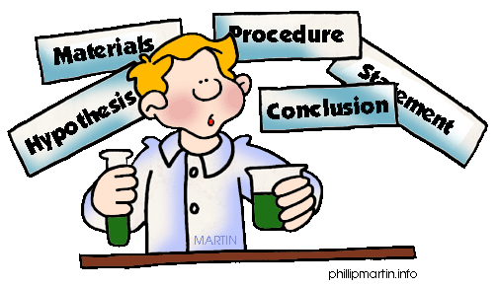
The Research
Many studies have found that the transformational leader is more effective, has higher rates of employee satisfaction, and maintains higher levels of group performance. A common theme of behavior observed and integral of a transformational leader’s character is their social and emotional intelligence.

Slide 315
Police Leadership: A Systematic Review of the Literature Mitchell Pearson-Goff and Victoria Herrington Policing, Volume 8, Number 1, pp. 14–26 (2013)
Emerged as important for leadership: ethical behavior, trustworthiness, legitimacy, being a role model, communication, decision making, and critical, creative, and strategic thinking ability.
Five key activities emerged as important for leaders to engage in: creating a shared vision, engendering organizational commitment, caring for subordinates, driving and managing change, and problem solving.

Slide 316
A study by Vito, Suresh, and Richards published in, “Policing - An International Journal of Police Strategies and Management” in 2011
Surveyed the opinions of 126 police mangers in 26 states regarding their ideal leadership style given the choices from servant, autocratic, and laissez-faire leadership styles. The study revealed a strong preference for servant leadership, rejecting the autocratic and laissez-fare

Slide 317
Dr. Joseph A. Schafer, completed a similar survey (FBI NA) that found the following traits of effective leaders:
Set a proper example and demonstrate trustworthiness.
Consider input from others.
Accept responsibility and admit mistakes.
Make informed decisions based on appropriate research and study.
Treat all employees fairly and with dignity.
Allow subordinates to handle duties commensurate with their skills and authority level.

Slide 318
Traits of Effective Leaders Biggers, (2021)
Being risk-open and pursuing new opportunities and ideas from followers, which promotes an enterprising work culture
Delegating tasks and spreading power downwards throughout the organization
Making decisions with other leaders democratically and based on evidence as a team, combining strengths, while lessening the negative impacts of their weaknesses
Setting challenging goals for followers and expecting excellence to encourage improvement

Slide 319
Mentoring followers by providing social support and training them to become leaders, as well as helping them grow professionally and personally
Asking followers for their opinions and ideas before making decision
Encouraging followers to assume more control over their work and to play a more active role in their own career development
A set of empowering personal beliefs and a vision that fits the organization's needs

Slide 320
Traits and habits that were common among the ineffective leadership
ACTS OF OMISSION
ACTS OF COMMISSION
Focus on self over
others
Ego/arrogance
Closed mindedness
Micro-management
Capriciousness
Poor work ethic
Failure to act
Ineffective
communication
Lack of interpersonal
skills
Lack of integrity
(Schafer, 2010)

Slide 321
Most common characteristics of bad leaders include: Bigger, S. (2021)
A lack of empathy or connection with followers
Obsession with gaining and increasing personal power, rather than having a focus on making the organization better
Bullying co-workers and followers
Favoritism
Criticizing colleagues and peers who are considered to be threats to their status or position

Slide 322
Using power and threats to get people to do things
Refusing to engage properly in teamwork or consult with others before making decisions
High levels of risk-aversion that causes the organization to miss opportunities for growth
Lack of trust in delegation, that keeps the organization from operating quickly and efficiently

Slide 323
The Moral Injury of Ineffective Police Leadership: A Perspective Simmons-Beauchamp & Sharpe, (2022)
Ineffective police leadership is characterized by inconsistency, moral ambiguity, lack of support, oppression, and self-serving agendas
The pervasiveness of ineffective leadership is further experienced in the paramilitary context of police culture where orders and rank are expected to be followed
Communities require police to be well to effectively address public safety
It is critically important that police leadership be aware of what impacts their officers’ mental health while creating and supporting psychologically safe workplaces.

Slide 324
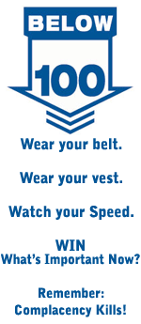
Officer Safety and wellbeing are huge issues in leadership and can broadly be defined under five categories
Stress and Fatigue
Vehicle Operation
Operational and Emergency Responses
Training
Mental and Physical Health Wellness

Slide 325
The Chemistry of Stress Dr. Daniel Goleman and Dr. Richard Boyatzis Harvard Business Review
When people are under stress, surges in the stress hormones adrenaline and cortisol strongly affect their reasoning and cognition
Attention fixates on threat from the boss rather than the work at hand and memory, planning, and creativity go out the window
Poorly delivered criticism and displays of anger by leaders are common triggers of hormonal surges
Research demonstrates that when someone who is very important to a person expresses contempt or disgust toward that person, stress triggers an explosion of stress hormones and a spike in heart rate
Leaders are not immune to the contagion of stress

Slide 326
Focus upon occupational stress and how it can adversely impact workplace environment and performance.
Study after study has found the primary stressors for police officers are not the external pressures or dangers of the job, but rather the exerted internally from within the organization and administration
Stress occurs when demands are placed upon an individual that exceed that individual’s capacity to deal with it
Stress intensifies when the individual lacks the means to avoid, alter, or control those demands
The less control employees have over what they are expected to do and the outcome of their efforts, the more likely they are to experience significant stress

Slide 327
Unsupportive management systems cause officers to experience stress due to a lack of control
Study results indicate that officer’s perception of stress, induced by the traditional organization
Could be reduced by leaders adapting and implementing employee participative management practices
That is far more detrimental than traditionally perceived stressors.
Stinchcombe, (2004), Shane, (2008)

Slide 328
Issues with Stress in the workplace upon the commander
Many police managers experience health problems, both physiological and emotional
Command brings forth a variety of new stressors:
Office Politics
Deadlines
Budget Constraints
Performance Appraisals
Grievances
Disciplinary Actions
Personnel problems really cause stress

Slide 329
Stress Contagion
Often, leaders do not understand how their behavior can lower employee job satisfaction and contribute to higher stress levels in their subordinates
Like an infection it rolls downhill and adversely impacts:
Officers’ physical and mental health
Quality of their personal/family life
Work performance
Professional behavior

Slide 330
Supervisor Strategies for Managing Employee Stress Jimmieson et al, (2021)
Problem Identification
Gathering Information and maintaining continuous communication
Execution of the immediate problem
Providing instrumental support
Reducing stressors via job design principles
Offering flexible hours
Managing workload
Mediation
Providing resources to ensure task completion
Informing external parties

Slide 331
Coping assistance
Offering emotional support
Connecting employees to organizational resources
Helping stressed employees to reappraise
Follow-up and evaluation
Monitoring and follow-up with stressed employees
Prevention
Tailoring to the needs of the individual
Managing role expectations to prevent employee stress
Encourage healthy lifestyle
Facilitate growth and development

Slide 332
Organizational Culture
Fostering an open and transparent culture
Create workplace fun
Provide praise and recognition
The findings provide context as to the environment within which supervisors must manage employee stress, as they attempt to balance the needs of the employee together with organizational demands, as well as their own role demands and personal stress

Slide 333
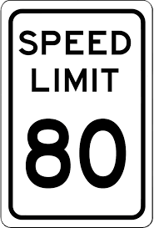
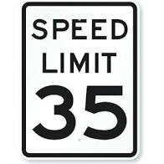
Hypervigilance
Hypervigilance is a state of increased awareness
Hypervigilance can be considered the first domino to be knocked over in a theory of police stress
Other dominos are negativity, apathy, pessimism, job insecurity, and loss of control
You can invest energy in the present to cultivate new experiences that then become the seeds for your future
You can cultivate or curate experiences in the now and then they become, if you practice them, they become automated enough that your brain will automatically construct them in the future

Slide 334
Tool Kit for Resilience
Broaden and build
Growth mindset over fixed mindset
Gratitude from blessings
Understanding meaning and acceptance
Understanding the ABC model and developing a playbook
Communication skills
Physical, mental, spiritual, and social fitness

Slide 335
Resilience among police officers: a critical systematic review of used concepts, measures, and predictive values of resilience Janssens, Van der Velden, Taris, Van Veldhoven & Marc (2018)
Increased awareness and self-management of stress reactions
Reduced distress, anger, sadness, and fatigue
Reduced sleeplessness and physical stress symptoms
Increased peacefulness and vitality
Reduced competition, improved communication, and greater cooperation within work teams
Improved work performance
Greater confidence, balance, and clarity under acute stress
Quicker recalibration following acute stress
Improved listening and relationships with family

Slide 336
The Burden of Competence

Slide 337
21st Century technologies have changed everything
Regarding how people receive and gather information
Information is real time
Information is observable
Information is more assessable (good and bad)
Information is more manipulated and focused
Information has more value and profit production
Examples: From the Arab Spring to online College courses

Slide 338
A billion hours ago, modern Homo sapiens emerged
A billion minutes ago, Christianity began
A billion seconds ago, the IBM personal computer was released
5.6 billion Google searches ago…was this morning
Hal Varian, Chief Economist Google
“The Internet is the first thing that humanity has built that humanity doesn’t understand, the largest experiment in anarchy that we have ever had.” Eric Schmidt, Former Executive Chairman
of Alphabet Inc.

Slide 339
Knowledge Doubling Curve Buckminster Fuller
Until 1900 human knowledge doubled approx. every century
By the end of WWII every 25 years
Today, different types of knowledge have different types of growth (Nano-tech every 2 years and Clinical every 18 months)
On the average human knowledge is doubling every 13 months
The “Internet of things” will lead to the doubling of knowledge every 12 hours (IBM)

Slide 340
Technologies Influence on our culture We have a dysfunctional relationship with reality
In the information age, truth and untruth exist at the same level of authority it is difficult for people to judge --Salman Rushdie
Speed of notifications and responses
Single perspectives and lack of contextual features
No personal interaction (relationship)
No filters or verifications (propaganda or rumors)
Ideology driven (Tribal polarization)
Emotionally driven
Victim to the bias (confirmation, sample, etc.)
Mega-processing

Slide 341
Decontextualization
When things are viewed from a single subjective perspective, absent any objective evaluation from the totality of all the facts and circumstances. Then reduced to a simple proposition from a very contextual, complex, and complicated situation.
Three contributing factors for this phenomenon:
Lack of specificity
Advocacy over objectivity (Not taking enough time to form thoughtful questions)
Our biases (Confirmation, sample, and group think)

Slide 342
When inaccurate or wrong information is repeated, an illusion of truth occurs: People believe repeated information to be true — even when it is not. MIT Sloan (2022) and Unkelbach, Koch, Silva, et al., (2019)
Misinformation, regardless of whether it was mistakenly passed along or shared with ill intent, obstructs good decision-making
We have a tendency to perceive repeated information as more believable than information we hear for the first time, regardless of whether the information is in fact true
Repeating false information can create at least an illusion of truth

Slide 343
Four strategies that can improve the likelihood that leaders and their teams will base their decisions on credible information
Avoid the bias blind spot: where people believe that biases cloud other people’s actions but not their own
Avoid epistemic bubbles: teams reflecting diverse perspectives outperform more homogeneous groups even when the latter have members with higher individual abilities on average
Question facts and assumptions: Developing an internal fact-checking and external fact-checking practice
Nudge the truth: managers should be prepared to respond with facts and repetition, repetition, repetition

Slide 344
OUR VUCA WORLD
FORCES
EFFECTS
DEMANDS
Volatility
Nature, Dynamics and Speed of Change,
Risk and Instability
Proactive Vision
Proactive Management
Uncertainty
Unpredictable due to Unknown Contexts
Delay, Paralysis, and lack of Confidence
Understanding
Diverse and Integrated Perspectives
Complexity
Intricacy, depth of Involvement, and Interrelationships
No single Solution, Nuanced, and Context Rich
Clarity
Flexibility, Adaptability and Creativity
Ambiguity
Environment is Outside of Expertise
Vagueness, Obscurity, and Equivocal
Agility
Sound Interpretation,
Cognition, and Innovation

Slide 345
Managing Use of Self for Masterful Professional Practice Jamieson, Auron & Shechtman, (2010)
Seeing is a heightened awareness through an objective lens of the complexity of the situational environment and circumstances around us.
Knowing is the ability to analyze, evaluate, understand, interpret and make sense of the contextual features involved.
Doing is recognizing complexity and demonstrating flexibility, exercising competency and courage to adapt and execute a full range of behavioral options or alternatives

Slide 346
8 competency clusters based on Bartram’s Competency Model for General Job Performance (2005)
Leading and deciding
Supporting and cooperating
Interacting and presenting
Analyzing and interpreting
Creating and conceptualizing
Organizing and executing
Adapting and coping
Enterprising and performing

Slide 347
The Dunning–Kruger effect (Kruger & Dunning, 1999)
Ignorance is prevalent in everyday life
Ignorance is often invisible to those to suffer from it
People with substantial deficits in their knowledge or expertise often are not able to recognize those deficits
The less you know about something, the more you feel you know
The more you know about something the more you recognize what you don’t know
In short, those who are incompetent, for lack of a better term, have little insight into their incompetence—an assertion that has come to be known as the Dunning–Kruger effect

Slide 348
Humility is a crucial nutrient for the mind
Arrogance is ignorance plus conviction
“While humility is a permeable filter that absorbs life experience and converts it into knowledge and wisdom, arrogance is a rubber shield that life experience simply bonces off of” --- Tim Urban
Seek confident humility: where we have faith in our capability while appreciating that we may not have the right solution or even be addressing the right problem
This gives us enough doubt to reexamine our old knowledge and enough confidence to pursue new insights

Slide 349
Our Responsibility as Public Safety Leaders
As professionals we are paid to be constantly aware of the limits of our understanding
We are expected to doubt what we know, and be curious about what we don’t know
Then strive to learn and update our views with new information and data
Remember…we are public servants, sworn to the constitution (not our beliefs)
Moreover, as leaders we must be able to see and understand the contextual features, nuances and “operational realities” in which we work

Slide 350
The focus for leadership development outcomes was found to be individual
Outcomes Identified:
Competencies
Knowledge
Skills
Behaviors
Abilities
Self-development
Vogel, Reichard, Batistič, & Černe, (2020).

Slide 351
How do leaders gain or lose credibility? Daniel Han Ming Ching, Tae-Yeol Kim, Brad Gilbreath, and Lynne Anderson. Why People Believe in their Leaders – or Not. MIT Sloan Management Review. Fall 2018 Vol 60 No 1
Behaviors that reflect competence and trustworthiness enhance credibility
An inability to demonstrate relevant job knowledge hurts credibility, as does behavior that isn’t aligned with the organization

Slide 352
Leaders are viewed as competent when they…
Emphasize the Future
7.94
Emphasize Organizational Outcomes
7.85
Emphasize Employees
7.66
Take Action and Initiative
7.34
MEAN SCORES
Communicate Effectively
7.26
Gain Knowledge and Experiences
6.75
1
2
3
4
5
6
7
8
9
Daniel Han Ming Ching, Tae-Yeol Kim, Brad Gilbreath, and Lynne Anderson. Why People Believe in their Leaders – or Not. MIT Sloan Management Review. Fall 2018 Vol 60 No 1

Slide 353
Leaders are viewed as incompetent when they…
Fail to demonstrate relevant knowledge and expertise
7.80
Fail to take appropriate actions
7.54
Take ego-driven actions
7.49
Fail to appreciate employees
7.45
Create confusion among employees and key stakeholders
7.43
MEAN SCORES
Communicate poorly
7.03
Are close-minded
6.83
1
2
3
4
5
6
7
8
9
Daniel Han Ming Ching, Tae-Yeol Kim, Brad Gilbreath, and Lynne Anderson. Why People Believe in their Leaders – or Not. MIT Sloan Management Review. Fall 2018 Vol 60 No 1

Slide 354
Leaders are viewed as trustworthy when they…
Communicate and act in a consistent manner
7.92
Protect the organization and employees
7.54
Embody the organization’s vision and values
7.33
Consult with and listen to key stakeholders
7.11
Communicate openly with others
MEAN SCORES
7.08
Value Employees
6.87
Offer support to employees and key stakeholders
6.71
1
2
3
4
5
6
7
8
9
Daniel Han Ming Ching, Tae-Yeol Kim, Brad Gilbreath, and Lynne Anderson. Why People Believe in their Leaders – or Not. MIT Sloan Management Review. Fall 2018 Vol 60 No 1

Slide 355
Leaders are viewed as untrustworthy when they…
Promote an unethical climate in the organization
8.56
Communicate dishonesty
8.24
Act in a self-serving manner
7.77
Behave in an inconsistent manner
7.53
Communicate in a guarded or inconsistent manner
MEAN SCORES
7.19
Ignore the input of employees and key stakeholders
7.05
Treat employees as expendable
6.92
1
2
3
4
5
6
7
8
9
Daniel Han Ming Ching, Tae-Yeol Kim, Brad Gilbreath, and Lynne Anderson. Why People Believe in their Leaders – or Not. MIT Sloan Management Review. Fall 2018 Vol 60 No 1

Slide 356
Competent Leaders are Valuable and Respected
They see things others don’t see
They are confident
They are consistent in their expectations
They cause and promote development
They translate knowledge into action seamlessly
INCOMPETENT LEADERS FRUSTRATE AND
STRESS
COMPETENT LEADERS MOTIVATE AND PRESS

Slide 357
“Wisdom is the ability to anticipate the consequences of a decision you make.” Dr. Curtis McClung
Competencies: The abilities, values, technical skills, conceptual capacities, personality traits, and other characteristics of people that lead to superior performance
Competency: is the wisdom to know and the discipline to behave consistently with that knowledge to drive conduct
The beginning of wisdom is to “know what you do not know.” ----- J.K. Galbraith
There are errors and unforced errors… Leaders can create the very problems they face. The root cause is often ignorance or stupidity. Ignorance can be overcome if we make the effort, but you can’t fix stupid

Slide 358
KEY ABILITY IN CONTEMPORARY LEADERSHIP AND ORGANIZATIONS
Absorptive capacity—the ability to value, assimilate and apply new knowledge for learning and problem solving (Cohen and Levinthal, 1990; Kim, 1997; Volberda, Foss, and Lyles, 2010).
Absorptive capacity helps organizations adapt and evolve in high-velocity environments (Floyd and Lane, 2000).
It does this by focusing leaders on eﬀectively capturing and deploying the ﬁrm's knowledge-based assets.

Slide 359
Cognitive Control and Cognitive Flexibility
Cognitive control: helps individuals in overcoming automatic response sets (Diekman, 1982), in favor of a more appropriate contextual response (Reder & Schunn, 1999)
Cognitive flexibility: ability to cognitively control and shift mental mind set (Canas, Quesada, ˜ Antol´ı, & Fajardo, 2003)
As contexts become more dynamic the need for cognitive flexibility grows, in order to balance being both innovative and holding to the routine (Davis et al., 2009)
Integrative complexity is the ability to develop, and hold opposing traits, values, and ideas and then integrate them into larger ones.

Slide 360
The Architecture
The way we do things have evolved overtime as a result of lessons learned
When we deviate from core policy, we assume risk
Risk in unavoidable, but often manageable
We must have the ability to adapt and change to the complexity we encounter to maintain an advantage
Exploration and different choices provide the landscape for innovation
A balance is achieved, through the analysis of the specific contextual features

Slide 361
Organizational Competency is important and has three important components.
First is leadership:
Agencies always reflect their leadership
The boss, the highest figurehead, casts the vision, creates the environment, and manages the process
Influencing results and sustains performance
Creates, develops, sustains agency culture

Slide 362
Second is the individual employee:
People with good soft skills and good work ethic
People who are competent and confident
The most valuable resource and tool for either great success or absolute failure is the employee
Based upon their conduct, their behaviors, and their performance, efficiency and productivity are determined.

Slide 363
Third is organizational competency;
1.) Policy, procedures, protocols and
customs.
2.) Training, development and capacity
building
3.) Supervision and mentorship
These are the structures in place to guide and direct the required elements that insure credible, efficient, and effective operations and professional culture

Slide 364
Policy is evaluated under four criteria for serious consideration: Kraft and Furlong, (2015)
Effectiveness: will the policy or program work
Efficiency: the cost in relation to benefits
Equity: the fairness aspect
Political feasibility: does the public support exist

Slide 365
The Process Knowledge Spectrum
Edmundson, (2012)
Complex
Operations
Routine
Operations
Innovative
Operations
Uncertainty

Slide 366
Operations and Policy Analysis Must be grounded in operational reality
Has objectives, approaches and limitations, you must look through 3 lens
Professional lens (consistent with other agencies)
Scientific (evidence based) lens
Political lens (public perception)
Two Processes:
Top-down vision: Defining, analyzing, constructing, developing criteria, assessing and evaluating alternatives and drawing conclusions
Bottom-up construction: Rooted in the operational realities of those that do the job

Slide 367
Leadership’s influences in the operational realities of work sometimes are measured by… How we manage policy and procedures nexus to people
“Our should and may versus shall and will”
Rules: a prescribed guide for conduct or action. (statements that say what a person is and isn't allowed to do) Research has found that rules are superior to human judgement
Standards: something established by authority, custom, or general consent as an approved model or example. (a principle that is used as a basis for judgment) Sometimes policy can become brittle under context
“Rules simplify work, standards allow discretion for adjustment to the contextual particulars of the situation afoot.”

Slide 368
CASE STUDY

Slide 369
Contextual Factors That Support Knowledge Management Gonzalez and Massaroli de Melo (2018)
Explicit Knowledge: codified form, standards, rules, data, records, files (I Know What)
Tacit Knowledge: abilities and skills intrinsic to the person (I Know How)
Explicit knowledge is easily transferable and coded, while tacit knowledge is rooted deeply into the system within the organization.

Slide 370
Independent Autonomy
Sometimes the why is never explained in policy or training
Experiences create layers of invaluable context that process into understanding
“Tacit Knowledge”
abilities and skills intrinsic to the person I Know How
Policy, procedures, and practices
“Explicit Knowledge”
codified form, standards, rules, data, records, files
I Know What

Slide 371
Hard Skills
Soft Skills
Technical expertise and Knowledge for a job
Doing things without other people interactions
Working with sets of facts
Conceptual and Theory Based knowledge
Understanding how to Perform in a Domain
Require acquired knowledge
Cognitive in Nature
Interpersonal qualities, People skills
Anything that involves other people interactions
Interpersonal Communication
Behavioral
People Sensitive and Empathetic
Problem-solving
Conceptual/analytical and Critical skills
Visual, Oral and Aural
Judgment and Synthesis

Slide 372
Competencies
Competencies are sets of behaviors that are instrumental in the delivery of desired results or outcomes
They are specific work-related constructs that are relevant to successful job performance
It may be a trait, motive, skill, aspect of one’s self image or social role, or body of knowledge that he or she uses
Competencies are “behavioral repertoires”, while competence is a “state” of attainment
Competencies are Organizational performance accrues from the performance of individuals

Slide 373
CIRCUMSTANCES
PERSPECTIVE
SPHERE OF KNOWLEDGE
Understanding Context
Understanding Operational Realities
Experience
Domain Competency
FUNCTIONAL
APPLICATION
COMPETENCY
CYCLE
LEARNING
WISDOM
Knowledge and Experience Tend to be Domain Specific
Practice
IMPLEMENTATION
ACTION

Slide 374
Depth of Experience
Experiences create layers of invaluable context that process into understanding
Practical experiences force the interaction with the real-world implications of theories, concepts, and training
Shapes the beliefs that transform into the operational realities of conduct
Experiences lead to nuanced opinions
Practical experience provides a foundation to manage uncertainty, ambiguity and other challenges and shapes the relationship to job responsibility

Slide 375
The Importance of Developing T-Shaped Skills Abubakar, (2019)
T-shaped skills include the horizontal of the “T” (broad) and the vertical part of “T” (deep)
The horizontal refers to the ability to collaborate with experts in other discipline and use knowledge garnered from them
The vertical refers to the expert's knowledge and experience in a particular field

Slide 376
Often, In today's law enforcement profession some officers experience has not been:
Grounded by working many diverse cases
Complimented by a competent mentor
Oversight from a competent supervisor
Tested from the witness stand in court
It is what officers have been able to get away with over time.
Police are the gate keepers of the criminal justice system. Often, nothing is wrong until someone takes exception.

Slide 377
Examples of what we miss from the courtroom experiences
Brady vs. Maryland (Discovery)
Motion to suppress (Searches and Seizures)
Jackson-Denno (Voluntariness of In custody Statements)
Bruton Rule (Statement of a non-testifying co-defendant implicating the defendant)
Roviaro v. U.S. (informer-tipster cannot be revealed under any circumstance. Informer-participants or informer-witnesses, generally have exceptions to the rule of privilege)

Slide 378
Todays Police Supervisor
Must learn and know their job to make informed decisions, provide advice and mentor
This requires “DOMAIN SPECIFIC COMPETENCY”
Often, leadership and management skill sets must be substantially enhanced and sustained to relay on others for collaboration and feedback
In contemporary law enforcement the ranking officer may not be the smartest or best informed in the room
Experience alone is no longer enough…we must be continuously be educated.
We must reevaluate our experience in the here and now

Slide 379
Change the paradigm
Gain a perspective of the entire organization landscape and design effective sense and respond mechanisms to detect subtle, but nevertheless essentially important, changes in the internal and external work environments
The personal skill sets of their leadership must be substantially enhanced
The ranking officer may not be the smartest or best informed in the room

Slide 380
Leaders must think strategically Aaron K. Olson (2015)
Strategic thinking makes leaders more effective because of the focus on what's going on within their organization
Recognizes patterns: dives into data, gathers information from feedback
Makes choices: structured decision-making processes
Manages risk: knowing that any choice is a trade off, the ability to maximize value, while mitigating risk

Slide 381
The Competent leader must filter information through three perspectives
Managerial approach
Political approach
Legal approach

Slide 382
The Three Perspective Equation
Specificity of the law, policy or rule
Understanding of facts and circumstances
Contextual environment
Discretion
This formula relies on objectivity and the domain competency necessary to accurate see and evaluate the contextual features

Slide 383
Content and Context
The same "content" may have a totally different meaning (or function), if it is put in a different “context”
This difference of meaning, function or process is closely related to the concepts of the totality of the facts and circumstances in a given situation, issue, incident or event.
The same features can have a totally different function or meaning, depending on which logical type they are situated in.
Interpretation may result in objective characteristics or subjective feelings or both

Slide 384
CONTEXT The Interrelated conditions in which something exists or occurs
How it is viewed (Importance of perspective)
How it is interpreted (Depends upon how it is viewed)
How it is defined (The definition relies upon the rules and competency of fact patterns)
How it is described (We construct our own realities)

Slide 385
Keys to the Evaluation of Context
Specificity of facts: progresses from general to specific in nature and narrowly tailored to each fact
Attention to the nuances: assess the subtle distinctions or variations in facts and their patterns
Expertise, experience or practice in a particular domain: diversity from multiple perspectives
Organic skepticism: a continuing reluctance to accept an ends without a means through devil's advocacy

Slide 386
Deconstruction, articulation and differentiation: the process or fact of being different or making something different from other similar things
Objectivity: impairsal, fair, free from favor or bias
Totality perspective: consideration of the continuing relationship between the elements of facts and circumstances and how they fit together harmoniously
Provides the information for self-evaluation, correction, revision and sometimes outright abandonment of ideas

Slide 387
Why Context is Critical in Leadership
Understanding the notion that our beliefs are often grounded in our anecdotal experiences
The importance of context, nuance, and objectivity in contemporary issues
In order to use context effectively, we must see, understand, and interpret the diverse elements that make it up
Empirical research and study in conjunction with our experiences can be very beneficial in developing strategy to move forward and promote meaningful change to mitigate, reduce, and prevent problems

Slide 388
Context is Critical to Sense-Making
Be able to see the context from multiple angles
That ability to evaluate those perspectives combined with a heighten sensitivity of awareness
The way we learn and interpret things helps to shape understanding and influence behavior

Slide 389
Knowledge nexus to Understanding
Must pursue the unification or connectedness of knowledge
The key to understanding anything is to understand the context in which it sits
The contextual richness requires:
The identification and objective understanding of all the variables
Their synthesis and analyzation
Their evaluation and interpretation
Contextual knowledge: Knowing the bigger picture, knowing the way all the pieces fit together and how they influence change

Slide 390
In Contextual Rich Environments: A disciplined and deliberate mindset is required for Identification and objective understanding of all the variables, then synthesis and interpretation
See and Identify the entirety and the interrelated components and parts at work
Conduct an objective (unbiased) and critical (understanding of the influences and processes at work) analysis, then a pragmatic evaluation
Identify and understand the nuances
Never let the fact you don’t like the source influence your objectivity and open mind

Slide 391
Well Trained Public Service Professionals By Fredrick Mosher
“Have perspective on themselves and
their work, and on the social and
political contexts in which they find
themselves working”

Slide 392
The proper perspective is found with a “Conflict of Idea’s”
“The real voyage of discovery lies not in seeing new landscapes, but in having new eyes.”
--- Marcel Proust
You must Challenge what you think you know…solicit other views and ideas
Create an environment for questioning and debate
Specificity in content for credibility of context
Objective perspective and evaluations over subjective feelings and thoughts (fact driven process over defaulting to your assumptions)
Evidence based and reason driven

Slide 393
One perspective provides such a limited view
Multiple perspectives, filtered through objective analysis and pragmatic evaluation promote more accurate interpretations and sound conclusions
We must understand and consider the environmental, cultural and historical context in the situation, then objectively interpret the issues afoot…
Do not become trapped in paradigms of out of date, out of touch methods, practice or procedures
We always question what we disagree with, but almost never question what we agree with
The reason we want to know a lot of stuff is to be able to frame thoughtful questions to learn more.

Slide 394
Four distinct but intercorrelated aspects of intellectual humility Krameria-Mancuso & Rouse, (2015)
Having respect for other viewpoints
Not being intellectually overconfident
Being able to separate one’s ego from one’s intellect
The willingness to revise one’s own viewpoint

Slide 395
The Key is Active Learning, Critical Thinking and Active Open-Mindedness Leigh, (2007)
Sustain a state of “active open-mindedness” Baron, (1994)
The focus is on rigorous testing of a view, argument or belief
The ability to integrate new information into your current set of beliefs
The willingness to change your existing beliefs according to the strength of evidence that supports them
Resisting intuition or confidence in order to delay judgement until all facts can be gathered (Kahneman, 2021)

Slide 396
Critical thinking is a “skillful” responsible thinking
Model of Inquiry: Leigh, (2007)
Active Learning and Knowledge Acquisition
Critical Thinking
Active Open-Mindedness Baron, (1994)
That is conducive to good judgement because it is sensitive to context, relies on criteria and is self-correcting Lipman, (1988)
Three simple things you can do to improve your critical thinking skills: Bouygues, (2019)
Question Assumptions
Know what we don’t know
Reason Through Logic
Diversify Thought

Slide 397
Thought Process
DIVERGENT
THINKING
CONVERGENT THINKING
Create Choices
Imagine
Research
Suspend Judgement
Evaluate
Test
Operational Reality
Make
Choices
Finding Out
Sorting Out

Slide 398
A successful team needs to manage three phases well: Dr. Phillip Tetlock
A diverging phase, in which the issue, assumptions, and approaches to finding an answer are explored from multiple angles;
An evaluating phase, which includes time for productive disagreement;
A converging phase, when the team settles on a prediction. In each of these phases, learning and progress are fastest when questions are focused, and feedback is frequent.

Slide 399
Our Responsibility as Public Safety Leaders
As professionals we are paid to be constantly aware of the limits of our understanding
We are expected to doubt what we know, and be curious about what we don’t know
Then strive to learn and update our views with new information and data
Remember…we are public servants, sworn to the constitution (not our beliefs)
Moreover, as leaders we must be able to see and understand the contextual features, nuances and “operational realities” in which we work

Slide 400
Evaluating Context
Fact-finding
Insight
Understanding
CONTEXT
Capture
Analyze/Evaluate
Interpreting
BEING ABLE TO FRAME ISSUES

Slide 401
Framing and Re-framing Bolman & Deal, (2017)
Mental models= maps, mind-sets, schema, paradigms, cognitive lenses are FRAMES
Often our preferences are framed-bound rather than reality-bound.
Frames act as a coherent set of ideas or beliefs that form a prism or lens that enable you to see what’s going on in the world around you
Frames define the questions we ask and solutions we consider
Leaders fail when they take too narrow of a view
We must think flexibly and see organizations from multiple angles, to deal with the full range of issues we inevitably encounter.

Slide 402
The Four Frame Model : Each frame has its own image of reality. You may be drawn to some and put off by others. Applying all 4 deepens your appreciation and understanding of organizations. Bolman & Deal, (2017)
Structural: The rational side, perspective of an analyst, architect and designer that bends toward excellence
Human resource: The people side, perspective of a servant, supporter, who is empowering that bends toward caring
Political: The conflict side, perspective of an advocate, negotiator and coalition builder that bends toward justice
Symbolic: The cultural side, perspective of a prophet and visionary that bends toward meaning and faith

Slide 403
Bolman and Deal, (2017)
How you think determines what you see and how you respond to situations
A frame is an amalgam of beliefs and assumptions that you carry in your head to help you understand and negotiate some part of your world
An accurate frame makes it easier to: (a) know what’s going on, (b) see more options, and (c) make better choices
Frames are vital because muddled human affairs don’t come with computerized navigation systems to guide you turn by turn to your destination
Instead, you need to develop and carry accurate cognitive maps in your head

Slide 404
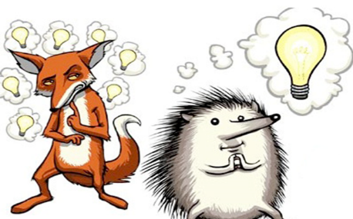
“Foxes and Hedgehogs”
A dichotomy that is meant to evaluate two perspectives consistent with character and cognitive styles of individuals in positions of authority within organizations
Two opposing world views that may be useful in thinking about human nature (Zaleznik 2008)
Classified along a spectrum between hedgehogs and foxes (from Isaiah Berlin essay on Leo Tolstoy)
“The fox knows many little things, but the hedgehog knows one big thing.”
-- Archilochus

Slide 405
How Foxes Think | How Hedgehogs Think
Multidisciplinary – Finding a diversity of perspectives. Looking outside of their comfort zone to whatever different methods might work better than the current ones. | Specialized - Loyal to their current data and skills. They focus on how things they know they can do may be used instead of learning new skills that might be better suited to a new environment.
Adaptable – Change is the Only Constant. When something works, it could work better differently, when something doesn’t work then a new method might work better. | Inflexible– They stick with “The way it’s always been.” Change for when necessary or forced, and only as a way to refine the status quo for now, not create a new approach for each new problem.

Slide 406
How Foxes Think | How Hedgehogs Think
Self-critical – Constantly evaluating themselves and open to criticism. Learning about where they failed gives them a chance to transform and improve. | Stubborn – Their mistakes are blamed on bad luck or on peculiar circumstances. (“A good model had a bad day.”) A prisoner of their own experience or ideology.
Tolerant of complexity – They are aware that they don’t know all the variables, and they may never know them all. They know that one solution will not fit all problems and some problems have multiple sources that need different solutions. | Order-seeking – They believe every problem has a clearly defined solution. One system can be shoehorned to fit any environment and that variables and complications are bound to have some uniformity between them.

Slide 407
How Foxes Think | How Hedgehogs Think
Cautious – They never think “yes or no”, but instead “It depends.” They are constantly changing their outlook based on new information and context. | Confident – They rarely hedge their predictions and are reluctant to change their minds or outlooks. Often, look for confirmation instead of refutation.
Empirical – They rely on research and objective observations not on the expectation, but on “what we know right now suggests.” They see the trees, then decide if it’s a park or a forest. | Anecdotal – They are Fixed to their beliefs. They expect that if something doesn’t fit their expectations that they just don’t have the full picture yet. They look for the forest when they see a tree.

Slide 408
Foxes are better forecasters
Hedgehogs are more decisive and see everything through the lens of a single organizing principle
Hedgehogs take risk and move forward; foxes are more cautious and calculative as they proceed
Hedgehogs take a narrow view, while foxes embrace a more integrated perspective
Both cognitive styles are essential keys to maneuvering in, and navigating through the evaluation of any issue
“It’s not what they think, it’s how they think” (Tetlock, 2005)
Continuum of contextual
factors and features
Totality of the facts and
circumstances
Foxy
Hedge-hogish
Though Process

Slide 409
My selections From Habits of Mind 16 Essential characteristics for Success Arthur L. Costa and Bena Kallick AND Ten Commandments for Critical Thinking By: Tom Chatfield
1. Persisting: Sticking to task at hand; Follow through to completion; Can and do remain focused.
2. Managing Impulsivity: Take time to consider options; Think before speaking or acting; Remain calm when stressed or challenged; Thoughtful an considerate of others; Proceed carefully.

Slide 410
3. Listening with Understanding and Empathy: Pay attention to and do not dismiss another person's thoughts, feeling and ideas; Seek to put myself in the other person's shoes; Tell others when I can relate to what they are expressing; Hold thoughts at a distance in order to respect another person's point of view and feelings.
4. Thinking Flexibly: Able to change perspective; Consider the input of others; Generate alternatives; Weigh options.

Slide 411
5. Thinking about Thinking (Metacognition): Being aware of own thoughts, feelings, intentions and actions; Knowing what I do and say affects others; Willing to consider the impact of choices on myself and others.
6. Striving for Accuracy: Check for errors; Measure at least twice; Nurture a desire for exactness, fidelity & craftsmanship.

Slide 412
7. Questioning and Posing Problems: Ask myself, “How do I know?”; develop a questioning attitude; Consider what information is needed, choose strategies to get that information; Consider the obstacles needed to resolve.
8. Applying Past Knowledge to New Situations: Use what is learned; Consider prior knowledge and experience; Apply knowledge beyond the situation in which it was learned.

Slide 413
9. Thinking and Communicating with Clarity and Precision: Strive to be clear when speaking and writing; Strive be accurate to when speaking and writing; Avoid generalizations, distortions, minimizations and deletions when speaking, and writing.
10. If in doubt, wait: Pause and silence are friends of better thought (time may provide more clarity for difficult messages or may reveal to remain quite)

Slide 414
11.Thinking Interdependently: Willing to work with others and welcome their input and perspective; Abide by decisions the work group makes even if I disagree somewhat; Willing to learn from others in reciprocal situations.
12.Remaining Open to Continuous Learning: Open to new experiences to learn from; Proud and humble enough to admit when don't know; Welcome new information on all subjects.

Slide 415
13. Know your limits: Know what you don’t know, seek expertise when yours runs out (Remember…expertise is SPECIFIC)
14. Seek refutation over confirmation: any idea can endlessly be confirmed if you’re only looking for support-you can convince yourself the earth is flat if you never look more than a mile away. Seek out challenges and contradictions and put your arguments and beliefs to a genuine test. If an idea or a theory cannot be tested or disapproved, it isn't worth much.

Slide 416
15. Beware sunk cost: once you have put time, effort, cash or care into something, it is tempting to stick with it no matter what, in order to justify your input…Don’t, cut your losses, don’t get shacked by the past
16. Every option you’re facing can be wrong: before you choose, ask-is the best or most meaningful response even an offer? A website says you must enter your personal details or not get access. Perhaps the better choice is to reject the deal
A politician says we must either raise taxes or lower immigration, but there's no reason for you to accept either. Look outside the frame. Ask whether you’re really being given a choice. Ask is there a different, better way of thinking?

Slide 417
Critical Thinking Process
Knowledge (Define Who, What, Why, Where, how while being thorough, comprehensive and complete)
Comprehension (Organize your thoughts, select the facts, choose the ideas. Be able to interpret information objectively and accurately understand the facts)
Application (Be able to use facts, rules, and apply principles and standards)
Analysis (Separate the whole issue into components and examine and evaluate each set of facts or circumstances)

Slide 418
There are 8 structures that define thinking. Learning to analyze thinking requires practice in identifying these structures in use.
From Dr. Richard W. Paul Guide to CT
Point of View
Purpose
Implications and
Consequences
Questions at Issue
ELEMENTS
OF
THOUGHT
Assumptions
Information
Concepts
Interpretation and Inference
Each of these structures has implications for the others.
“Thinking about your thinking, while
your thinking, in order to make your
thinking better”

Slide 419
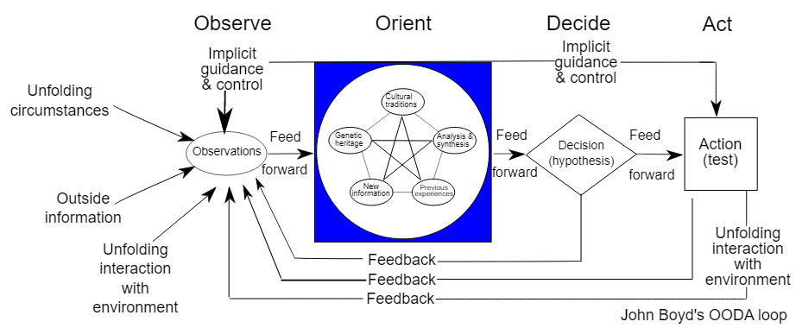

Slide 420
FIVE STEPS TOWARD CRITICAL THINKING From the Book “THE BURDEN of COMMAND”
1. A constantly objective and open mind free from emotion and belief-based bias
2. An aggressive and proactive quest for research, inquiry, and study to identify all available facts and circumstances within a sound foundation of the veracity of all information is key
3. All conclusions must be based upon facts; all claims must be supported by facts
4. Work with an objective process of reasoning; include others’ opinions in the process
5. Reflect on conclusions for alternate theories, ideas, and questions; anticipate both intended and unintended consequences

Slide 421
EXAMPLE
Remember the stagnancy of the air force drone program when the Generals that all sat at the command table were former pilots…How valuable are drones to our military today?
Whether local, state or federal Police Officer, Correctional Officer or Lawyer our disciplines and/or peers can cause use to filter what we see into our neat set of rules, conditions and perimeters rooted in our beliefs and personal experiences

Slide 422
“There are known knowns…These are things we know that we know. There are known unknowns…That is to say, there are things that we know we don't know. But there are also unknown unknowns. There are things we don't know we don't know.”
Donald Rumsfeld

Slide 423
BE CANDID regarding your knowledge base
When you do not know…say you do not know.
Never lie, mislead or BS

Slide 424
Frankfurt’s (2005) conception of bullshit as an absence of concern for the truth
Like other irrational beliefs, bullshit is a real, prevalent, and consequential phenomenon
Due to this prevalence and potential for harm, the ability to recognize and avoid bullshit is an essential skill to have in today’s world Walker et al. (2019)
While many people may believe that they can reliably detect and resist bullshit, empirical findings suggest otherwise Pennycook, Cheyne, Barr, Koehler& Fugelsang, (2015a); Pennycook & Rand, (2018); Pfattheicher & Schindler, (2016); Sterling, Jost & Pennycook, (2016)

Slide 425
“Bullshit is unavoidable whenever circumstances require someone to talk without knowing what they are talking about. Thus, the production of bullshit is stimulated whenever a person’s obligations or opportunities to speak about some topic exceed their knowledge of the facts that are relevant to that topic.”
Frankfurt, Harry G. (2005) “On Bullshit.”
Princeton: Princeton University Press.

Slide 426
On the reception and detection of pseudo-profound bullshit Pennycook, G., Cheyne, J.A., Barr, N., Koehler, D.J.,& Fugelsang, J.A. (2015) Judgment and Decision Making, Vol. 10, (6), 549–563
There are two candidate mechanisms that might explain a general “receptivity” to bullshit.
The first mechanism relates to the possibility that some people may have a stronger bias toward accepting things as true or meaningful from the outset.
The second mechanism relates to a potential inability to detect bullshit, which may cause one to confuse vagueness for profundity.
The tendency to perceive bullshit sentences as meaningful, which is called bullshit-receptivity, is different from bullshit-sensitivity, which refers to the ability to distinguish bullshit sentences from genuinely profound sentences

Slide 427
Four crucial factors in rational decision making Thompson, (2002)
Gathering Information
Identifying the choices or options that are open to you
Working out the implications or consequences of each of these options
Making an evaluation

Slide 428
Rational Decision Making Adapted from: Bardach (2012), MacRae & Whittington (1997) and Thompson, (2002)
First, consider why and if you need to make a decision.
Don’t fall victim to the action imperative “that drive to do something”
Define the problem and challenge assumptions
Follow a critical thinking process (with a range of diverse perspectives)
Identify the goals and objectives sought
Consider a range of alternative solutions
Evaluate each alternative to clarify their consequences
Choose the alternative with the greatest potential for solving the problem or producing the best result

Slide 429
Leaders Must Develop Qualified Patience Edwards, (2021)
A state where one develops the skill to manage impulses and temper passions in a measured space of time
Leaders as problem solvers do best when they perceive themselves as learners
In order to gather facts and apply circumstances through a filter of “specificity” with objective and critical reasoning
Within the context of the situation and the elements of the operational realities (policies, procedures, standards etc.) that apply
Look broad for consequence forecasting
Know what we don’t know
Make informed decisions on the foundation of objective judgements rooted in reasonable facts
Respond rather than react

Slide 430
Noise (Kahneman, Sibony, and Sunstein, 2021)
Noise is the undesirable or unwanted variability in a final integrated judgement or decision
lack of consistency or fixed pattern; liability to vary or change.
Formula to mitigate noise:
Aggregate independent observations
Central is “Independence”
Decomposition (break decision down into components “mediating assessments”)
Independence (information collected and evaluated separately)
Delayed holistic judgement: (Do not exclude intuition, but delay it)

Slide 431
Judgement Tichy & Bennis, (2007)
Good judgement calls are a process, not an event
It starts with the leader recognizing a need and framing the call
It continues through execution and adjustment
Leaders must make calls in three critical domains:
People: the most difficult, and the most critical
Strategy: direction set for the organization to achieve a desired state in the future
Crisis: management of a disruptive or unexpected event that threatens to harm the organization or its stakeholders

Slide 432
Having a storyline Leaders must use mental frameworks to guide good judgement Tichy & Bennis, (2007)
Teachable points of view that set direction and behavioral value
It interprets the presence and shapes the future
Creates a sense of purpose
Is both rational and emotional
Is an organic and ongoing process (updated as situations change)
Creates a sense that the organization is embarked on an ongoing journey

Slide 433
Causes of Unintended Consequences
The world’s inherent complexity (parts of a system responding to changes in the environment)
Perverse incentives
Human stupidity
Ignorance
Self-deception or other cognitive or emotional biases.
Rushing to judgment without the facts

Slide 434
Lack of objectivity and foresight
Poor or lack of communication with right people
Incorrect analysis
Errors in thinking
immediate interest, outweighs long term interest
culture, beliefs, and values
Not taking other people’s perspective into consideration (Oblivious to feedback)
Poor interpretation, analysis and evaluation
Not woven into the ground level operational realities and core mission

Slide 435
“Five Distinct Truths Governing Decisions” Sir Winston Churchill
That there is a full authority.
That there is a reasonable prospect of success.
That greater interest are not compromised.
That all possible care and forethought are exercised in the preparation.
That all vigor and determination are shown in the execution.

Slide 436
DO NOT FALL VICTIM TO THE OUTCOME BIAS
Outcome bias focuses exclusively on judging the past decision by its outcome or result
Rather than the known information, intentions and processes in deciding if the decision was correct. (or reasonable)
Those presented with bad outcomes rated the decision worse than those who had good outcomes.
You should evaluate a decision by ignoring information collected after the fact
And focusing on what the right answer is or was at the time the decision was made.
Analyze intentions, knowledge, context, and process .

Slide 437
Dr. Stein Cass on Risk
Risk is defined as “the likelihood and impact of potential problems or undesirable events which might occur and prevent meeting an objective.”
Risk analysis is defined as “attempts to define what could go wrong and what to do about it.”
Risk management is defined as the program framework for risk analysis and uses the results to make decisions and take actions.
We must ensure risk taken are Calculated Risk.

Slide 438
Any risk related decision is likely to be acceptable if:
It conforms with relevant guidelines
It is based on the best information available
It is documented
The relevant people are informed
London Department of Health 2007

Slide 439
Confidence
“What turns our thoughts into action”
Is a tremendous asset
Must be tempered by humility
Must be tested by an objective (emotion free) and open mind
Must be rooted in competency

Slide 440
Competence
Confidence
COMFORT

Slide 441
No one of us, is as smart as all of us, collaboration is key… We must balance advocacy and inquiry
The continuum
HUMBLE
CONFIDENT BUT HUMBLE
ARROGANT

Slide 442
What about confidence research, work environment and Gender?
First, we need to understand Gender issues
Gender relations involve attitudes, self-concepts and identity, focusing on social categories and structural relations
Gender roles are societies expectations of the proper behavior, attitudes, and activities of males and females (Seen differently by many)
Gender differentiation in our culture is embedded in social institutions (family, education, religion, politics, economy, medicine and media)

Slide 443
The Confidence Code Katty Kay and Claire Shipman
Women tend to have “Wells of self-doubt” and as a result hold themselves back
Take criticism too personally
Try to be perfect
Fear failure
Afraid to take risk

Slide 444
Compared to men, women are less likely to give positive assessments of their competence and qualifications (Niederle and Vesterlund 2011; Soll and Klayman 2004)
They assign less value to their accomplishments (Beyer and Bowden 1997; Bylsma and Major 1992)
When taking on difficult tasks, women underestimate their successes relative men, which discourages women from seeking out further opportunities in that domain (Ehrlinger and Dunning 2003)
Women are less likely than men to feel confident in themselves and their abilities to take on challenges—gender differences that are small but robust to different samples and surveys (Gecas 1989; Kling et al. 1999)

Slide 445
The origins of the confidence gap begin in adolescence and develop through early adulthood (Kling et al. 1999; Twenge and Campbell 2001)
Differences in self-confidence have been shown to be a psychological barrier to women’s decisions to run for office (Lawless and Fox 2010)
These differences by gender are thought to be socially imposed, given that the size of the gender gap varies across countries with different levels of gender equality (Bleidorn et al. 2016)
Subtle patterns of socialization about gender roles likely drive the emergence of gender gaps in self-esteem, where confidence is more likely to be valued as a masculine trait than a feminine one (Kling et al. 1999).

Slide 446
Zheng, Kark & Meister, (2018)
A wealth of research shows that female leaders, much more than their male counterparts, face the need to be warm and nice (what society traditionally expects from women), as well as competent or tough (what society traditionally expects from men and leaders)
The problem is that these qualities are often seen as opposites
This creates a “catch-22” and “double bind” for women leaders
In the long run, organizations and society must produce systematic change to alleviate conflicting expectations for women and additional hurdles for their leadership
But as long as female executives face the double bind, they will need to find ways to manage it

Slide 447
The fact that women have lower expectations of success than men in many areas of achievement, which might be indicative of their tendency to underestimate themselves – is well established in the literature. (Betsworth, 1999; Beyer, 1999; Kay & Shipman, 2014; Meyerson, Sternbach, Zwischenberger, & Bender, 2017) Herbst, T. H. (2020). Sarsons, Heather, and Guo Xu. (2021)
Gender is an important variable to keep in mind while trying to motivate a team because it can determine a person’s assertiveness (or lack thereof) and in turn create a confidence gap between genders within the workplace

Slide 448
A significant body of research indicates that gender is an important predictor of leadership style and that it influences the experiences of female leaders in the workplace (Jackson et al., 2014)
Stereotypes of male leadership qualities continue to hold women back by affecting perceptions of performance and status
This is because the persistence of male leadership stereotypes creates unequal power relationships

Slide 449
Women can be viewed negatively when they do not conform to the required gender stereotype (Alqahtani, 2019) and those who go against their gender stereotype can be viewed as less effective and less preferred (Rhee & Sigler, 2015)
Inevitably such workplace experiences will impact feelings of self-confidence by women leaders
This research contributes to literature on workplace coaching for female leadership which is important given the recognized lack of studies (Gray et al., 2019)

Slide 450
First, it supports the current trend to achieve gender equality by understanding the experiences of women in the workplace particularly in relation to confidence (Alqahtani, 2019; Herbst, 2020)
Second, it provides support to existing theories of female leadership (Eagly, 2007; Eagly & Carli, 2007, and Gray et al., 2019) which identify the effect of gendered stereotypes in masculine environments and the importance of workplace role models for women in building self-confidence

Slide 451
In summary, this research helps improve gender equality in leadership by furthering our understanding of how workplace coaching can support change for female leaders
Wilkinson & Rose, (2022)

Slide 452
While levels of self-confidence can be shaped by social contexts and personal experiences, women can also choose to strive to be more confident—to check patterns of self-doubt, to mindfully decide to take more risks, and to push to take on challenges
Wolak, (2020)

Slide 453
Influences at work
Identity (who people are and how they are seen in terms of the group they belong)
Power (the ability to direct or influence)
Privilege (an advantage others lack)

Slide 454
Management Responsibilities for a Healthy and Equitable Work Environment
Awareness: Conscious of what's happening around you
Attitude: Respect for all, demand for an equable environment where discrimination and harassment have no place
Action: Intervention and consequences

Slide 455
The Four Traits of Confidence: Growth Mindset, Courage, Grit, and Self-Compassion Kosterlitz, (2015)
Trait 1: Growth mindset--the belief that with effort you can succeed.
Trait 2: Courage--the "heart" to take action to achieve your goals. Courage enables action, even in the face of fear and self-doubt..
Trait 3: Grit--the ability to persevere when the going gets tough.
Trait 4: Self-compassion--handling your missteps with kindness. Self-compassion is being kind to yourself when you fail or make mistakes.

Slide 456
Women face two unique challenges in the workplace that mentors can help them overcome (Insala, 2017 & 2019)
1) Lack of confidence: women [often] underestimate both their abilities and their performance
2) Poor self-advocacy: Women are happy to advocate for others, but they are often uncomfortable advocating for themselves

Slide 457
Managing to clear the air: Stereotype threat, women, and leadership Hoyt & Murphy, (2016)
Awareness of unconscious biases and unwarranted stereotypes that affect the evaluations of others
Self-efficacy and self-esteem are important components of self-confidence (Kane, Yarker & Lewis, 2021)
Increasing opportunities and representation
Presenting stereotype inconsistent information in order to help reduce stereotyped thinking
Growth and development mindsets and behaviors
Making explicit the characteristics of good leadership that avoid stereotyped descriptions

Slide 458
Gender-blindness (Martin & Phillips, 2017)
A strategy that advocates for the downplaying of difference and focus on similarities between men and women
Increases a women's perceived fit and therefore confidence in workplace environments
The effects of gender-blindness were especially helpful for women in masculine contexts
In addition to confidence, we find gender-blindness affected action-taking through a two-step process, such that gender-blindness increased women’s identification with agency, which in turn increased confidence, and led to action taking

Slide 459
W. Brad Johnson and David G. Smith Harvard Business Review March 13, 2017
Strong leadership can set the right tone for genuine gender inclusion.
This includes being purposeful in creating a workplace environment where women feel they belong and are accepted as full members, and are not intentionally or inadvertently excluded, objectified, or sexualized

Slide 460
Leaders, through overt actions or tacit silence, have profound influence on the organizational climate for women and men at work, and are accountable
There is a profound distinction between passive gender inclusion (attendance at diversity and gender workshops, working to avoid harassment and bias in one’s own relationships)
And active gender inclusion (demanding respect and equity for women, in both word and deed, especially when no woman is watching)

Slide 461
Facts, nuance, variables, and context Everyone is an Individual; everyone is a work in progress
Are women expressing a lack of confidence, or are men expressing overconfidence in their work?
One person’s Overconfidence is not to be mistaken for lack of confidence in another.

Slide 462
Building Confidence in your Subordinates
Ownership
Mitigating fear
CONFIDENCE
Recognition
Expand Self-Image
Empowerment
Support and Mentorship

Slide 463
Leaders must adopt, promote, sustain and require a “growth mindset”
Leaders increasingly must be able to humbly show their followers how to grow by admitting what they do not know, modeling teachability, and acknowledging the unique skills, knowledge, and contributions of those around them. Owens & Hekman, (2012)
“Knowledge has to be improved, challenged, and increased constantly, or it vanishes.” Dr. Peter Drucker

Slide 464
Mindset: The psychology of success Carol Dweck Stanford University
The importance of an open and learning mindset in leadership
Each organization either has a learning orientation or a learning disability
A “growth mindset,” relates to one’s ideas about the nature of intelligence
A positive and efficacious sense of self and confidence in the ability to engage with and contribute to the world
Recognize that accomplishment is built upon sustained effort and hard work

Slide 465
How do we guide if we do not know where we are?
Managing agents during the course of their duties require a supervisor to be competent, confident and responsible to their oversight responsibilities in many specific areas of expertise…
Managers must keep in and keep up

Slide 466
Revisiting the Learning Organization: How to create it. Ho Wook Shin, Joseph C. Picken, Gregory G. Dess, Organizational Dynamics Vol. 46, 2017. 46-56
The growth and development of the agencies we lead are reliant on five processes:
Establishing and communicating a clear sense of direction and purpose
Empowering our employees at all levels
Accumulating and sharing internal knowledge
Gathering and integrating external information
Challenging the status quo and enabling creativity.

Slide 467
Craft is the culmination of knowledge based on hands on police experience
Experience, not scientific knowledge, is the foundation of effective police work
By encountering a variety of situations and people over time, managers learn valuable practical knowledge and develop specific skills
However, experience (the anecdotal) can become an obstacle to understanding and accepting (empirical) scientific results
The key is our constant and ongoing professional growth and development in our domain competency areas by generalist and specialist open-minded and critical perspectives

Slide 468
Evidence Based Study
Uses research and study into
everyday procedures to evaluate current
practices and guide officers, supervisors,
managers and executives in their future decision making
Promotes best police practices that work best under certain sets of circumstances
Evidence-based means a practice has strong empirical support - one report does not make a training evidence-based. I worry about the profession starting to attach this term to training, practice, or programs w/o the needed empirical foundation.
---- Dr. Renee Mitchell

Slide 469
Tools and Techniques to enhance your professional Growth and development
Conventional sources: Academic journals, trade journals and [police] periodicals. Much can be learned from professional journals, [domain specific] books
University or college
Training sessions
When gathering external information, a broader range of sources can be covered
Using the Internet. Use important and credible police sites (Research, read, evaluate, study and stay current)
Google alerts to your interest
Organizational Twitter SME followings

Slide 470
Academic journals online
IADLEST and the International Law Enforcement Educators and Trainers Association (ILEETA)
IACP, BJA, COPS, Daigle law group, Public Agency Training Council, www.oyez.org , AELE Law Enforcement Legal Center (www.aele.org), police foundation, FBI LE Bulletin, etc.
www.crimesolutions.gov
www.strategiesforpolicinginnovation.com
www.americansebp.org
Police one, Law Enforcement.com [be careful on politics]
SME designated U-tube

Slide 471
Data analytics: finding strategies and tools for managing large volumes of both structured and unstructured data that are used to identify trends, detect patterns and glean valuable findings from the sea of information available to agencies
Networking. Networking among colleagues inside and outside of law enforcement— at lunches, coffee breaks, training classes, Intelligence meetings, court, conferences, conventions and professional associations
Useful for gathering external information
Adopting strategy and tactics
Adopting ideas for building and refining your practice

Slide 472
Partnerships: with those from other disciplines related to yours
Other criminal justice agencies
Professors at research universities in need of public service time
State and federal partners
Community partners (Faith based and other credible non-profits etc.)
Self-auditing. finds ways to improve by identifying and adopting best practices from others
Enhance your performance by adopting others ideas
Analyzing and evaluating lessons learned
Insulate you and your agency from problems and liability

Slide 473
The early identification of shortcomings and how those issues are waiting to surface
To expose those issues and resolve them under manageable circumstances before they can result in bad outcomes
Sharing information: with stakeholders
Other disciplines in criminal justice/public safety
You learn a great deal by regularly sharing information with stakeholders, clients and the public
Social media strategy (monitoring)
Craft specific research and development:
Take the time and efforts to probe and learn the M.O. and expertise of the offenders to learn the practice, patterns and perspectives
Ongoing Action Research by Practitioners

Slide 474
Examples of required competencies in managing and supervising officers' operations specific to Patrol, Investigations and Narcotics
Three Tiers of Police and Citizen Encounters
Use of force
Search and Seizure
Brady material
Fact-finding and report documentation
Informants and Evidence management

Slide 475
Factor Murphy’s Law, Complexity and Change into every Equation
We never can prevent mistakes and problems because we are humans (we can control how we handle them)
Remember when advocates can’t defeat your facts or find technical problems in the law or process, then they attack the way you managed the case, incident or event (or you)
We can make every attempt to prevent mistakes and mitigate risk by watching what happens in other agencies nationwide (proactive awareness)
Study other agencies mistakes then look at your processes to see if it could happen to you (study and learn)

Slide 476
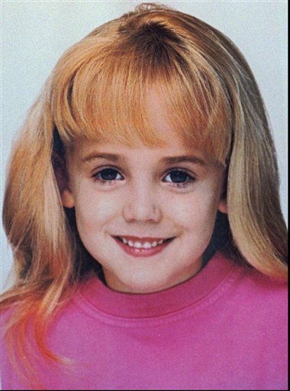
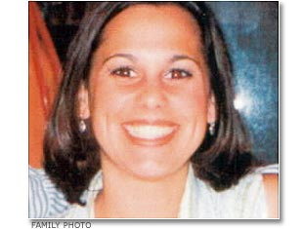
Case Study
Both cases happened during the Christmas holidays with affluent families.
The Success
The Failure
Initial responders did not recognize issues afoot.
Proper investigative measures not taken.
Resources too little too late.
Absolute failure in case management, stakeholders, and media management.
Initial responders recognized issues afoot.
Proper investigative measures taken and followed upon.
Resources dedicated.
Exemplary case, stakeholder, and media management.

Slide 477
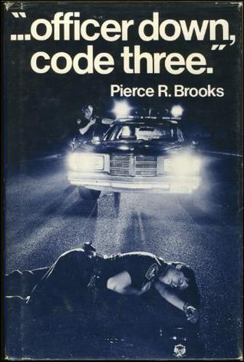
Ten Deadly Errors Pearce Brooks (1975)
Failure to maintain proficiency and care of equipment
Improper searching and handcuffing of a suspect
Tired, not enough rest, or asleep on duty
Relaxing too soon
Missing danger signs
Taking a bad position
Failure to watch a suspect's hands
Tombstone courage
Preoccupation or not paying attention
Apathy, an erosion of disciplined behavior and quality of performance

Slide 478
The Most Common Type of Incompetent Leader Harvard Business Review By: Scott Gregory March 30th 2018
Absentee leaders
People in leadership roles in name only.
They were promoted into management and enjoy the privileges and rewards of a leadership title but avoid partaking in any meaningful leadership opportunities.

Slide 479
The key derailment characteristics of bad managers are well documented and fall into three broad behavioral categories:
Moving away behaviors: which create distance from others through failure to connect beyond what’s absolutely necessary (physically absent)
Moving against behaviors: which overpower and manipulate people while enhancing their position. (emotionally absent)
Moving toward behaviors: which include using flattery, overly conforming, and being reluctant to take chances or stand up for subordinates. (responsibility absent)

Slide 480
Not many of you should become teachers, my brothers and sisters, for you know that we who teach will be judged with greater strictness.
James 3:1

Slide 481
The Burden of Servant-hood

Slide 482
Are you a Servant Leader? Greenleaf, (1977)
Do people believe that you are willing to sacrifice your own self-interest for the good of the group?
Do people believe that you want to hear their ideas and will value them?
Do people believe that you will understand what is happening in their lives and how it affects them?
Do people come to you when the chips are down or when something traumatic has happened in their lives?
Do others believe that you have a strong awareness for what is going on?

Slide 483
Do others follow your requests because they want to as opposed to because they “have to?”
Do others communicate their ideas and vision for the organization when you are around?
Do others have the confidence in your ability to anticipate the future and its consequences?
Do others believe you are preparing the organization to make a positive difference in the world?
Do people believe that you are committed to helping them develop and grow?
Do people feel a strong sense of community in the organization that you lead?

Slide 484
7 Dimensions of Servant Leadership Liden, (2008) and Liden et al. (2015)
Emotional healing or being sensitive to the personal concerns of followers
Demonstrating a conscious, genuine concern for helping the community
Conceptual skills or showing knowledge about the organization and the tasks that are prerequisites for providing help to followers
Empowering followers or encouraging and helping followers to identify and solve problems, as well as to determine when and how to complete work tasks

Slide 485
Helping followers grow and succeed or demonstrating a genuine concern for followers’ career growth and development
Putting subordinates first or using actions and words to make it clear to followers that satisfying their work needs is a priority
Behaving ethically or interacting openly, fairly, and honestly with others
Servant leadership is about treating stakeholders as valued individuals to whom the organization owes a multi-faceted set of moral duties to pursue their welfare, growth, and wholeness Greenleaf, (1977)

Slide 486
Characteristics of Servant Leadership
Calling
Listening
Empathy
Healing
Awareness
Persuasion
Conceptualization
Foresight
Stewardship
Growth
Building Community
“ A society grows great when old people plant trees whose shade they will never sit under”
Greek Proverb

Slide 487
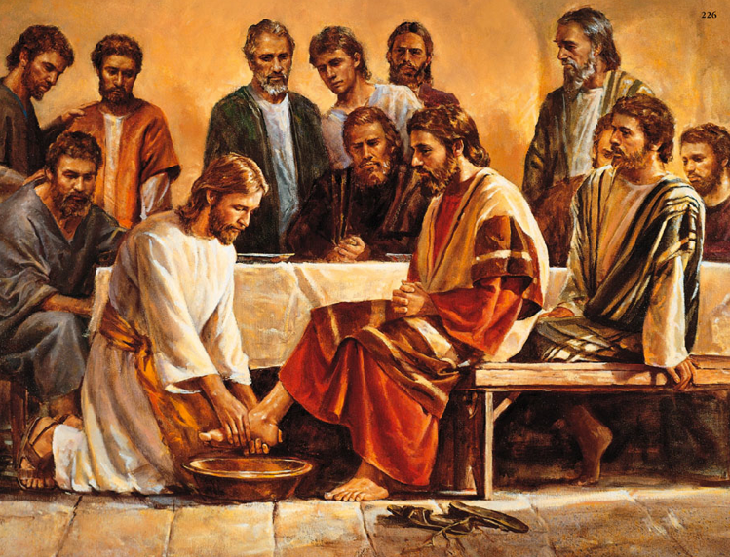
“So if I, Your Lord and Teacher, Have washed your feet, you also ought to wash one Another’s Feet. For I have set you an Example, that you also should do as I have done to you.”
- Jesus Christ John 13, 14-15

Slide 488
Servant Leadership: A systematic review and call for future research The Leadership Quarterly 30, (1), February 2019, Pages 111-132 Eva, Robin, Sendjayac, Dierendonck & Liden
With over 200 studies having been published on servant leadership, we now are able to provide substantial advice for practitioners.
The consistent positive relationships found between servant leadership and valued outcomes (even when controlling dominant forms of leaderships, such as transformational and LMX) at the individual level (e.g., individual citizenship behaviors, task performance, creativity), team level (e.g., team potency, team performance), and organizational level (e.g., customer satisfaction, return on investment)

Slide 489
Servant leaders focus on providing for followers so that they reach their full potential, become empowered to handle tasks and decisions on their own, and who adapt to communal sharing and a culture of serving others
[Paramount is the focus and work toward the subordinates' professional growth and development]
Along with the many benefits of servant leadership, practitioners must be prepared to exert tremendous effort in developing a servant leadership culture, starting with themselves as role-models
However, studies find that it is unlikely that self-centered, dogmatic, narcissistic people can be trained to be other-centered, sensitive, empathetic, socially sensitive servant leaders

Slide 490
Because servant leaders focus on employee well-being they tend to foster significantly: Kaltiainen & Hakanen, (2022)
Higher levels of work engagement
Higher levels of task and adaptive performance
Lower levels and incidents of burnout

Slide 491
Three styles of compassionate leadership: Hougaard & Lama, (2019)
[Action and Efficacy Examples]
The trailblazer: who leads from the front, takes risks, and sets an example
The ferryperson: who accompanies those in his/her care and shapes the ups and downs of the crossing
The shepherd: who sees every one of her/his flock into safety before themselves
Three styles, three approaches, but what they have in common is an all-encompassing concern for the welfare of those they lead.

Slide 492
Servant Leaders Remember the 3 Task of Management in Context By Dr. Peter Drucker
Focus upon the organization and its specific purpose and mission
Make work both suitable and productive for human beings
Taking responsibility for the organization's social impacts

Slide 493
Professional Relationships
Must be based on a reputation of credibility and trust
Must be navigated and negotiated in caring ways
Must be proactive attention and concern for both parties' perspectives
Must be sensitivity and priority in response to what others what and need
Must identify purpose and meaning as it relates to others (Benefits)
Must be as much concern about someone else’s situation as you are about your own situation

Slide 494
Dasborough and Ashkansay 2002
“Suggest that subordinate views of leaders may be influenced by their perception of the leader's intent…(Example given)
Sincere organizational focus versus manipulative self-serving focus
People make inferences from their behavior and the behavior of others

Slide 495
When your people bring you an issue or problem that is very serious to them but not to you or the agency you must show them that their concerns are important.
“Put them before you.”
Your actions and timeliness of the actions will tell the story.
Make your people a priority then they know their value and will work to keep it.

Slide 496
Loyalty is a major component to Servant leadership.
Loyalty to the higher duty
Loyalty to management
Loyalty to your mission
Loyalty to your people
Loyalty to the truth

Slide 497
Leaders who serve remain aware regarding their people’s situation and feelings
Work-place/shift/call issues
Emotional issues afoot
Family issues
Financial issues
Self esteem issues
Performance issues
Important issues to their people
Remember, at times you are protecting the officer from him or herself
Watch and Listen

Slide 498
OFFICER CARETAKING RESPONSIBILITY
Be sensitive and alert to officer fatigue and its nexus to work hours and work times between shifts in conjunction with court, training and other job responsibilities
Consider safety issues (driving), decision making, health, family, job performance, risk and increasing exposure to liability
Monitor (within policy) secondary employment, from hours and times worked to proactive guidance regarding officer’s decisions and actions that may be affected by some conflict between the police agency’s interests, a private employer’s interests, and the officer’s own personal interests. (STAY AHEAD OF PROBLEMS)

Slide 499
LEADER MATERIAL SACRIFICE
(What I have and what I give)
Talking the talk and walking the walk
Example:
If 8 new computers arrive and you have 8 subordinates, they get the computers, not you!
YOUR PEOPLE RANKED FIRST!
LEADER ATTENTION SACRIFICE
(What I do and how I do it)
You demonstrate your subordinate's importance by your attention toward him or her
how you see them, determines how you treat them
When they feel valuable then they act valuable

Slide 500
Personal inconvenience versus leadership opportunity
Put self over good of the group
Failure to look for or demonstrate opportunities to lighten your people’s loads
Reducing uncertainty by planning and projection with call status with proactive quest and forecast of routine availability to manage the future and reduce stress

Slide 501
Time is one of the greatest gifts God bestows upon us. Time is our most valuable resource, asset and investment
A leader's time and energy is a beneficial sacrifice up front
The time and energy are redeemable when the investment is in the development of your people
The leaders time builds relationship and promotes like minded thinking regarding goals and objectives
It is an investment that pays huge dividends

Slide 502
A Servant Leader makes every effort to support and be there (when possible) for their people
Personal Issues
Important life events (the good and bad)
Special occasions
Weddings
Sickness
Funerals
Work Issues
“I will never ask you to do, what I wouldn't do myself”

Slide 503
Man Enough for the Job Retold by Ella Lyman Cabot
Great men do not disdain small duties.
An incident is told of the first American war, about an officer who set his men to fell some trees which were needed to make a bridge. There were not nearly enough men, and work was getting on very slowly. Up rode a commanding-looking man and spoke to the officer in charge, who was urging on his men but doing nothing himself. “You haven’t enough men for the job, have you?”
“No, sir. We need help.”

Slide 504
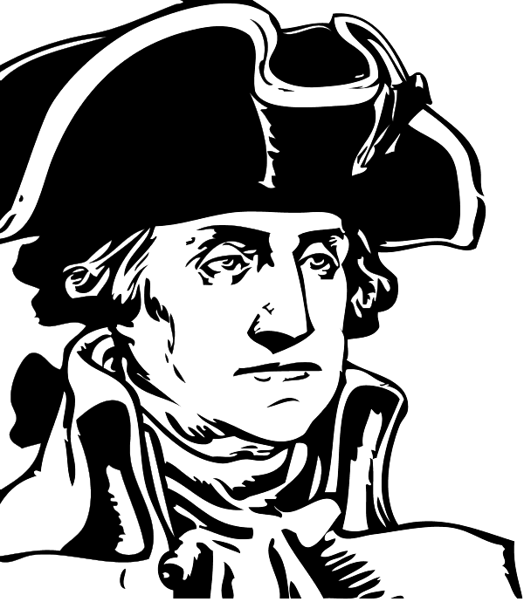
“Why don’t you lend a hand yourself?” asked the man on horseback.
“Me, sir? Why, I am a corporal,” replied the officer, looking rather affronted at the suggestion.
“Ah, true,” quietly replied the officer, and getting off his horse he labored with the men until the job was done. Then he mounted again, and as he rode off he said to the officer, “Corporal, the next time you have a job to put through and too few men to do it you had better send for the Commander-in-Chief, and I will come again.”
It was General Washington.

Slide 505
Field Engagement and Involvement: A Balanced Perspective
Assistance with the labor when needed, provide a break or close the gap to get home
Take care of, and eliminate the mundane things (contextual selection of responsibilities to help)
Leave the important things to your folks. (DO NOT MICROMANAGE)
Seek, inquire and listen. The additional time and energy you provide is appreciated
Insulate with degrees of separation, to remain in a leadership capacity in case of problems (Stay Within the Management Role and Responsibilities)

Slide 506
“TRUST”
Trust is defined as a willingness to be vulnerable to another person or party based on some positive expectations regarding the other party’s intentions and/ or behaviors
Key dimensions are reliability, openness, competence, compassion [R.O.C.C.] and/or benevolence, integrity and competence (Mayer, Davis, & Schoorman, 1995.,Brockner et al., 2004; Mishra & Mishra, 1994; Mishra & Mishra, 2013)
Trust is a ‘multifaceted construct comprising cognitive, affective, behavioral, and ethical components’ (Lewicki & Brinsfield, 2012, p. 37)

Slide 507
Beliefs and mindset toward an individual's identity
Recognition that their identity and work have value
Treating individuals with dignity
Demonstrating respect
Promoting a sense of security
Dr. Donna Hicks
How you treat people is Important
Identity
(value)
Recognition
(awareness)
Dignity
Respect
(behavior)

Slide 508
Diversity and authenticity at work Adapted from Phillips, Dumas & Rothbard, (2018)
Bonding around the work itself is powerful, especially for those who are collaborating across racial [gender] boundaries
We must be intentional about getting out of our comfort zones and connecting with people who are different

Slide 509
Leader Member Exchange (LMX) Theory Graen & Uhl-Bien (1995) How we evolve from stranger, to acquaintance, to maturity… leader characteristics, follower characteristics, and interpersonal relationships
The tendencies of leaders to develop “special” relationships with some team members. This tendency is central to leader-member exchange theory.
The theory basically recognizes that in most, or at least many, leadership situations not everyone is treated the same by the leader. Instead, people fall into “in” groups and “out” groups in relationships with their leaders.
Obviously, the group you are in can have quite a significant influence on your experience with the leader.

Slide 510
[ Key is awareness, fair process and proactive quality interaction in terms of time, content and context of relationships]
http://images.slideplayer.com/15/4848861/slides/slide_13.jpg

Slide 511
The idea behind the Pygmalion effect is that increasing the leader's expectation of the follower's performance will result in better follower performance Mitchell, Terence R.; Daniels, Denise (2003)

Slide 512
Three situations where conflict is most likely to arise: By: David Wilkinson the Oxford Review
Change, This is unsettling to all involved in the process and can cause ructions in an organization.
Conflicting goals and objectives, with different values and priorities
Limited resources, Where bodies within the organization are competing for the same resources, this can lead to problems arising

Slide 513
Fair Process Consist of Three (3) Principles Kim and Mauborgne HBR
Engagement: Involving individuals in decisions by inviting their input and encouraging them to challenge one another's idea’s
Explanation: Clarifying the thinking behind a final decision
Expectation clarity: Stating the new rules for the game, the performance standards, penalty for failure and new responsibilities

Slide 514
Three Dimensions of Organizational Justice Central to Peoples Perspective of Fairness in Organizations Greenberg & Colquitt (2008)
Distributive justice: The concern for fairness in resource distributions, such as pay, rewards, promotions, and the outcome of dispute resolutions.
Procedural justice: People also attend to the fairness of the decision-making procedures that lead to those outcomes, attempting to understand how and why they came about.
Interactional justice: Individuals are also concerned with the nature of the interpersonal treatment received from others, especially key organizational authorities.

Slide 515
The Key is the Leaders Legitimacy
The fair exercise of authority by the leader
At the center is trust:
The perception of fairness or unfairness shapes trust
How fairly does the leader exercise their authority
Treatment is essential to that judgement of trust

Slide 516
Meta-analyses have provided empirical support for the direct and indirect relationship between organizational justice and all three facets of employee performance: task performance, organizational citizenship behavior, and counterproductive work behavior Berry, Ones, & Sackett, (2007); Cohen-Charash & Spector, (2001); Colquitt, Conlon, Wesson, Porter, & Ng, (2001); Colquitt et al., (2013)
Research findings suggest that employees who feel mistreated or wronged by their organization may act in a manner to get even or restore a sense of equitable balance (Ambrose, Seabright, & Schminke, (2002); Mitchell & Ambrose, (2007); Skarlicki & Folger, (1997)
The tenets associated with organizational justice are salient and administrators should focus on fair treatment to minimize detrimental behavior among officers
Tyler et al., (2007); (2015) Wolfe et al., (2018).

Slide 517
Four Essential Components for a Leaders Behaviors to Influence the Subordinate’s Perception of Fair Process Adapted from Tyler, (2011)
1. Being treated by your supervisor with dignity and respect
2. A supervisor who values and provides an opportunity for you to voice your concerns or opinions
3. A supervisor who is transparent, and explains their decision-making process
4. A supervisor that remains neutral, impartial and conveys trustworthy motives

Slide 518
The Key is being treated fairly “ Three Dimensions of Justice” Often, the outcome is not as important as the treatment and process we experience
Context
Treatment
And
Process
Judgement of Outcome
“LEGITIMACY”
Dr. Tom Tyler’s Research at Yale University

Slide 519
Employee Discipline and When They Fall Short at Promotion Time
Optimism, history and how their response, (attitude and things they can do) may shape the future in their favor
Write up, Suspension and Demotion Dynamics: in the context of the attitude of the employee and the perceptions of demeanor and optics observed by managers
Good things may happen from the bad, their attitude and work ethic are the rudder to steer to recovery and success or lead them off a cliff to disaster

Slide 520
Poor Leaders Create Unfair, Insecure and Dysfunctional Environments to Work
Factors:
Autocratic and Capricious
Unempathetic and non-caring
No individual consideration or value
No participation, voice, autonomy or ownership opportunities
No opportunity for growth and development
No purpose, meaning or direction
Do not provide a sense of security

Slide 521
When Officers Experience Legitimacy and Fair Treatment
Officers perform better
Less turnover
Officers experience less stress
Officers have better mental and physical health
When officers experience and understand the concept of fairness, then they treat others they deal with fairer also (less use of force)
Officers become more responsive to the directives of management
Officers become more willing to voluntarily do what is needed for the organization to thrive, including following the rules and cooperating with coworkers to complete tasks

Slide 522
Five complex and dynamic issues in contemporary Policing
Recruitment and Retention Orrick, (2008), Rand, (2010) and PERF, (2019), Andreescu & Vito, (2021).
Following command vision, policy and procedure (Buy-in to change and preventing misconduct)
Donner et al., (2015)
Use of Force Trinkner, et al. (2016)
Uncertainty in a dangerous, dynamic and volatile work environments Wolfe et al. (2017)
Adverse Effects from negative media (de-policing)
Wolfe & Nix, (2016)
They all may have direct and indirect nexus to how officers are treated by their supervisors

Slide 523
Important and Timely Research Nix & Wolfe, (2016), Weisbud, Alpert & Amedloa, (2018), Rodell, Colquitt & Baer, (2017), Wolfe & Piquero, (2016), Wolfe, J. Rojek, Manjarrez, & Rojek, (2018), Reynolds & Hicks, (2015) Andreescu & Vito, (2021).
Studies now accept the existence and relevancy of de-policing [The Ferguson Effect]
Subjective opinions of media negativity on de-policing and negative law enforcement executive influence on de-policing were significantly correlated
This indicates a potential association between media portrayal of law enforcement and executive actions (increased Internal Affairs or enhanced policies)
Leadership is highly influential regarding de-policing

Slide 524
The internal dynamics of a police department shape the way officers relate to their organization and how they approach their job
Recent work has highlighted the importance of fairness in creating a supportive organizational climate within police departments
When supervisors are fair and cultivate confidence among officers, they can minimize the harmful effects of negative publicity
Studies have highlighted the importance of sergeants and upper-level management, particularly how front-line officers view those members in supervisory/leadership positions

Slide 525
Supervisors should be fair, objective, honest, and respectful when dealing with their subordinates in order to communicate that the agency has their back even when it may appear the community does not
Research suggests that organizational justice—that is, respectful and fair treatment of officers by their supervisors—may reduce the impact of officers' hostile media perceptions
Law enforcement officers who believe their supervisors are organizationally fair are more satisfied with their jobs, more confident in their authority, and more likely to use procedural justice.

Slide 526
Organizational justice appears to be more salient to [officers] facing uncertainty because supervisor fairness provides cues that the agency has their best interests in mind and will support them in the future
In policing, then, increasing perceptions of procedural fairness in interactions with supervisors could increase ofﬁcer productivity and decrease the likelihood that an ofﬁcer will engage in behavior such as excessive use of force or disparate treatment of minorities
The proposition is that if an agency takes care of its ofﬁcers, Its Ofﬁcers Will Take Care Of The Community

Slide 527
A major reason for turnover is the perceived quality of supervision
The relationship that immediate and midlevel supervisors with their officers has the most influence on an officer's decision to stay or leave the department Orrick, (2008)
Officers need help to balance their life with career
Perceptions of organizational justice are associated with lower levels of engagement in several forms of police misconduct
Survey of police officers revealed that most officers believed that their supervisors were not biased on gender or race, but biased on who you know, two-thirds said such was the basis for getting a good assignment. Johnson, (2015)

Slide 528
Meta-analysis of current research showed that organizational justice was linked to positive views concerning organizational outcomes, increased trust in the organization, job satisfaction, organizational commitment, and overall opinions of the organization Donner et al., (2015)
Conversely, perceptions of injustice are associated with increased job stress, police misconduct and rebellious or destabilizing activities

Slide 529
Expecting officers to never engage in deviant behavior is not reasonable and when you compare their engagement versus never engaging in the behavior, the authors have found that the most consistent concept is how officers are treated.
However, a case can be made that the large and extra-large organizations have higher levels of organizational defiance, and this is a concern for supervision and the culture of the organization.
Thus, the tenets associated with organizational justice are salient and administrators should focus on fair treatment to minimize detrimental behavior among officers Reynolds & Helfers, (2019)

Slide 530
If officers perceive injustice, regardless whether these perceptions are founded, officers will react in accordance with their perceptions
When employees feel leadership neither cares about their welfare or appreciate their efforts, they are less likely to perceive that their organization supports them
To reduce turnover in police organizations, police administrators should implement and follow policies and procedures to ensure a fair, consistent and just treatment of all employees. Andreescu & Vito, (2021).
Unfair treatment is internalized by officers as feelings of ‘not being supported’ and ‘being expendable’

Slide 531
Occupational stress and attitudes toward misconduct in law enforcement: The moderating role of organizational justice Lawson, Wolfe, Rojek, and Alpert (2021)
Evidence to a growing body of police research on why organizational justice must be a critical component of police managerial practices.
Perceptions of fair supervisory treatment have the potential to protect officers from the harmful effects of occupational stressors.
The need for police chiefs, administrators, and all levels of police supervisors to understand organizational justice and its effect on misconduct.
Implementation of departmental policies and procedures informed by organizational justice can reap a variety of beneficial outcomes.

Slide 532
We found that organizational justice moderated the connection between workload stressor and noble-cause corruption beliefs
While officers who experience more workload stressors have a higher likelihood of endorsing noble-cause corruption beliefs, this relationship is weakened if they believe command staff treats them fairly
Findings also shows the potential harmful effects of organizational injustice
Lawson, Wolfe, Rojek & Alpert, (2022).

Slide 533
Individual Professional Growth and Development of you and your staff through training is Paramount
Provide training opportunities
Ensure training is “Fresh” with current issues
Ensure continuity of information and practice in work unit
Ensure you, their peers and supervisors are “up to speed”
Ensure work unit supervision supports training effort and CULTURALIZES IT
Ensure custom and culture match training

Slide 534
Many organizational failures are a direct result of the lack of competency regarding subject matter by senior management.
Cause: Lack of training/education
Reasons: 1) Senior Managers refuse to
seek training
2) Senior Managers feel they don’t need it.
3) Senior Managers feel they can’t be gone.
4) Senior Management’s boss wouldn’t let them go

Slide 535
Training hurts today
To take people from their duties…“But, the investment you make today, pays tremendous dividends tomorrow.”
“It motivates and prepares your people for the future.”
Training is critical ingredient to the formula to promote the professional growth and development of your people and enhance your agency

Slide 536
Making Yourself Redundant Louis Efron Forbes Magazine, August 29th, 2013
A leader is not doing their followers, boss, or organization any favors by building a team that can’t function without them.
They have a duty of care to teach their followers to fish instead of fishing for them.
At day’s end, the true test of effective leadership manifests itself when a leader is absent.
Start trusting your people to work on their own making it okay to fail and learn from mistakes

Slide 537
Succession Responsibility
The Commander has a tremendous responsibility to ensure that his or her second in charge is ready, willing and able to take over COMPLETELY and SEEMLESSLY in their absence.
Such requires a commander to grow and develop their supervisors to KNOW AND DO THE COMMANDERS JOB WELL…
Commanders must provide:
Information and Resources
Mentorship and Oversight
Opportunity and Meaning
Support and Praise

Slide 538
The 70:20:10 approach in training Kajewski & Madsen, (2012); Jennings, (2013)
Posits that 70 percent of the learning an individual does occurs at work, through projects and day-to-day experiences
20 percent occurs through networks and, in particular, through being coached and mentored by peers and more senior staff
10 percent occurs through formal schooling opportunities outside the office

Slide 539
Some of our Subordinates
Have a poor understanding of policy, procedure and the law from just reading
No life or practical experience in the job that they can fall back on to draw options or alternatives
Lack of intuitive skills sets
Often, Ignorance may be a base line condition
Staleness of practice
Lack of competency and confidence in specific domains
Difficulty understanding contextual features and make false assumptions… (Really important in discretionary thinking)
No filter for objective evaluation (CT Skills)

Slide 540
Training Alone Is Not Enough Contemporary Leaders Must Be Active and On-Going Mentors to Their Subordinates
THE WORD MENTOR CAN BE TRACED BACK TO HOMER'S myth of Odysseus, The king of Ithaca left his son Telemachus in the care of Mentor, who guided and taught the youth for the 10 years his father was away fighting the Trojans, A mentor, therefore, has always been considered one who draws upon a deep knowledge base to teach and guide

Slide 541
The servant leader understands the tremendous need and awesome responsibility to provide a meaningful and ongoing culture of PROACTIVE MENTORSHIP to their managers, supervisors, and subordinates in their work units
Mentorship is critically important to start at the front end
Not just when problems occur!
YOU CANNOT WAIT

Slide 542
A servant commander is a constant and ongoing mentor to their people.
The mentor relationship is based in five components:
Belief in mission and purpose
Competence in the job
Genuine care and commitment to your apprentice
Encouragement and pride in your apprentice's work
Absolute dedication to professional conduct and behavior “You want them to be successful.”

Slide 543
Using Mentoring and Storytelling to Transfer Knowledge in the Workplace Swap, Leonard, Shields & Abrams (2001)
Skills, managerial systems, and norms and values, woven into interdependent systems of knowledge termed core capabilities, are critical to any organization
These types of knowledge, and especially their tacit dimensions, are conveyed through processes of socialization and internalization
Two mechanisms key to those processes are mentoring and storytelling

Slide 544
Seven progressive and continuous efforts
Engage: Vision, purpose and meaning
Establish Expectations: Roles and relationships
Enlighten: Insight and education
Encourage: Motivate and support
Enable: Provide autonomy, opportunity, and practice
Develop: Accountability through evaluations and feedback
Model: Continuous demonstration and ideological conversation of proper work contexts

Slide 545
Four additional strategies to foster employee development and high performance. Roberto, (2021)
Demonstrate fervent belief in employees’ potential to achieve their goals
Make it safe for employees to acknowledge their mistakes and ask for help as they tackle challenging assignments
Give people confidence on tough assignments by sharing stories of adversity and perseverance
Coach employees on the most effective methods for learning new skills required to accomplish a challenging task

Slide 546
Four essential elements of persuasion Harvard Business Review Jay A. Conger
Establish credibility: Grows from expertise and relationship
Framing to find common ground: Illuminate the impact and benefits to everyone
Provide vivid evidence: Stories, illustrations, metaphors, and examples
Connect emotionally: Accurately sense and respond to your audience's emotional state

Slide 547
MENTORSHIP
Mentoring is a tool that organizations can use to nurture and grow their people
Managers must mentor to their people to set vision, train in the proper skills, ensure consequence thinking and shape the “culture” of the work unit.

Slide 548
Mentor People Who Aren’t Like You Harvard Business Review By: Richard Farnell April 17th, 2017
Leaders tend to coach and mentor their “own,” and here’s the human impulse that drives it: Even those who believe that diversity improves creativity, problem solving, and decision making naturally invest in and advocate for the development of the subordinates who are most like them.

Slide 549
Mentoring across social and demographic lines is good for the mentor
It can make you a more empathic and emotionally intelligent leader
Better at spotting potential outside the usual mold
Better at understanding the obstacles people face when they aren’t part of the dominant group
Makes it a little easier for the next person to get leaders’ attention and support.

Slide 550
Mentors are Pathfinders and Navigators Through Agency Policy and Procedure’s Interface with Operational Realities
Through complex systems of bureaucratic requirements
Translate and interpret “intent of and rational behind procedures and policies” to ensure best practice
Outline methods and manners to ensure compliance without impeding performance and achievements
Provide a dual framework, encompassing the subordinate being required to "think through” and the supervisors responsibility to “help them through” the series of actions or complicated tasks that seem unnecessary but are required by the agency
TIME IS OUR MOST VALUABLE ASSET

Slide 551
Personal scenarios, anecdotes, and case examples offer valuable, often unforgettable insight. Mentors who can talk about themselves and their experiences establish a rapport that makes them “learning leaders.”
Proactive prophylactic explanations and advice:
Showing them things to expect
Sharing past mistakes (lessons learned)
Not just knowing policy, but providing real examples where the policy meets operations (articulating policy rationale and Illustrating consequence thinking)
Showing examples of job issues (telling war stories)
Capacity building (modeling, casting vision, and teaching)

Slide 552
O’Leary, Orr & Mike Bennett,(2017). Relational Leadership, Storytelling, and Narratives: Practices of Local Government Chief Executives. Public Administration Review, 77 (4), 515–527
Stories have a capacity to cut across professional or departmental boundaries and engage people with a shared sense of context and purpose
Stories can generate an emotional connection helpful to motivating and influencing staff
Stories can help challenge and reframe the assumptions that underlie particular ways of practicing
Stories lend themselves to talking about the public mission of organizations
Attention to stories and narratives helps us understand leadership influence as collective and collaborative

Slide 553
Mentors
Never ever “walk past poor performance.”
Correct in private in a supportive manner.
Attack conduct only, never the person.
Described how behavior adversely effects mission.
Give examples of correct methods and explain consequences.
Solicits feedback.

Slide 554
Mentorship with legal issues is critical.
The best education was often from the witness stand
Reasons for policy and procedures
3 tiers of police citizen encounters
Seizures, PC, consents, search warrants and force
Constitutional insight and understanding
Reasons behind law (Examples: Brady material and Jackson-Denno hearings)
Courts reasons and intentions
Consequences involved

Slide 555
Mentorship to supervisors and officers for individual and collective safety
Driving
Pursuits (Vehicle and foot)
Tactics (Encounters, arrest, searches and transports)
The best tool they have… (their brain) THINK
Risk versus Reward mindset

Slide 556
The Impact of Marginal Policing
Top 6 Issues officers get themselves in trouble:
Failure to know, understand, train, follow, and enforce policy (Lack of supervision and oversight lead to poor work unit culture)
Making marginal cases: (borderline or fringe cases that lack legitimacy or fairness, out running the prosecution)
Authoritative mindset: “You disrespecting me”
Unlawful stops and detentions: (fishing expeditions, lack of specificity, stereotyping or stopping on a hunch)
Unlawful arrest: (lack of P.C. or P.O.P.)
Unreasonable force: (from the domino effect)

Slide 557
A Systematic Social Observation Study of Police De-Escalation Tactics Police Quarterly 0(0) 1–35 August 2018 Natalie Todak and Lois James
We also found that ofﬁcers varied in their use of de-escalation
Older and more experienced ofﬁcers were signiﬁcantly more likely to employ successful de-escalation, likely indicative of their honed skills from repeated practice on the street
This has promise for de-escalation training programs that can distill this experience and jumpstart the learning process for younger and less experienced ofﬁcers

Slide 558
Mentoring through change
An Organization Does Not Change until the Individuals Involved with It Change
Interventions are the Actions and Events That Are Key to the Success of the Change Process
Leadership Is Essential to Adapting to the Change Process
Facilitating, embracing and sustaining Change Is a Internal “All IN” Collaborative Effort
Central is Understanding, Feelings and Perceptions and Realizations about the Change Process

Slide 559
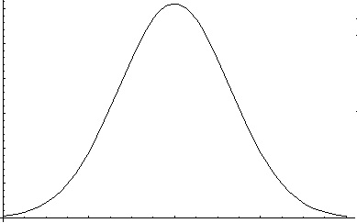
Often, Change, whether good or bad is equally resisted. Change is not an event, it is a process
Restraining Forces
What are the forces resisting change
Driving Forces
What are the forces driving
change
IMPACT/EFFECT
UNCERTAINTY AND STRESS
GROWING
LEARNING
UNDERSTANDING
CHANGE
ADAPTATION

Slide 560
Some Do’s and Don’ts for Mentors
Do’s
Set high standards, role model professional conduct and work ethic
Be clear about your motives. Ensure there understood
“Clear vision, clear expectations”
No mixed messages chances
Look after your protégé’s needs but consider your own as well “remember mission and performance.”
Be prepared to make objectives and evaluations driven by facts not relationship.

Slide 561
Don’ts
Do not lose patience “sometimes the best require process.”
Remember different people have different experiences that shape their perspectives and behavior, Often, we must recondition them
Don’t require your exact footsteps to be followed. Value the protégé’s unique path if your vision and mission accomplished.
Never let relationship defeat frank conversation and objective assessments.

Slide 562
Mentoring to “newly promoted or assigned supervisors From “Saving new supervisors from themselves” Carol A. Walker HBR
You must help them understand the why’s and how's regarding:
Their ability to listen and communicate
Their ability to delegate
Receiving help and support from above
Projecting confidence
Focusing on the big picture
Providing constructive feedback

Slide 563
“A Teacher affects Eternity; He or She can never tell where their influence stops…”
~Henry B. Adams

Slide 564
Develop your officers by building their capacity to do the job, then when their ready… turn them loose and let them work!!!
Train them (formal, informal, FTO, OJT and mentorship)
Provide specificity as to standards and give them clear unambiguous expectations
Observe them at work(Oversight)
Evaluate their readiness level with the task or job required. (Their competence, confidence, and willingness)
Provide Feedback (for their continued professional growth and development)

Slide 565
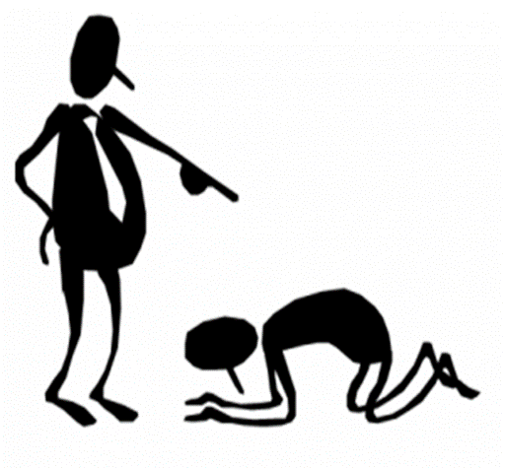
Never micro-manage!
As a servant leader, you tell them and show them. Then let them swing on the trapeze while you act as the safety net.
The manager can be more involved, but they must not do the employees job or hijack their role.
You can pick the hymnal, select the song and verse…
But let them do the singing
“Trust is about Risk”

Slide 566
The most common reasons for not delegating are: Maynard (1996)
Lack of patience
Insecurity (Risk adverse)
Inadequacy (Can’t do the job)
Occupational hobby (doing things rather than ensuring things get done)

Slide 567
Seven (7) deadly sins of delegation Wilson, (2010)
The “do it my way” syndrome
Believing our people are not ready yet
Abdicating, (not giving up the throne) not delegating
Not providing clarity or specificity
Lack of communication to others
Taking it back
Not establishing clear return and report processes
When managers violate certain aspects of the process the entire delegation of authority process will fail (Pollock, 1986; Maynard, 1996; & Wilson, 2010).

Slide 568
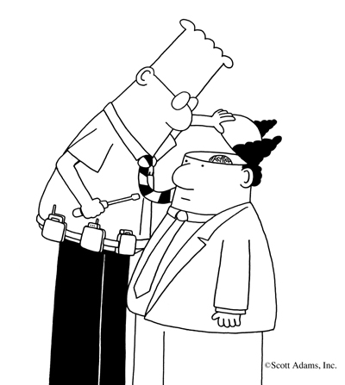
THE MICROMANAGER
Self-centered and absorbed
Manipulative/ controlling
Excessive monitoring or reporting
Excessive demands for approval
Dysfunctional delegation/collaborations
Withhold information (will not share)
Paranoid and insecure

Slide 569
The most common meaning associated with “micromanagement” in the public safety culture is:
To provide supervisory oversight with excessive control and attention to details that are best left to the operational personnel.
Police Chief, IACP, (Gove, 2009)

Slide 570
The micromanager is typically one who is obsessed with control and is overly concerned with all aspects of employee work.
Micromanagers tend to dictate every detail of the work for which their subordinates are responsible, and they truly believe that their way is not only the best but also the only way.

Slide 571
Workplace Consequences from a Micromanager
Subordinates appear frustrated, depressed, and/or unmotivated. Subordinates never take initiative, instead seeking permission from their supervisors before doing anything.
The work unit has higher than normal employee absence, leave request, attrition and turnover
Low work unit creativity, productively and morale
High work unit stress
Subordinates go out of the way to avoid the manager
Management attempts to control the flow of all information in and out of the work unit
Management does not involve subordinates or solicit their opinions and advice about operations
Dysfunctional information flow, dysfunctional delegation, no individual growth or development

Slide 572
Employment professionals have found micromanagement to be one of the top three “misery” factors that lead to employee resignation.
Micromanagement over time is extremely ineffective.
Managers spending inordinate amounts of time on task that should have been delegated.
It causes burnout and leaves little time for managers to build a vision and focus on the future.
Micromanagers very rarely view themselves as such. They refute such claims by citing their management style as “structured or organizational.”
Micromanagers, like many addicts, are the last to recognize they have a problem

Slide 573
Root Causes of Micromanagement (Chambers, 2004)
Fear, confusion, and discomfort of the leader.
A lack of confidence, the potential failure of others, being ignored, the threat of others competence, and loss of recognition.
Lack of patience, emotionally insecurity and increased pressure.

Slide 574
Symptoms of the Micromanager White, (2010)
Often supervise a particular project telling people exactly what to do and how to do it
Are control freaks; they are fundamentally insecure and afraid to trust the performance of those below them
They often frustrated because they would have gone about the task differently than you
They typically go alone to the boss's office, as they do not wish subordinates to gain credit
They become irritated when others make decisions without consulting them
They explode when their bosses by-pass them and go directly to one of their subordinates

Slide 575
They keep track of the number of copies made on the Xerox machine, count paperclips, or scrutinize the number of long-distance phone calls
They are obsessed with meaningless details; they spend an inordinate amount of time overseeing simple tasks.
They frequently call the office while on vacation
They dictate time, often creating deadlines for deadlines sake
They demand overly frequent and unnecessary written status reports
They are so busy that delays happen frequently, while people wait for their input or signoff

Slide 576
Micromanagers stretch themselves too thin and take on too many projects
Their in-box stays full because they move from one to job to another without completing any of them
They are too busy to meet with subordinates and not available to provide guidance
They constantly want to know where all their team members are and what they’re working on
Micromanagers abhor mistakes. Seldom praising, they consider their employees incompetent and soon lose the respect of coworkers and employees
They are quick to blame, and they seldom admit their own mistakes and shortcomings.

Slide 577
Insecure leaders think everything is about them and as a result:
Every action, every piece of information, every decision is put through their filter of self-centeredness.
When someone under their charge performs well, they fear being outshone.
When someone under their charge does poorly, they react in anger because it makes them look bad.
Insecure leaders desire the “status quo” – for everyone but themselves.

Slide 578
Anyone who questions the leaders' facts or ideas is seen as a troublemaker or disloyal
They are inconsistent because they are incompetent and lack the confidence to make sound decisions or take risk
When leaders are insecure, they often project that insecurity down to the people below them

Slide 579
Newly promoted supervisors might have problems adjusting to their new responsibilities and tend to micromanage
The attention to detail, control, and autonomy that was important as an officer before promotion follows into the new position.
The new supervisor fails to see the “big picture” of the responsibility's attendant with promotion.
As such, there can be problems with delegation and teamwork.
Many will return to what is comfortable and familiar, performing tasks themselves to ensure that the work is done properly
It may also stem from their own insecurity

Slide 580
Holding people accountable is not micromanagement.
To make people take responsibility you must hold them accountable.
To communicate clear unambiguous standards and expectations, then ensure people meet those standards and expectations through oversight is NOT micromanagement

Slide 581
There are times when extraordinary circumstances require extraordinary management approaches in conjunction with honest and candid dialogue with the employee
Examples:
High profile or Politically sensitive cases
High risk and/or dangerous activities
Dealing with inexperienced or new employees
Dealing with marginal employees
THE KEY IS UPFRONT COMMUNICATION WITH EMPLOYEES REGARDING THE TASK AT HAND

Slide 582
Micromanagement is when you try to do their jobs.
Good management is when you ensure they do their jobs.
Exemplary management is when you create a culture where they “would die” before they didn’t do their job.

Slide 583
Harvard Business School Rosabeth Moss Kanter
With rising interdependence and unpredictability, the cost of micromanagement are increasing.
We must rely on more and more of our people to make decisions on matters for which a routine response may not exist.
The degree to which the opportunity to use power effectively is granted to or withheld from individuals is one operative difference between those organizations that stagnate and those that innovate.”

Slide 584
Simon Sinek
When authority is kept at the top, it is more likely that factions will emerge and compete for favor rather than work together for the good of the whole.
In contrast, a leader that distributes their authority empowers their people to take responsibility to advance the group’s interests information is shared, mistakes aren’t hidden and innovation thrives.
When our leaders give us the authority to make decisions, we feel inspired to make our own sacrifices to see their vision advanced.

Slide 585
The Contemporary Environment’ Nexus to Leadership and Management McChrystal, S. (2015)
Our environment erupts with too many possibilities to plan for effectively, we must become comfortable sharing power
Increased complexity, disruption and unpredictability requires increased agility and adaptability
Loosening control and empowerment are necessary to promote innovation, initiative, creative thinking, agility and adaptation
“Eyes on, Hands off” leadership philosophy

Slide 586
“When leaders see what’s going on, they naturally want to control what's going on…We must become comfortable at sharing power” McChrystal, (2015)
Empowerment is unnatural and we want to command and control
The velocity and volume of decisions needed exceed the capabilities of the best supervisors
The speed required for initiative often exceeds bureaucratic means
Empowerment provides “ownership” and autonomy that translates into “growth and development” to innovate and adapt to changing and dynamic circumstances

Slide 587
The first step away from micromanagement is for supervisors to admit being micromanagers
Only then can a conscious effort be made to work toward a more inspired management style
Awareness and commitment are crucial to successful change
A rapid transformation is unlikely; committed supervisors are best served by focusing improvement efforts on one or two specific characteristics that are causing the micromanaging tendency and then building momentum from incremental successes.

Slide 588
Supervisors need to maintain an open mind, be flexible in thought, and engage in participative management
Officers are allowed to provide input. In this manner employees are most likely to buy into their supervisors’ management style and feel empowered to make sound decisions themselves
There also needs to be an allowance for and an acceptance of mistakes (to the extent possible in law enforcement work)
Errors will happen, and when they do, an appropriate response is critical [look for understanding the issue and lessons learned rather than blaming]

Slide 589
When delegating responsibility, upfront communication becomes essential
Time should be spent detailing tasks and expectations at the outset rather than saying nothing and critiquing at the end
As with most remedies to micromanaging, communicating at appropriate times and in the proper manner is crucial
Substitute micromanagement with leadership. Be resolute with strategy but flexible with tactics
Create an atmosphere of open communications by encouraging employees to speak up and ensuring that they are heard
Value their opinions and judgment even if you don't agree White, (2010)

Slide 590
Progress reports could be requested at predetermined intervals for more complicated tasks.
Use “SITREPS”
This way, subordinates do not have to guess about when to provide updates
Supervisors do not have to badger employees for information
Regular updates not only allow for better communication; they also allow for early adjustments when problems are found.

Slide 591
Praise is a necessary part of supervisor feedback
Too often, supervisors look to correct behavior rather than to provide praise.
New supervisors are especially prone to this trap.
When an evaluation is given only after mistakes are made, the shadow of micromanagement is cast.
Seeking out praiseworthy actions will change the perspectives of both supervisors and subordinates, each seeing the other in a more positive light.

Slide 592
When I took command of the Benfold, I realized that no one, including me, is capable of making every decision. I would have to train my people to think and make judgments on their own. Empowering defining the parameters in which people are allowed to operate, and then setting them free. But how free was free? What were the limits? I chose my line in the sand. Whenever the consequences of a decision had the potential to kill or injure someone, waste taxpayers money, or damage the ship, I had to be consulted…short of those contingencies, the crew was authorized to make their own decisions. Even if the decision were wrong, I would stand by my crew. Hopefully, they would learn from their mistakes, and the more responsibility they were given, the more they learned.
- Captain Michael Abrashoft

Slide 593
BAD LEADER
GOOD LEADER
VS.
Me first
Move up
Guard information
Take credit
Hog the ball (Star)
Dodge the ball (Blames)
Holds grudges
Manipulate others
Others first
Build up
Share information
Give credit
Pass the ball
Catches the ball (takes blame)
Forgives/forgets
Motivate others

Slide 594
Superior performance promotes motivation among the people.
Being recognized as the best in and of itself benefits everyone’s status and self esteem.
21st century operations often require team approaches
“The servant leader builds outstanding teams”
through premier leadership.

Slide 595
Characteristics of Exemplary Teams McChrystal. S (2015)
Trust
Relationship
Common purpose
Awareness
Systematic understanding
Strong connectivity
Shared consciousness

Slide 596
This class is not about…“I’m okay. You’re okay.” or hold hands and sing “Kum baa yah.”
It does not mean leaders should adopt other’s emotions as their own or try to please everybody; such would be a “nightmare” and make performance impossible
Rather, taking employees’ idea’s, thoughts and feelings into thoughtful consideration and then making intelligence decisions that factor that information into the response
Servant leadership mindset, organizational and process fairness, individual consideration, empathetic perspective, workplace sense of security, job participation and voice are all critical

Slide 597
Your priorities become their priorities when you show them the benefits.
When you become a servant,
they become servants also

Slide 598
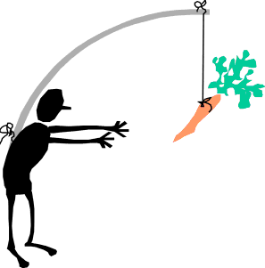
Motivation is a result of a passion to accomplish something in the fashion one desires.
That desire must be fostered, nurtured, and sustained attention and care.
“People must feel special and their work Purposeful”

Slide 599
People find their work meaningful when four factors are in place Bailey, C. & Madden A. (2016) MIT Sloan Management Review
First, they must feel they are contributing to the core purpose of their organization.
Second, people are able to craft their job so that it makes a significant contribution.
Third, their tedious tasks are kept to a minimum
Finally, jobs are seen as less empty when employees see people benefiting from their work.

Slide 600
The Burden of Communication

Slide 601
Communication
Communication can be defined as exchange and sharing of information between two or more parties (individuals or groups) in order to achieve mutual and purposeful understanding
As the need and demand for knowledge continues to rise and intensify, Communication is the focus of organizational behavior and operations
Interpersonal communication should be considered as a strategic issue and should be planned, developed, organized and controlled
Naumovski, et al. (2017)

Slide 602
Why Leadership Matters to Internal Communication
Internal communication is a central process by which employees share information, create relationships, make meaning, and construct organizational culture and values (Berger, 2008)
Immediate supervisors are the information source preferred by employees and thus have more credibility with employees than senior executives
Leadership communication shapes follower perception (Men, 2014)
Leadership is the nucleus of the organization’s internal communication process Mast & Huck, (2008)

Slide 603
Communication is Social Dr. John Stewart University of Washington
Humans are “social animals” that make sense and meaning out of things with others
It is a collaborative process
Collaboration does not mean we always agree
We “co-labor” together to make meanings in response to one another
The process between people uses both verbal and non-verbal (people talk, look and listen in many ways)

Slide 604
Dr. John Stewart, University of Washington “Bridges not walls”
Communication is relational, focusing upon the quality of contact that people create together
Animals live in worlds of objects and things, humans live in worlds of meaning
We construct meaning together
Culture and beliefs figures prominently into the process

Slide 605
Communication Competency arises from 4 basic components Littlejohn and Jabusch, (1982)
Process Understanding: ability to understand the dynamics of the communication event
Interpersonal sensitivity: ability to perceive feelings and meanings
Communication Skills: ability to develop and interpret message strategies in specific situations
Ethical Responsibilities: Concern for well being of all parties and responsibility for outcomes

Slide 606
Being Responsive is tremendously Important
Responsible relationship partners convey understanding, validation and caring
They are sensitive to their partners feelings and want to make them feel comfortable, valued, listened to and understood
These relationships develop through an interpersonal process in which actor's reactions to partners influence partners perceptions of actor's responsiveness
Cable and Reis, (2006)

Slide 607
People who perceive others as responsive become responsive themselves and perceive their partners as more responsive, leading to high quality relationship for both
People not only can create the types of relationships they want-those characterized by high responsiveness, and consequently, higher quality but can also create high quality relationships for others
Canevello & Crocker, (2010)
People who have Interpersonal intelligence have the ability to read, sympathize and understand others
Individuals with interpersonal intelligence are good with people and achieve significant improvement and progress toward social interaction
Naumovski et al. (2017)

Slide 608
Trust, communication, and leadership are the three-legged stool of modern organizations Cummings, (2013)
Communication is the thread that weaves the leader’s fabric to create a blanket (culture) of trust within their organization
Once trust is established, leaders can achieve their goals more effectively and efficiently with the full faith and support of their team
It develops the environment for credible direction and meaningful vision, and creates a culture for a feedback rich environment

Slide 609
How communication affects trust and engagement Zeffane, Tipu & Ryan, (2011)
Perception of effective communication with management has one of the strongest effects on an [agencies] trust climate
When communication channels begin to deteriorate, misunderstandings and misrepresentations abound and a climate of mistrust sets in
Managers' ability to listen, communicate clearly, and lead had the strongest effect on employees’ organizational commitment
To promote and build positive trust relationships, managers must communicate as honestly and directly as possible with their employees, particularly during uncertain times

Slide 610
“Three Keys to Effective Communication” Laurie McCann, University of California, Santa Cruz.
What you say and how you say it
What you hear and how you hear it
What you do with the information
“Seek First to Understand, Then to be Understood”
-- Stephen Covey
“Collaboration is vital, difficult and learnable”
-- Russel M. Linden
Ask instead of telling when you can
You can be polite and respectful in almost every management situation

Slide 611
Being treated with dignity
Being treated with dignity helps a person feel worthy of respect
Feeling respected means, we feel appreciated for who we are and what we do
How we communicate (how we speak to people and what we say) is one of the ways we can extend or withhold dignity and respect from others
Respectful interactions are key to ensuring we uphold the inherent character of human dignity

Slide 612
Tolerance is key
Tolerance does not require us to abandon our convictions or accept viewpoints we disagree with
It does, however, require enough respect for those around us to do more than just “put up with” their presence, which can impart a sense of hostility

Slide 613
Importance of Aggressive Listening and Observing
Listening is not waiting to talk…listening is an important collection point where people pour out their emotions, hints, innuendos, motives, beliefs, opinions and suggestions through words, tone of voice and body language cues
When your good at Listening, you will hear what People didn’t say.

Slide 614
Active Listening Is…
Sensing
Maintain Interest
Control emotions
Do not interrupt
Postpone judgement
Responding
Show interest
Clarify the message
Evaluating
Empathize
Organize information objectively
Content/context

Slide 615
Structured Communication Cycle “Don’t make judgments until you have all the facts.”
Aggressively
Observe Aggressively Listen
Questions and/or articulating statements
in clear unambiguous terms
Thorough processing of context/nuance and understanding information
Evaluate and prepare proper feedback
“form thoughtful questions”

Slide 616
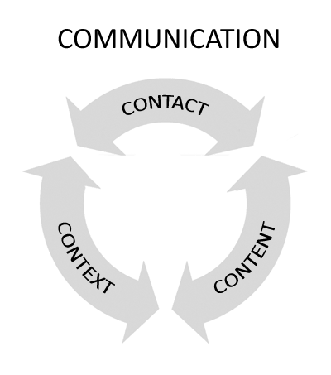
THE MEDIUM
INVOLVED

Slide 617
THE INFLUEANCES AFOOT
The Perceived Understandings of Roles and Responsibilities: Internal and external stakeholders, executives, managers, peers, and subordinates
(The Importance of Proactive Management “Upfront”)
Current Assumptions: What we know at the time
Our Beliefs: Cultural, political, religious values, norms or morals. Subjective standards and analysis.
Field of Experience: Sets of specific experiences or background that are parties in communication bring to bear on the interaction
Communication Context: Environment for the communication interaction

Slide 618
Logos
(Logic and Reason)
Kairos
(Timing)
Pathos
(Emotion and Empathy)
Ethos
(Trustworthiness
and Credibility)

Slide 619
Beware of the Curse of Knowledge Making assumptions about what other people know can cause a lot of confusion Soeiro, (2021), Harford, (2021), Heath & heath, (2006), and Newton (1990)
Once you know something, it can be difficult to take the perspective of someone who doesn’t
This phenomenon, known as the curse of knowledge, can lead to miscommunication, conflict, and professional stumbles
To avoid this pitfall, one should slow down, think about what their audience needs to know, and try to catch themselves making assumptions

Slide 620
Whenever you assume that something is obvious to all parties, you’re likely to leave yourself open to ambiguity.
Slow down your communication, avoid assumptions
Empathize with the person to whom you’re speaking
Ask yourself if they would really know what you're talking about, and if they really are as familiar with the topic as you are
Think about the smaller skills and facts that need to be understood, too, not just the main point

Slide 621
Pittenger, Hockett, & Danehy, 1960
Communication behaviors, whether they involve verbal messages, gestures, or some combination thereof, usually occur in PACKAGES
Usually, verbal and nonverbal behaviors reinforce or support each other
All parts of a message system normally work together to communicate a particular meaning.

Slide 622
Words and Vocabulary
All messages are ambiguous to some degree. Ambiguity is a condition in which a message can be interpreted as having more than one meaning
Words with different meanings or unknown definitions of words can be very problematic
Sometimes ambiguity results when we use words that can be interpreted differently

Slide 623
Nonverbal communication is the transfer and exchange of messages in any and all forms that do not involve words. Matsumoto, D. R., Frank, M. G., & Hwang, H. S. (2013).
One of the major ways by which nonverbal communication occurs is through nonverbal behaviors
These are behaviors that occur during communication that do not include verbal language
One source of messages in nonverbal communication is the environment or context
Another source of nonverbal messages is one’s physical characteristics or appearance
Nonverbal communication also occurs in the dynamic actions of the face, voice, and body

Slide 624
3 Cs of Nonverbal Communication
Context: includes what environment the situation is taking place in, the history between the people, and other factors such as each person's role (for example- an interaction between a boss and employee)
Gestures in clusters prevents us from allowing a singles gesture or movement to be definitive in determining a person's state of mind or emotion
Congruence: refers to the words being spoken matching the tone and the body language

Slide 625
PAY ATTENTION Devote the time and effort to listen carefully and watch closely to be Ready to Probe
Demonstrate respect, interest and attention through your behavior (words and non-verbal projections)
Attentively watch the receiver’s non-verbal reactions
Often, what they don’t say, and their reactions to what is said by you can speak volumes
Sometimes people will provide cues to their attitudes and understanding, or signal their mindsets
Be sensitive and observant before, during, and after communications
Then probe when you sense a need

Slide 626
Communications is a learned behavior Fairhurst, (2011)
Many of us remain unaware of how our language shapes context in our organizations
The traditional communications model is narrow and lacks the complexity and richness
How we co-create meaning together is important
Reality is subjective
Framing builds reality for others

Slide 627
OUR COMMUNICATIONS Reflect on these three questions and ask which question is most like you
Do you frequently lack an edit function where you speak exactly what's on your mind?
Do you always try to say what is appropriate to the
situation, trying to stay within polite social norm?
3. Do you carefully choose your words with a heighten
sensitivity and awareness toward language forms and
usage?

Slide 628
From Barbara J. O’Keefe’s research on Message Design Logic
When communicating, people use one of three design logics to form their messages and interpret those from others:
Expressive
Conventional
Strategic
These design logics can gauge your sensitivity to the framing concept.

Slide 629
Expressive
Least sensitive to the framing concept.
Primary communication goal is to express yourself.
Friends may remark that you lack an
“edit” function; you tend to be blunt and very
literal.
[Often the Expressive reacts instead of responds]
On the positive side, others may find you honest, genuine and trustworthy because you don’t “play games.”

Slide 630
Conventional Most managers fit into this category
Some sensitivity to the framing concept.
Social context influences our thoughts (go along to get along)
Your focus is on what is appropriate given the context.
However, you tend to see the context as “fixed.” (thus your reacting to context)

Slide 631
Strategic
Great sensitivity to the framing concept.
Heightened sensitivity to language selection and delivery (careful wordsmith)
People and situations are not fixed; rather they are created and negotiated through language.
In difficult situations context is redefined
However, you may be perceived as manipulative when self-interests dominate.

Slide 632
Message Design Logics
The Strategic has the capacity to be conventional and expressive
The Conventional does not have the capacity to be expressive
The Expressive, is probably expressive all the time
If your all three, you are probably strategic

Slide 633
The Strategic understands that:
Effective framing is the ability to define the situation in the “here and now” in ways that connect with others
Through framing, we create the realties to which we must then respond (critically important in a V.U.C.A. world context)
It is the ambiguity or uncertainty of the situation here and now that opens up for interpretation – and thus an opportunity to emerge as a leader (or failing to emerge as a leader)

Slide 634
The skill of framing opens the range of what is socially constructed in our world
Three (baseball) umpires disagreed about the task of calling balls and strikes
The first one said, ‘I calls them as they is.’
The second one said, ‘I calls them as I sees them.’
The third and cleverest umpire said, ‘They ain’t nothing’ till I calls them’. ---- Herb Simons (1976)
The label ‘strike’ reifies an action, objectifies a reality, and prompts us to act as if these objectivities are real

Slide 635
By Framing We guide and help to make sense out of things by changing one particular meaning over another
The strategic can see the context from multiple angles
That ability to evaluate those perspectives combined with a heighten sensitivity to and skilled use of language is central to shape things and place more meaning to one thing over another
The way we interpret things helps to shape understanding and influence behavior

Slide 636
Framing Fairhurst & Sarr, (1996), Pondy (1978), Entman (1993), and Weick (1979)
The ability to shape the meaning of a subject, to judge its character and significance
To hold the frame of a subject is to choose one particular meaning over another
When we share our frames with others (the process of framing), we manage meaning because we assert that our interpretations should be taken as real over other possible interpretations
We do not suggest that every subject is suitable for framing

Slide 637
Framing Fairhurst, (2011)
To the extent that uncertainty or ambiguity mark a given subject, what is real and important is often what we say is real and important
Often, we are powerless to control the turbulence of our environments, but can control the context under which the turbulence is seen
Framing shapes meaning of the subject
We manage meaning asserting our interpretation over others
We use language, thought and forethought

Slide 638
Framing Fairhurst (2011)
Leaders that understand their world can explain their world (they can create rich mental models)
When we can see from different perspectives, we have the ability to shape “the here and now”
This ability to see from multiple angles defines our communication strategy then using our mental models we develop our thoughts
We then shape the nature of the realities to which we respond with our words
We are managers of meaning and co-constructors of reality

Slide 639
Three Important Techniques for Framing
Develop your mental models (acumen)
Prime for spontaneity (program your unconscious mind)
Use positive emotional contagion (use high energy non-verbal expressions and credible empathic illustrations that connect with people)

Slide 640
6 rules for the objective framing of issues Fairhurst, (2011)
Remain sensitive to and manage context
Define the situation in the most objective and specific terms
Apply ethics
Interpret and evaluate uncertainty
Design a response from the deconstruction of the facts and evidence guided by a critical thinking process
Control spontaneity in both thought and communication

Slide 641
Do Not Spin OR Bullshit
Questions of right and wrong arise whenever people communicate
Ethical communication is fundamental to responsible…decision making and…enhances human worth and dignity by fostering truthfulness, fairness, responsibility, personal integrity, and respect for self and others

Slide 642
Re-framing
Listen and affirm with empathy
Take an attitude of “help me to understand”
(what led you to this perspective? Try to
undercover the assumptions and data)
Neutralize emotionally charged statements
(absorb, but not reflect emotions)
Shift either or arguments to AND
Patience is a space for reflection and thought
- Tom Friedman

Slide 643
Organizational Communication
Downward
Too many Messages
Upward
Risk fear for Retribution Regarding Feedback
Leader Adverse Emotional Response
Horizontal
Culture that Discourages Networking
Leaders not Encouraging or Providing Time or Opportunity for Networking
Unempathetic Messages
Contradictory Messages
Ambiguous Messages
No opportunity for Feedback
Not Enough Channels or Network Opportunities
No Message, Vision or Direction
No Solicitation or Encouragement for Feedback

Slide 644
Managerial Communications Strategies and Applications Hynes, 2011
One Two Three
Climate Relationship Specific Content
Culture Status Medium
Interest Environment
Emotional state Timing
Subject knowledge
Communication skills
Purpose of message
NOTE: Highly interdependent and affect each other concurrently (each variable is affected by the others)

Slide 645
Five Levels of managerial communication Hynes (2011)
Intrapersonal (Observing, listening and reading, necessary for decision making and problem solving that requires accurate information)
Interpersonal (Two or more people exchange thoughts, sharing information, feedback and maintaining relationship)
Group communication (Meetings that are formal or informal)
Organizational (Operates within networks that link its members)
Intercultural (Interactions between people of diverse cultures)

Slide 646
3 varieties of informal networks Kelley & Caplan, (1993)
Communication Webs (Who talks to whom)
Expertise networks (Based on which people are sought after for advice)
Trust networks (Driven by relationships)

Slide 647
Two main principles from research regarding the role of leaders and the networks they build Wilburn & Campbell, (2012)
The ability to lead is directly affected by the networks a leader builds
A leader's behavior influences the type network structure that develops in organizations, which consequently impacts organizational performance
Network Insularity: Gathering of Liked minded people and similar perspectives from close relationships
Network Diversity: Developing other relationships that promote different more diverse perspectives
Increasing network diversity and fighting off insularity is a challenging task for a leader

Slide 648
“Assumptions”
The least little thing you do or don’t do…
Say or don’t say…
Impacts people’s perceptions and leads to assumptions some true and some totally false.
You must be deliberate to be self-aware and proactively communicate to people to prevent infectious rumors

Slide 649
Rumors = Ambiguity x Interest
Rumors are created when the available message is ambiguous
If all information were available and clear from formal channels no rumors would be created
When the message is ambiguous, but interesting rumors will result
Information via the “grapevine” is 70% to 90% accurate, but always distorted

Slide 650
The chain of command
Law enforcement agencies have formal channels (chain of command)
Identifies the grouping of individuals to be accountable for task accomplishment
Ensures that the grouping of responsible individuals are situationally aware
Facilitates the analysis and evaluation of information (with other information)
Informs decision making
We must ensure we keep people plugged in

Slide 651
A successful and effective open-door policy
Provides guidelines that enable communication between everyone at all levels of the organization.
Provides the expectation that officers will address problems first with their supervisor.
An officer is always welcome to set up a meeting with a senior manager
With a debrief following the officer’s meeting with his direct manager or supervisor.
If outcome is not satisfactory, the senior manager needs to bring the employee and supervisor together to assess the situation

Slide 652
An unstructured unregulated open door policy will…
Cause Problems and Dysfunction
Disrespects your supervisors and managers
Limits you to not having the proper and necessary and specific contextual knowledge and features known by supervisors
You may empower a subordinate officer to circumvent the proper roles and responsibilities necessary for effective operations

Slide 653
The Truth about Hierarchy MIT Sloan Management Review Winter 2018 By: Bret Sanner and J. Stuart Bunderson
When a group has a functional chain of command, disagreements can be more easily resolved so the group can take coordinated action
Key is that higher ups act in ways to support the group, rather than acting in their own best interest
Higher ups must use their advantaged position to encourage members to collaborate, through information sharing, experimentation, and reflection
Individual goals and feedback will keep members focused on their task and outcomes

Slide 654
The Truth about Hierarchy MIT Sloan Management Review Winter 2018 By: Bret Sanner and J. Stuart Bunderson
How can teams benefit from Hierarchy?
Can help the group generate, identify and select new ideas
Create ground rules that enable and encourage group members to speak up
Can promote group learning and performance
“Hierarchy doesn’t need to go away, but the hierarchy of responsibility has to change so that everyone feels like they can speak up if they see something wrong.“
“You need to CREATE A WAY for people to come forward with concerns." (Edmondson, 2019)

Slide 655
Four repeating themes where officers circumvent the chain
Supervisor not available
Supervisors’ inaction or non-responsiveness
Supervisors not doing their job
Confusion about who defers to whom
Questionable behavior included forms of employee harassment, abuses of organizational policies and practices, and unethical behavior.

Slide 656
Factors that inhibit advancement of information
Failure to place the emphasis on and putting the work toward promoting on-going communication
Leader insecurity
Failure to seek and promote value in feedback
Personal censors (due to bias or beliefs)
Piece meal evaluation from marginal information promotes a poor interpretation (failure to see the big picture)
Blind to facts, ignorance or arrogance (Can’t see it)
Fear of retribution from a counter opinion or position (worry of negative image or status)
Closed minded, intolerant environment

Slide 657
When communicating “up and down” the chain of command…
Be sensitive to:
Ego’s…”Do not send messages, when you can personally give them”
Saying the title and rank…”Of subordinates and supervisors”
The terms… “Us or we, rather than me, mine or I”
Breaks in the chain, going up or coming down… “Inform and coordinate about those communications where people are “skipped” do not assume they are or will be briefed”
Never let people be surprised or embarrassed by being left out of the know.

Slide 658
Nine critically important steps to follow in the development of accurate and industrious communication skill sets:
1. Never gossip. 2. Never communicate indirectly or by proxy. 3. Never speak negatively about other supervisors or subordinates in front of other subordinates. 4. Never let relationships motivate or drive initial contact; treat everyone with respect and dignity and follow the proper roles, responsibilities, and jurisdictions. 5. Never put others in awkward, difficult communications positions.

Slide 659
6. Speak and be courteous with everyone encountered. 7. Respect the rank and the title of others in your communications (both verbal and written)
8. Intentionally craft your communications for transparency. There is no such thing as “secret.” (Don’t ever put out what you can’t take coming back) 9. Give constant on-going, or at a minimum weekly or bi-weekly status updates; keep subordinates and supervisors in the loop.

Slide 660
Managers and supervisors in the work unit must speak with one voice.
Subordinates must not be subjected to mixed messages or fears of one supervisor overruling another.
“Subordinates must never have an environment that results in supervisor shopping.”

Slide 661
Never put subordinates in the awkward position of having to tell their peers, what should come from the mouth of the supervisor.
Example: “Tell Joe I said let you handle this one.”
“Find Jill and tell her I said switch call.”
There is a difference between broad vision statements, request and specific directions.

Slide 662
Managers must be aware of how broad brush-nonspecific communications may adversely impact their people
Be broad where the facts dictate to be broad, but never eliminate exceptions for common sense
Deal with the individual, not the group regarding individual performance issues
Do not impact the many over issues with the few

Slide 663
Practice how you communicate and keeping people plugged in, aware and in the loop
Be an active planner of communication
When people are out of the office and return later. (Vacation and leave)
When you attend a meeting or briefing that provides meaningful information to others.
During the course of an incident or event where important information is generated, collected, or disseminated.

Slide 664
Meetings as a means of communication in the work unit “to meet or not to meet…that is the question.”
Meetings impact your people's time
Meetings interrupt work
Meetings are additional work
Meetings may not be the most efficient way in some cases to dispense or gather information
Meetings structured appropriately may encourage valuable feedback
Sometimes meetings are very necessary and important and the best method to communicate

Slide 665
Think Tanks
Select group organized to study a particular subject (such as a specific case, policy issue, or a scientific problem) and provide information, ideas, and advice
Structured evaluation, assessments, and feedback
Premortem versus Postmortem paradigm
An interactive platform for Mosaicking
Devils advocate role
Caution: Beware planting the “Boss” opinion seeds

Slide 666
Nelson Mandela was born the son of a tribal chief. When asked by a journalist how he had become a great leader, he said,
“When I was a boy, I remember going to tribal meetings with my father and I remember that they always sat in a circle and my father was always the last to speak”
Lessons:
Give the same consideration to everyone and treat them with equality (not hierarchical, people feel free to speak)
Ask questions to clarify what others are saying, seek to understand their thinking
Be the last to speak

Slide 667
When to conduct and how to communicate in meetings Prewitt, (1998)
Be clear about the purpose of the meeting: Establish its importance at the outset
Is the meeting necessary: Clarifying what the meeting will accomplish (results orientation)
Prepare for the meeting: Time, place, duration with a narrowly tailored agenda distributed so participants can be prepared and understand the anticipated issues (be sensitive to duration)
Avoid haphazard decision–making: Proactively seek feedback and build consensus
Establish criteria to evaluate proposed solutions: Provide sufficient time for follow-up

Slide 668
Internal and External Stakeholder Management
A direct nexus exist between relationships and communication.
The better the relationship – the better the ability to communicate properly.
Thus - “the benefits of pre-existing relationships.”
Focus on the frequency and the quality of the interaction together

Slide 669
REMEMBER
“The most important thing in communication is hearing what isn't said.” Dr. Peter Drucker
“Prevent and mitigate the environment for assumptions to be made, strive for connection, clarity and comprehension”
John Edwards
“If you leave room in your communications for misunderstanding, you will probably be misunderstood”
Dr. David Walton

Slide 670
Stakeholder Interactions
Be professional:
Demonstrate the appropriate conduct and behavior
Be responsive:
Maintain open and continuous lines of communication
Provide a specific and defined answer
Saying…”I’ll get back with you” is the functional equivalent of saying, “I don’t really care.”
ALWAYS RETURN PHONE CALLS AND E-MAILS
Be kind and courteous:
Make a point to contact stakeholders when you don’t need anything
Do not fall victim to the “if you can’t hurt me or help me test”
Be honest, open and transparent

Slide 671
Effective and meaningful Communications with Stakeholders
Be Aware:
First, the identification of all internal and external stakeholders and why they are stakeholders
Second, objective situational awareness evaluations:
Evaluate and be sensitive to the stakeholders' roles and responsibilities within the context of the situation
Try to walk in the other person’s shoes, empathetic to their interactions, concerns and responsibilities to others
Weigh the issues involved that may affect others, and affect their roles and responsibilities
Third, the nexus and relationships of different stakeholders toward you and each other

Slide 672
Fourth, the content and frequency of engagement, dialogue, and follow up communications with them
Get out and see people, stay in touch and connected to sustain relational influence…BE A RELATIONAL ENGINEER
The evaporation of influence can be far worse than the emergence of problems
Relationships with others are far bigger than one person
(Don’t let ego and hurt feelings cause problems)

Slide 673
Four switches for persuasion Yang, (2018)
Solution Switch: Demonstrate that your solution is the reasonable answer to their problems
Trust Switch: Demonstrate expertise as an authority figure
Likability Switch: Befriend your stakeholder
Evidence Switch: Stakeholders need reasonable proof not promises

Slide 674
Crucial nature of dialogue – needing to listen, to understand different perspectives, value ideas, establish relationships Cunliffe & Eriksen, (2011)
Dialogism means talking with people not to them
Understanding that meaning emerges in specific moments of responsive conversation between people, and that everything that is said is in relationship to ‘others’: other people, other ideas, other conversations
Talking with means all views are shared and considered – cross/back and forth dialogue
Be mindful and create the space for dialogue

Slide 675
Successful, high-powered coalitions do five things: Kanter and Cem Hayirli, (2022)
Exercise moral leadership
Operate at the speed of trust
Find a balance of commitments
Navigate competing coalitions
Focus on solutions

Slide 676
Linden’s (2010) collaborative leadership skills:
Articulate purpose and vision
Articulate the “Common Interest” involved
Feel driven to achieve the goal, with solid but measured ego
Listen carefully to understand others’ perspectives
Look for win-win solutions to meet shared interests
Use pull more than push
Think strategically, connect the project to a larger purpose

Slide 677
The differences in “Push” and “Pull” Most situations require far more pull than push (Linden, 2010)
Push is more about…
Pull is more about…
Talking
Telling, explaining
Meeting my needs
Getting you to do what I want
Listening
Asking, inquiring
Trying to meets all of our needs
Creating conditions in which you and I want the same thing

Slide 678
Look toward ways of working things out toward being able to help stakeholders versus “saying I’m sorry” or “I can’t help you” on its face.
Work toward the difficult YES versus the easy NO, whenever possible
Do not default to can’t without trying to figuring out a possible how
Try to be of service to stakeholders and they will remember it.

Slide 679
Successful leaders constantly “preach” and “cast” vision to leverage their influence
Vision is that state the leaders wishes to be in…the position, status, and condition of organizational culture through individual behaviors
Vision Identifies Your Destination
First, the leader must understand and develop the components of their vision
Second, they must articulate their Vision and communicate the theme early, continuing a consistent theme to solidify its meaning and promote its influence
Third, connect how that vision connects and enhances the organization, employee and the purposeful job performance (story line)

Slide 680
Casting Vision
Words create worlds
With belief we rise to our leaders' expectations
Vision provides expectations and shapes culture
The leaders target is broad, general to specific in nature, preaching to all employees in a very open, redundant, repetitive and public fashion
The leader must role model the responsibility and demonstrate the accountability
Make known in a very serious open, clear and repetitive manner the ZERO-TOLERANCE for specific inappropriate behaviors from anyone at anytime

Slide 681
Focus on Job Purpose and Employee Meaningful Contribution
You must articulate and demonstrate your belief and loyalty to mission and its purpose
Sell that purpose, belief and faith to your people (statements, examples and stories)
Show how they factor into the purpose and are important towards its ends in becoming meaningful
PROMOTES THE SHARED VALUES AND BELIEFS
ALSO factor into the Equation: Know your employees' desires and goals

Slide 682
3 Stages of “Preaching” Vision 1+2+3 = How we do things around here
1) Proactive (The Future)
Modeling and mentorship
Framing strategic objectives
Framing our focus of issues
Preventive, prophylactic, advice, guidance, or council
2) Operational/Situational (The Present)
Tactical issues
Performance expectations
Roles and responsibilities
Active Feedback
3) Oversight and Mentorship (The Past)
Responsibility and Accountability
Opportunities for operational feedback (lessons learned)
Focus on individual professional growth and development

Slide 683
Translate that vision into a clear strategy about what actions to take, and what not to do.
Develops standards and conduct and shapes the “Culture of the workplace”
Sustains the climate of the workplace
Puts people “on Notice”
Prevents, reduces and mitigates problems
Helps people focus and understand the important issues afoot (Emphasizes your expectations, enhances awareness and promotes prioritization)
Promotes “consequence” thinking over reactionary thinking
SERVES AS DEVELOPMENTAL FEEDBACK IN GENERAL TERMS

Slide 684
The Importance and Utility of Vision Ed DeVelasco
If the lower level personnel understand the vision and the values (How we do things) then it becomes accountability at the lowest level.
They do not have to wonder or ask supervisors; they know the expectations and understand the consequences involved

Slide 685
THE BULK OF MANAGERIAL PROBLEMS ARE FROM (Policy, Practice, or Rule Violations) Ronal W. Serpas
Misapplication
Misunderstanding
Miscommunication
OR
Misplaced values and convictions
Deteriorating behavior from professional to personal
Character Corrosion and Erosion
Un-professional, un-ethical or criminal conduct

Slide 686
Two-Thirds of Managers Are Uncomfortable Communicating with Employees By Lou Solomon MARCH 09, 2016
Why don’t leaders have feedback conversations more often?
Because not all leaders are comfortable with the responsibility. The fear of hurting people’s feelings and dealing with potential drama and retribution hold us back.
69% of the managers said that they’re often uncomfortable communicating with employees.
Over a third (37%) of the managers said that they’re uncomfortable having to give direct feedback about their employees’ performance if they think the employee might respond negatively to the feedback.

Slide 687
Jen Cohan Crompton and Jacob Morgan on Subordinate/Manager Dilemma
Managers Need to Encourage Subordinates to Speak up…
They need to clarify their understanding to make sure it aligns with what the manager was thinking
If the employee has any apprehension or question from the beginning, this will only grow if the scope is left without clarification.

Slide 688
Managers need to ensure that they do not forget, be scared or worried about sharing information.
Often, managers only share a small piece of the puzzle, which means that the subordinate never really understands the big picture
This leads to confusion regarding the ultimate goal and the subordinate might not understand how their immediate responsibilities to contribute to the big picture.

Slide 689
A feedback rich environment promotes psychological safety where managers and employees trust and support each other
Where defects and problems are easily surfaced and never hidden
Where new ideas find fertile ground for testing to facilitate improvement
Speaking up was associated with:
More positive responses to growth opportunities and participation in decision making domain questions
Receiving feedback about one's performance
Individuals who received appropriate feedback about their performance were the same ones that find it easier to speak up

Slide 690
Feedback is a powerful and constructive practice that can induce changes in routines through three different means Adapted from: Blakcori & Aroles, (2021)
Making sense: meaningful feedback reenforcing good performance or corrective feedback regarding changes required for a routine with an understanding the roles and responsibilities as well as the purpose
Rationalization. “Acknowledging” the positive or negative aspects of a routine and contextualizing the importance in developing the case for rationalized change
Reviewing: emphasizing performance expectations and outcomes in employees’ evaluations

Slide 691
Nature of Feedback
Feedback is primarily a managerial resource that serves to motivate, direct, and instruct the performance of employees
Feedback must be sincere and specific in nature
Feedback is not only an organizational resource, but as an individual resource as well
Individuals are not merely passive recipients of feedback, but also active seekers Ashford and Cummings, (1983)
Research provides the evidence to support the assertion that people love feedback, only the right sort of (non-judgmental) feedback that helps them grow and supports their identity

Slide 692
Feedback is descriptive information regarding a learner’s performance in a given activity
Feedback is not “what we think of their performance”
Rather, feedback is meant to be ‘descriptive’ or an account of the facts or what actually happened
Effective providers of feedback learn to describe rather than interpret or judge Wilkinson, (2019)
Study after study has shown, an issue of understanding, thinking and learning about feedback and gaining feedback about the practice of feedback. Like most things, it is a learning process. Wilkinson, (2019)
KEY

Slide 693
A few foundation principles for providing feedback Gerald Knesek University of Michigan – Flint
1.) Trust: is a quality of relationship issue. It reflects on your character as a person
2.) Listening: requires an openness to hear the feedback that is being given
3.) Candor: When trust is present in the relationship and there is a real openness to understand what is being said, the ability to speak with greater candor exists
These three foundation principles work in conjunction with each other and cannot be separated in providing effective feedback.

Slide 694
Relationship and Identity Matter
Feedback should be in the context of a “dynamic partnership” between learner and teacher/coach/mentor, based on “listening, trust, and awareness of the other person’s emotional state, context and surroundings to facilitate learning and change”. Bing-You, et al.(2017)
Intercultural and racial differences between the giver and recipient can have a negative effect on the perception that the receiver has of the giver’s motives. Trust and stability of relationship is important
Major, et al (2016). Wang, et al.(2016), Oxford Review Research Report, (2019)

Slide 695
1.) Reinforcing Feedback (PRAISE)
Three (3) types of Feedback Knesek, (2015)
Focuses on sustaining positive behaviors and exceptional results
It looks for opportunities to recognize what a person is doing right
Everyone likes recognition for situations or behaviors that they performed well
Reinforcing Feedback in a feedback-rich environment is finding reasons and taking opportunities on a daily basis to recognize and reinforce positive behaviors and excellent performance

Slide 696
It includes noteworthy effort, rigorous thinking, creativity, and intermediate results.
Reinforcing feedback is the easiest to give, yet we do not give enough of it
It is not that we do not have time to give it, it is more a question of changing our daily behavior to make sure that we give it
Reinforcing feedback not only reinforces current behavior, but also encourages people to want to do better and achieve even better results (Done in Public)

Slide 697
Reinforcing OR Positive Feedback
Provides a sense of encouragement, recognition of a job well done, and self-esteem enhancement
However, receiving feedback only on specific facets of one’s performance may be discouraging without a “big picture” understanding of how well or poorly one is performing (Medvedeff, Gregory and Levy 2008)
I always use reinforcing before and after corrective in the context of a “feedback rich” culture.
Central is the specific content, overall context and authenticity, sincerity and truthful articulation

Slide 698
OGO Study Dave Novak “Recognizing Employees Is The Simplest Way to Improve Morale” Harvard Business Review May 9th, 2016
82% do not feel their supervisors recognize them enough for their contributions
On average 50 days had past since employee felt recognized at workplace
76% save their handwritten “thank you” notes

Slide 699
Steps when communicating positive feedback:
Describe results/conduct in SPECIFIC details
Tell why the conduct/results are important and purposeful
Encourage, empower, praise in public setting

Slide 700
2.) Corrective Feedback
Focuses on specific actions or behaviors that should be taken to correct a given situation or performance issue
It clarifies or provides a better understanding of a given situation or performance issue. It is usually prescriptive in nature focusing on a better way of doing something, yet is given in a way that preserves a person’s dignity
Always done in a private setting in a positive productive manner that promoted mutual respect, trust, and learning
Its focus is to incorporate understanding into the importance to uphold standards and appropriate conduct and performance in a specific situation to sustain agency credibility and employee success within the context of agency function

Slide 701
2.) Corrective Feedback
Focuses on specific actions or behaviors that should be taken to correct a given situation or performance issue
It clarifies or provides a better understanding of a given situation or performance issue. It is usually prescriptive in nature focusing on a better way of doing something, yet is given in a way that preserves a person’s dignity
Always done in a private setting in a positive productive manner that promoted mutual respect, trust, and learning
Its focus is to incorporate understanding into the importance to uphold standards and appropriate conduct and performance in a specific situation to sustain agency credibility and employee success within the context of agency function

Slide 702
The Feedback Sandwich Method
The utility of the sandwich method should be based upon context (the person, issue, and relationship all factor into the equation)
It should be a balanced approach taking into consideration the totality of the particular person, specific conduct/behavior, and strength of the relationship between the supervisor and subordinate
Dr. David Wilkinson, (2022)

Slide 703
3.) Developmental Feedback
Is more collaborative by nature and focuses on exploring opportunities that will help an individual realize their potential
It allows an individual to explore opportunities and develop new skills and competencies
It involves a conversation between a person who sees potential in a person and that person’s willingness to explore a developmental opportunity

Slide 704
Designed to help an individual achieve their potential
These conversations are collaborative and focus on the best interests of the individuals involved
The feedback is viewed as an opportunity, instead of a threat, and the decision is left up to the individual receiving it
It encourages continuous improvement, learning, and individual growth
Developmental feedback is future focused

Slide 705
Future Focused Feedback Gnepp, Klayman, Williamson, & Barlas, (2020)
Feedback that focuses on next steps and future actions, becomes more accepted and promotes more intention by the employee to follow
When feedback is perceived to be highly future focused, feedback recipients respond as well to predominantly negative feedback as to predominantly positive feedback
Performance may be managed most successfully by collaborating with the feedback recipient to generate next steps, to develop opportunities for interesting and worthwhile endeavors, and to enlarge the vision of what the recipient could accomplish

Slide 706
Managerial feedback related to the change process Psychogios, et al. (2018)
The process of change is considered as opening the gate for engagement into feedback
Providing feedback can impact the change process, since it can be seen as enhancing skills, understanding the necessity for change, enriching its scope and reducing resistance
Three key dimensions:
Informal feedback
Benefits-oriented feedback
Confidence-oriented feedback

Slide 707
The Foundation
Taken together, these three categories of feedback used together provide the basic ingredients for a feedback-rich environment.
When feedback is occurring on a regular daily basis between supervisors and employees in the spirit of correction and support
The annual performance appraisal will never come as a surprise because daily feedback ensures that supervisors and employees are in sync and always on the same page
The annual performance appraisal becomes a summary of things that have been talked about throughout the year.

Slide 708
When managers provide daily feedback (versus annual feedback), their employees are: Wigert & Harter, (2017)
6.0 times more likely to strongly agree that they receive meaningful feedback
3.6 times more likely to strongly agree that they are motivated to do outstanding work
3.0 times more likely to be engaged at work
Three key principles that define effective feedback conversations:
Frequent
Focused
Future-oriented

Slide 709
What about when an employee comes to you with a problem or is emotional Best Practice for Conflict Resolution
Aggressively (show non-verbals) Listen
Defer Judgement, evaluate and analyze the situation objectively.
Identify and clarify all the issues. (use open questions/ Socratic method)
How much do you know about the other parties' issue?
How much do they know about your issue?
Establish “basis of knowledge” with assumptions
3) Examine and assess all alternatives.
4) Solve the problems

Slide 710
Managing Conflict [Between the parties] Nour & Eli, (2022)
Encourage a “self-distancing” perspective of a neutral third party who wants the best for all involved (goal is to achieve a more objective, holistic perspective on conflict and, consequently, approach it in a more constructive manner)
Zero-tolerance for incivility and vilifying colleagues for their opinions is unacceptable
Begin an open discussion, offering participants an opportunity to articulate their own perspectives without interruption

Slide 711
Listeners don’t agree or disagree with the speakers’ views but, rather, listen without interrupting
After everybody has had a chance to speak, managers should express gratitude to all who spoke for sharing their perspectives in a respectful way and to all who listened for affording speakers the space to do so
Clarify any organizational information or policy overlooked that might pertain to the discussion
Underscore the classic negotiation wisdom of focusing on all parties’ interests and seeking creative solutions that make everybody better off

Slide 712
How to Work with Someone Who Isn’t a Team Player O'Hara, C. (2017)
Don’t jump to conclusions (or make assumptions regarding the cause or source of their behavior)
Start a dialogue (questions, rather than accusations)
Invite them in (More interactions will promote better relations)
Revisit the team’s mission (Use this opportunity to have a conversation about what the shared vision should be and the best methods for getting there)

Slide 713
Clarify roles and responsibilities (eliminate ambiguity or confusion, and then help clarify duties and responsibilities so that they have a better understanding of what’s expected of them)
Identify new opportunities to motivate (provide more responsibility or an opportunity to grow their skills, help them develop and project a sense of competence, or of mastery)

Slide 714
Passive Aggressive Behavior
Defined as resistance exhibited by such indirect behaviors as procrastination, forgetfulness, and purposeful inefficiency, especially in reaction to demands by authority figures
Passive-aggressive people tend to express their negative feelings harmfully, but indirectly
Instead of dealing with issues, they behave in ways that veil their hostility and mask their discontent

Slide 715
Passive Aggressive Employees
Must deal with the employee
Focus upon the context of the situation that relates to specific work-related issues
Identify the specific behavior and explain how it affects the employee and the mission of the organization (12 step philosophy)
Focus upon creating a relationship that encourages open communication and promotes specific issue feedback
Ensure they understand their roles and responsibilities
Set expectations and consequences

Slide 716
The Feedback plan starts with the Leader
THE BASE
Developing and sustaining the trust, relationship and the competency foundation
Creating and sustaining the feedback rich environment
THE STEPS
How you develop your information in a DISCRIPTIVE manner that is the basis for your feedback
How you describe the SPECIFIC behaviors
How you process and interpret
How you OBJECTIVELY evaluate and judge the issues
Have your ducks in a row…

Slide 717
The Essential Elements of Information EEI’s
Develop your theme and identify your EEI’s as to the specific behavior and conduct involved in the issues.
Theme is the main idea and underlying meaning you want to get across
EEI’s are the content of the theme, specific and accurate points designed to work in concert together to draw a logical conclusion toward the message you are trying to sell
REMEMBER: 1). Specificity in the content for credibility in the context. 2). Be candid, authentic, and kind

Slide 718
12 Steps in Corrective Feedback Adapted from Lizzio, et al. (2003) and Atwater & Waldman, (2013) Moore & Guardia, (2017), Choi, Johnson, Moon, & Oah,(2018), Levine, Roberts & Cohen, (2020)
1) Initial contact and ensure you protect their self-esteem (Give specific examples of something to secure self-esteem, them about and its meaning to the agency, or a positive benefit to them that will develop them) *LMX Huge with Sandwich varible
2) Share the responsibility with the problem (we have a problem)
3) Define the problem issues (Describe the specific observable behavior captured in your EEI’s)
4) Encourage them to talk (Give them voice and let them ask questions)

Slide 719
5) Aggressive non-verbal attention and listening (Clear your mind of other thoughts, filters, and distractions and attempt to understand “Objectively” what is being said)
6) Ask probing “un-accusatory” questions (for specific clarification in issues)
Focus on the behavior (NOT THE PERSON)
Identify, define and agree upon problems (Capture the issues and in specific terms “EEI’s”described how the behavior adversely impacts the organization/employee)

Slide 720
9) Solicit their solutions (Give them an opportunity to outline how to fix things)
10) Have them assist in expectations development (consider their path to common goals)
11) Agree on expectations and outline why they are important to the agency and to them (Lock them into their plan to meet your goals)
12) Assign a follow up meeting (Put the responsibility on THEIR shoulders…NOT YOURS, project positive expectations) end as an optimist

Slide 721
Communication Through Documentation Adams, (2015)
Business writing is about clarity and persuasion
The main technique is keeping things simple. Simple writing is persuasive
Simple means getting rid of extra words
Write short sentences
Avoid putting multiple thoughts in one sentence
Be descriptive and specific
Support conclusions with facts and circumstances
[Proofread for proper grammar, accurate spelling and do not use slang terms or police jargon]

Slide 722
People need to feel they are important and what they say, write, or do is valuable to you/organization…
21st century technologies can undermine this situation…
Take advantage of the utility of the technologies, but depend upon personal contact, evaluation and analysis in a human relational context
STRIVE TO DRIVE YOUR COMMUNICATIONS AS A “RELATIONAL ENGINEER.”

Slide 723
Cell Phones and E-mail Communications
Incoming cell calls should never divert attention from interpersonal scenarios
Put the phone away at the desk or table and be present
E-mails should not be “lighting bolts” or “flaming arrows” with unreasonable suspense times unless they are required or because of their origin are compelled to be.
Don’t rely totally on e-mail in an office. People require personal attention and opportunities to offer feedback.
You can’t see non-verbal behaviors through E-mail
E-mail is great for broad information updates and providing details and facts regarding operations to everyone

Slide 724
The Supervisors Communications Checklist Rabin, (1988)
Do I assume that if an idea is clear to me, it will be clear to the receiver?
Do I make it comfortable for others to tell me what’s really on their mind—or do I encourage them to tell me only what I like to hear?
Do I check my understanding of what another person has told me before I Reply?
Am I tolerant of other people’s feelings, realizing that their feelings, which may be different from mine, affect their communication?
Do I really try to listen from the sender’s point of
view before evaluating the message from my point
of view?

Slide 725
6. Do I make a conscious effort to build feedback possibility into all communication, since even at its best communication is an imperfect process?
7. Have I communicated the “why” of this communication so that the communication makes sense to the receiver?
8. Have I made an effort to relate this information or communication so that the receiver sees how it relates to himself, his job, or his organization?
9. Do I understand that people do not misunderstand because of perversity or contrariness directed to me, but because they are human beings?
10. Do I really understand that the first barrier any communication has to bore through is “Why should I read, or listen to, this communication?

Slide 726
Burden of Management

Slide 727
Three Important Trends Dr. Peter Drucker
Leadership will become increasing more simulative and collaborative rather than directive
The concern will be with the relationship of the leader in their respective organizational environment
Bureaucracies will be profoundly affected by contemporary turbulence and must adapt to become effective
-------------------------------------------------------------------------------
Henry Mintzberg says, “Management is neither a science nor a profession. It's a practice. And the practice fundamentally doesn't change. What changes is the content [and context]* of what you're dealing with.”

Slide 728
The Four I’s of Transformational Leadership Bass and Bernard, (1999)
Individualized consideration (employees should be treated as individuals)
Idealized influence (being a good role model and a leader with strong values)
Inspirational motivation (communicating a positive vision)
Intellectual stimulation (encouraging others to think for themselves)

Slide 729
You Must Manage in a Proactive Fashion and Manner, with a Proactive Mindset
The contemporary public safety’s organization worst enemy is:
Complacency and the lack of Communication

Slide 730
Your People are watching to see
Purpose and meaning with passion for the job and position
Ownership
Competence, confidence, and character
Fairness and adaptability
Performance and accountability

Slide 731
Managing is a relational, reflexive and ethical activity.
It is not just something one does
It is more crucially who one is and how we relate to others -- Cunliffe, A. (2014)
Differences of trait and talent are like blood types: They cut across the superficial variations of race, sex, and age and capture each person’s uniqueness. -- Buckingham, M.(2005)

Slide 732
What do great managers do? Buckingham, M.(2005)
They discover what is unique about each person and then capitalize on it
Average managers play checkers, while great managers play chess
The difference? In checkers, all the pieces are uniform and move in the same way; they are interchangeable
You need to plan and coordinate their movements, certainly, but they all move at the same pace, on parallel paths
In chess, each type of piece moves in a different way, and you can’t play if you don’t know how each piece moves.

Slide 733
More important, you won’t win if you don’t think carefully about how you move the pieces
Great leaders and managers know and value the unique abilities and even the eccentricities of their employees, and they learn how best to integrate them into a coordinated plan of attack.
Leaders succeed when they can cut through differences of race, sex, age, nationality, and personality and, using stories and celebrating heroes, tap into those very few needs we all share.

Slide 734
You must know your people
What are his or her strengths
What are the triggers that activate those strengths
What is her or his learning style [and interest]

Slide 735
Management is a balance depending on the person and the situation
I like this quote from John Wesley
First, do no harm.
Second, do good things.
Third, attend to the
Good Lords Work
-

Slide 736
How employees view their supervisors is the primary determinant of their overall satisfaction Hogan and Kaiser, (2005)
Personality predicts leadership style (who we are determines how we lead)
Leadership style predicts employee attitudes and team functioning
Attitudes and team functioning predict organizational performance.

Slide 737
How leader personality affects organizational performance. Hogan and Kaiser, (2005)
Employee
Attitude
Organizational
Performance
Leader
Personality
Leadership
Style
Team
Functioning

Slide 738
Organizational Effectiveness Hogan and Kaiser, (2005)
The ﬁrst component of organizational effectiveness is talented personnel: Talented personnel are identiﬁed through good selection methods and recruited through good leadership
The second component of organizational effectiveness is motivated personnel: people who are willing to perform to the limits of their ability. The level of motivation in a team or organization is directly related to the performance of management

Slide 739
The third component of organizational effectiveness is a talented management
The fourth component is an effective strategy: This is where many organizations have problems. An effective strategy depends on systematic research and a deep knowledge of industry trends.
The ﬁnal component of organizational effectiveness is a set of monitoring systems that will allow senior leadership to keep track of the talent level of the staff, the motivational level of the staff, the performance of the management group, and the effectiveness of the business strategy
It is the responsibility of the senior leadership in an organization to put these ﬁve components in place.

Slide 740
Execution of responsibilities require a integration and process of coordinated and functioning interactions between:
Strategy (seeing, identifying, developing, planning, mission, goals and objectives)
People (character, competency and confidence)
Operations (proper practice within the context of the environmental and circumstantial reality that achieves the best result)

Slide 741
MANAGEMENT SCIENCE Vol. 18, No. 2, October 1971 MANAGERIAL WORK: ANALYSIS FROM OBSERVATION Ten roles of Managers HENRY MINTZBERG
Three roles-labelled figurehead, liaison, and leader-deal with behavior that is essentially interpersonal in nature.
Three others-nerve center, disseminator, and spokesman-deal with information-processing activities performed by the manager
And the remaining four, entrepreneur, disturbance handler, resource allocator, and negotiator-cover the decision- making activities of the manager.

Slide 742
A REALISTIC MANAGEMENT PERSPECTIVE
Command Staffs and Commanders will often interpret what you “need” with what you “want” differently
Often, Command Staff view the issue from a more global perspective, while Commanders are more specific to their situation (Battlefield vs. Theater)
Only in rare situations will the commander have the benefit of all the resources he or she wants to accomplish the mission
The operational realities of Command require extraordinary leadership up and down and sideways in the organization
More often than not, commanders are expected to do more with less.” (This is a reality everywhere in our craft) Learn to do the absolute very best you can with what you’ve got.”

Slide 743
Two leadership Orientations Ohio State Studies 50’s
Worker-centered leadership: a socioemotional orientation…
Concern for morale and relationships among members.
Expresses consideration for followers’ feelings, opinions and ideas, and tries to maintain an amiable working environment.
Nurtures genial relationships between workers.
Fosters the growth of trust between the leader and the followers.

Slide 744
Task-centered leadership: Organizing work relationships and clearly defining the leader’s and subordinates’ roles. The emphasis is upon establishing good communication and effective ways of completing tasks:
Having subordinates following rules and procedures
Created structure in any task-related behaviors involved in the initiation of action
The organization and assignment of duties, and the determination of clear-cut standards of performance.

Slide 745
Three major types of leadership theory
Transactional leadership depends on the administration of rewards by a leader to influence a follower
Transformational leadership entails inspiration, and the transformation of a follower’s motivational state
Contingency or situational leadership deal with the notion that different circumstances call for different types of leadership
Effective leadership requires both transactional power and transformational influence

Slide 746
The applications exist on a continuum
https://3x5leadership.com/2017/09/18/which-leadership-is-most-effective-analyzing-transformational-servant-leadership/

Slide 747
Leadership: Theory and Practice, 7th edition, Sage publishing, Peter G. Northhouse (2016)

Slide 748
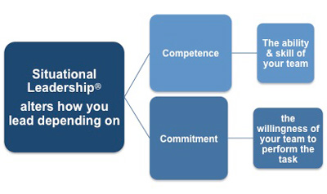
Situational Leadership Model
http://www.free-management-ebooks.com/faqld/leadership-06.htm

Slide 749
Transactional
Transactional leadership involves exchanges between leaders and followers designed to provide benefits to both
Leaders influence followers through contingent rewards and negative feedback or corrective coaching

Slide 750
Transactional Focus
Transactional leadership, also known as managerial leadership, tends to focus on supervision, organization and the leader driving performance
This a style of leadership that usually promotes compliance through both rewards and punishments

Slide 751
The Transactional Leader
One who rewards or disciplines based upon the subordinate’s performance. The transactional leader places emphasis upon direction and task results, work requirements and standards, and subordinate compliance and performance.
Transactional leaders believe in rewards and punishments as a means to influence subordinate’s conduct, behavior, and performance within the job.
Management by exception is often used

Slide 752
Management by exception Falls into 3 categories with 2 types Autocratic (Directive), maintaining the status quo and overregulation
Active
Passive
Leader watches and follows closely, then makes corrective actions for
Mistakes
Errors
Job Performance
Leader intervenes only after standards have not been met or problems arisen

Slide 753
Transformational
Employ idealized influence, inspirational motivation, intellectual stimulation, and individualized consideration
The transformational leader exhibits each of these four components to varying degrees in order to bring about desired organizational outcomes through their followers
Transformational leaders share a vision, inspire followers, mentor, coach, respect individuals, foster creativity, and act with integrity

Slide 754
Transformational Focus
Transformational leadership is where a leader works with people across the organization and with external stakeholders to help identify what change is needed, creating a vision to guide change and creating commitment to the organization, its values and any changes needed
It is more of a facilitative style of leadership that aims to build trust, involvement and commitment to the aims of the organization.

Slide 755
Transformational Leadership Bass, Avolio, and Colleagues
Idealized influence, refers both to the characteristics that followers attribute to the leader, as well as behavior the leader engages in related to being a role model and doing the right thing. A leader with strong values
Inspirational motivation, relates to broadly communicating a positive vision and holding high expectations
Intellectual stimulation, involves being open to new ways of accomplishing tasks and encouraging others to be creative in their thinking.
Individual consideration, focuses on a leader who treats employees as individuals, spends time coaching and developing their skills, cares, and is compassionate.

Slide 756
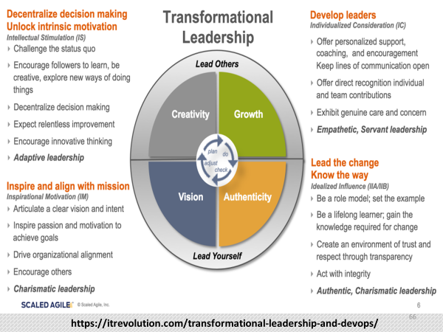

Slide 757
Contingent
Reward
Transactional
Behaviors
Expected Effort and Expected Performance
Passive or Active
Management by
Exception
Idealized Influence
Increased Motivation , Effort, and Performance
Beyond Expectations
Transformational
Behaviors
Inspirational
Motivation
Intellectual
Stimulation
Individual
Consideration
Adapted from Dugan, (2017)

Slide 758
How transformational and transactional leadership affects organizational learning Zhen Shao, Yuqiang Feng, Qing Hu, (2017)
Transactional leadership tend to promote transactional learning or learning to do what the leadership or management wants rather than learning what the organization needs to move forward and adapt to external changes
Transformational leadership however tends to develop a more change orientated learning approach where people are significantly more likely to engage in experimentation and change and performance orientated learning

Slide 759
The Relationship Spectrum
Transactional
Transformational
One party decides
One party provides resource
Inflexible expectations or contract decided at the beginning
Limited interest or buy-in by followers
Transparency not necessary
Risk and reward individually mitigated
Relationship must fulfill obligation/equity not needed
Participative decision
Followers bring a range of resources and competencies
On-going discussions and adaptation to changing events
Purpose and buy-in by followers
Transparency is essential
Risk and reward shared
Equity is core to vision

Slide 760
Perspective on Safety and Compliance
Transformational
Transactional
Promotes autonomy
Promotes fluid change
Difficult to establish routine
Hard to maintain the status quo
Inspires employees to “go the extra mile”
Does not promote autonomy
Difficult at adapting to change
Better at creating or maintaining routine
Preserving the status quo
Worse at inspiring creativity

Slide 761
Policing, Volume. 8 No. 1, Jan. 2014 Police Culture and Transformational Leadership: Outlining the Contours of a Troubled Relationship by: Tom Cockcroft
Must consider the complexities of the cultural terrain of police organizations
The operational context of much of police work can be considered largely “transactional” as opposed to “transformational”
The issues with lower level police discretion
The fundamental differences in the role and values between the private and public sector

Slide 762
Policing, Volume.8 No. 1, Jan. 2014 Police Culture and Transformational Leadership: Outlining the Contours of a Troubled Relationship By: Tom Cockcroft
Models that synthesize transformational and transactional styles might be a way of overcoming criticisms founded upon both the simplicity of two-fold classifications and the need for clarification of the relationship between the two models
Policing covers a wide range of roles within an increasingly complex organizational environment
It is unlikely that one form of leadership will be appropriate for every set of organizational relationships

Slide 763
A general strategy of how a leader can best develop his or her own personal theory of leadership which best works for their unique circumstances Sims, Faraj and Yun, (2009)
Defining goals for a specific situation
Defining potential leadership types
Identifying situational conditions
Matching a leadership style to the particular situation
Determining how the match between leadership style and situation will be made

Slide 764
In Summary
Transformational leaders explore new forms of learning and highlight unstable environments
Transactional leaders strengthen and improve an existing practices and are excellent in stable environments.

Slide 765
When to step in
When to step back
TRANSACTIONAL
TRANSFORMATIONAL
www.google.com/search?tbm=isch&source=hp&biw=1280&bih=588&ei=BkKQWv2sFMngjwS_vpaICw&q=Balance&oq=Balance&gs_l=img.3..0l1

Slide 766
Situational
Situational leadership emphasized leadership behaviors along a continuum between task-orientation in relation-orientation
Situational leadership also emphasized the level of maturity, or readiness of the followers as a contingency or context that leaders need to account for in order to establish the correct fit between the leader and follower

Slide 767
Hersey-Blanchard Situational Leadership Theory
The theory states that instead of using just one style, successful leaders should change their leadership styles based on the maturity or development stages of the people they're leading (Their readiness) and the details of the task.
Using this theory, leaders should be able to place more or less emphasis on the task, and more or less emphasis on the relationships with the people they're leading, depending on what's needed to get the job done successfully.

Slide 768
Under situational leadership, the leader's function is to determine the level of a follower's task and psychological maturity
Once the leader determines a follower's overall level of maturity, readiness or developmental stage, the leader should adjust their behavior in a way that most effectively manages the follower's behavior in light of the follower's maturity
More mature employees require less direction and support
While employees with less maturity require more direction and support

Slide 769
Leadership Styles Hersey and Blanchard
Directing (S1) – The leader provides specific direction, explains processes and decisions and closely monitors task accomplishment
Coaching (S2) – Continues to direct and closely monitor, solicits understanding, suggestions and supports individual processes
Supporting (S3) – Facilitates and supports, shares decision making responsibility
Delegating (S4) – Leaders pass responsibility and authority to make decisions onto the follower or group. Leader provides oversight

Slide 770
Follower Maturity or Development Levels
For Hersey and Blanchard the key issue in making these adjustments:
Is follower maturity, as indicated by their readiness to perform in a given situation.
Development or Readiness, in this sense, is largely based on two major factors – follower ability and follower confidence and commitment.

Slide 771
Maturity or Development Levels
D1 – People at this level of maturity are at the bottom level of the scale. They lack the knowledge, skills, or confidence to work on their own, and they often need to be monitored or pushed to take the task on.
D2 – at this level, followers might be willing to work on the task, but they still don't have the skills to complete it successfully.
D3 – Here, followers are ready and willing to help with the task. They have more skills than the D2 group, but they're still lack confidence or motivation in their abilities.
D4 – These followers are able to work on their own. They have high confidence and strong skills, and they're committed to the task.

Slide 772
Golf Club Analogy (Daniel Goleman)
“Leadership styles should be like the various clubs in a golf bag…you select the right club for the right shot.”
Define the specific situational elements within a particular environment, and develop guidelines of how leadership can be optimized within that environment…
Whether you should directive or empowering, “Really does depend” (Sims, Faraj and Yun 2009)

Slide 773
The Research
The transformational, authentic and servant leadership styles are positively correlated with team motivation
Whereas transactional leadership style is found to be negatively correlated
These theories define the importance of dove tailing the burdens of self-awareness, competence, servant-hood and communication into the burden of management to ensure you understand and apply the styles required based on the person and task
Transformational (Most preferred when appropriate)
Transactional (When required and necessary) OR A combination of both within the context of the situation and circumstances afoot.

Slide 774
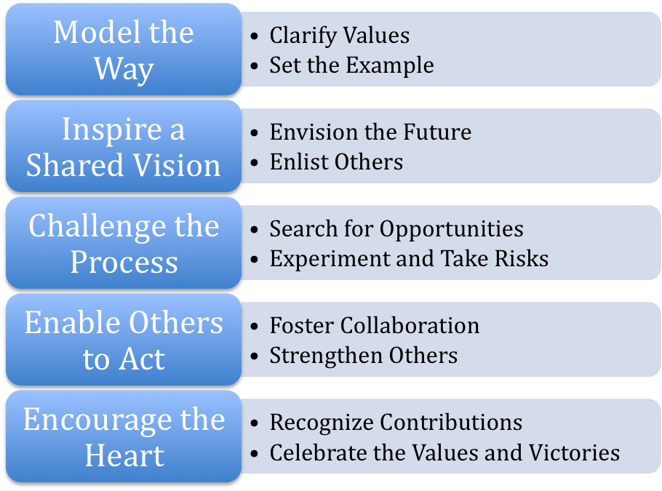
Kouzes & Posner, (2017)

Slide 775
Managing People (Key is Delegation)
FIRST ENSURE THEY HAVE THE CAPACITY
Delegate the entire task
Set clear goals and expectations
Provide context, resources, and support
Delegate responsibility and authority
Provide oversight and mentorship
Evaluate, provide feedback (Praise and developmental) and recognize performance
Ensure accountability

Slide 776
The Right Way to Hold People Accountable By: Peter Bregman Harvard Business Review JANUARY 11, 2016
Provide Clear unambiguous Expectations
Ensure they have the Capabilities to accomplish the task
Ensure Objective and Accurate Evaluations on progress
Provide “specific” and “clear” Feedback
Clear consequences
These five work together as a system to ensure the ability to hold people accountable

Slide 777
Delegation is Necessary for the Professional growth and development of your people
Fosters self-esteem
Promotes decision making
Builds confidence
Develops critical thinking skills
Creates autonomy
Promotes responsibility and performance through “Ownership”

Slide 778
The Importance of Ownership Wheatley, (2006)
People support what they create
Ownership describes personal commitment to the organization
Emotional investment of employees in their work inspire them to contribute
The best way to create psychological ownership is to have those responsible for implementation to develop the plan for themselves
The participation process makes the plans come alive as a personal reality

Slide 779
The Incorporation of Discretionary Thinking into Delegation
Operating within the proper context
Articulating the specificity of the facts known at the time
Domain experience
Requires consequence thinking
Knowing when to call for advise

Slide 780
When you delegate to a supervisor… “DELEGATE”
Trust your supervisor
Delegate responsibility and authority, not just the task
Provide context and how such relates to other work being performed by the work unit and how such affects the agencies mission… Remind them of the common goal toward their “Professional Growth and Development.”

Slide 781
Provide clear expectations that are both motivating and realistic
Communicate any special concerns or contingency plans
Provide a means for your contact (if they need you) and additional resources if needed
Do not bother or call them back and check with them…let them run things, LEAVE THEM ALONE AND LET THEM WORK
De-brief and evaluate when you return
Provide feedback (Ensure you start with praise) then developmental feedback

Slide 782
The leaders responsibility to “Pilot” the navigation through, sometime obstructionist bureaucracies
Prevent those with least knowledge of the situation to impede or delay, when time and initiative are critical
Maneuver through rules, policy and directives in a proper manner
Make contacts up the chain for them and in their behalf to make things more efficient and effective in the agency processes, systems and functions.

Slide 783
The nexus between relationships and decision-making regarding subordinates in your daily operations, assignments and selections
Perception trumps reality
Loyalty is a great virtue and positive relationships are the driver for great achievement but, sometimes a different view and opposite opinion are very healthy and beneficial
Objective evaluation, standards and criterion are your friend

Slide 784
Moreover, Your Agency Depends on Your Objective Judgement
The credibility gained and reputation built by selecting the most qualified versus the most comfortable is a huge organizational motivator.
It is easier to produce and invest the work and effort to handle issues at the front end than to try to fix them at the rear end
It is far quicker and easier to appoint or promote an individual to a position than to go through the long process to move them out

Slide 785
Moreover, the damage they inflict while they were there and during the removal process may be devastating to your people, the agency and you.
BOTTOM LINE
Your best officer may be your best because of similarity, liking or job performance, BUT…they may lack the necessary leadership competencies to manage other people.

Slide 786
IN MANAGEMENT Always be mindful of and sensitive to
The bell - any warning bells sounding
The book - laws, regulations, policies, and ethics
The candle - transparency “exposure to the light, public scrutiny”
TRANSPARENCY IS ESSENTIAL IN OUR CRAFT
Can you defend, will you feel good about, and will you continue to feel justified?
AJC TEST

Slide 787
Four reoccurring themes in contemporary leadership and management Admiral Michael Mullen USN Retired (Former Chairmen Joint Chiefs of Staff)
People
Change
Failure
Accountability
“The real challenge in contemporary leadership is an accurate knowledge and understanding of what is going on around you.”

Slide 788
Top 10 high liability areas Daigle Law Group
Use of force and force-related weapons
Pursuit and emergency vehicle operations
Accepting citizens complaints
Response to the mentally ill
Sexual and workplace harassment
Care and custody of detainees
Tactical operations deployment
Response to domestic violence
Evidence and property control
Off-duty and secondary employment

Slide 789
Accountability Factors Standards, supervision and discipline
The rule of law
Human/civil rights
Public service mindset
Professional practice
Transparency: Policies, strategies, decision-making, resources and performance are open to public scrutiny and oversight

Slide 790
Management and leadership begin with standards.
Structured management practices refer to an organization having a set of consistent policies and operational actions in order to manage the organization and employees:
Reasonable Span of Control
Rules of conduct
Objective Measures of performance
Criterion
Professional behavior
Expected results

Slide 791
Vision We Influence
Define higher duty (purpose)
Expectations
Zero tolerance issues
Mentorship
Coaching
Empowerment
L
E
A
D
E
R
Trust
Ownership
Responsibility
Accountability
M
A
N
A
G
E
R
Standards We Measure
Policy & Procedures
Structures, functions and processes
Conduct and behavior
Oversight
Performance
Resources applied
Goals and objectives
Efficiency and effectiveness
Results

Slide 792
Four main sources for management failure
Not being prepared: mediocracy, turning a blind eye, not dealing with it or not seeing it…Failure to sustain a “proactive” mindset.
Arrogance: close-mindedness resulting from ignorance, stupidity or ego that promotes a subjective versus objective assessment and evaluation
Deliberate indifference: the conscious or reckless disregard of the consequences of one's acts or omissions.
Bad unit culture: disregard for policy, procedure, training, poor supervision and oversight

Slide 793
Four main themes of failing Managers
Problems with interpersonal relationships (being insensitive, arrogant, cold, aloof, overly ambitious);
Failure to meet business objectives (betraying trust, not following through, overly ambitious, `poor performance’)
Inability to build a team (poor staffing, unable to build a team)
Inability to adapt to a transition (not strategic, conflict with upper management)

Slide 794
In the majority of adverse issues: “It happened because it could”
In General: Poor organizational culture over good
In Specific:
Incompetency over competency in the domain
Ignorance over awareness
Castle and Mote Mindset (Ego in my little world)
Disengagement over engagement
Avoidance over collaboration
No controls over the establishment of internal controls and divisions of responsibilities
Reactive instead of Proactive

Slide 795
Personnel Perfect Storms That Supervision Must Prevent
Attitude (“that ain’t my job” mindset)
Carelessness (dedication to other things other than their job)
Shortcutting or negligence (from not doing at all to not doing right…assumptions to poor fact finding)
Apathy or Indifference (lack of care, concern or interest)
Cynicism (skepticism, suspicion, distrust in people)
Personnel Mutinies (from micro-managers and/or closed employee feedback and poor morale)
Not holding people accountable and lack of transparency
Poor oversight/ no or poor documentation
Illegal, unethical or unprofessional conduct

Slide 796
In order for a manager to expect they must inspect.
“You must keep up on your business.”
Know about peoples conduct and behavior as it relates to issues, events, incidents and potential problems.
BE A PROACTIVE MANAGER
Stay ahead of problems

Slide 797
Red Tape: Its Origins, Uses, and Abuses. (Kaufman,1977)
“one person’s ‘red tape’ may be another’s treasured safeguard”
We as citizens are largely to blame for red tape because of the demands that we generate on government and by the accompanying need to ensure accountability
Red tape is often the inevitable price that we pay to ensure fairness and equity in the treatment of citizens
We should cut red tape wherever possible, trying to cut too much red tape is likely to lead to arbitrary and capricious behavior on the part of government and to abuse of the public trust

Slide 798
Critical Management of Administrative Oversight
Digital reviews
Operational realities of body cameras and officers in the field
Policy and training
File reviews of reports and case files
Search and seizure actions
Procedures, fact-finding, conclusions, evidence, leads etc.
Chain of custody (evidence practices)
Statements and admissions
Professional documentation
Open records post closure
CI Files
Administrative reports
Maintenance, equipment, purchasing, OT, petty cash etc.
Evidence / property rooms

Slide 799
Oversight Continued
Monitor and regularly audit compliance for policy, procedure, practice and ethical conduct
Search warrant affidavits
Raid plans/operation plans
Videos from Body cams, traffic stops to investigatory acts (consents to interviews)
Title 3 issues
Ensure consistent enforcement and discipline of violations
Respond appropriately to incidents and take steps to prevent future incidents
Promote and ensure full transparency

Slide 800
Professional Excellence: An Earned Honor Chief Lou Dekmar President IACP July 2018
The challenges we face as leaders of law enforcement organizations require us to balance varying pressures, while maintaining the support of our personnel and trust of the community
Because of the difficulty in maintaining the public confidence, we understand the concerns that accompany the identification of shortcomings; however, those issues are just waiting to be exposed
We should surface those issues and resolve them under manageable circumstances before they have resulted in bad outcomes

Slide 801
Maintaining Skepticism in Oversight Its not about trust, is about maintaining the best practice
Exercise an appropriate level of skepticism when considering the risk
Skepticism is an attitude that acknowledges the risk of management not doing their jobs (unintendedly or intentional)
Skepticism requires awareness to potential risk factors and a fortitude to ask specific and difficult questions and perform inspections

Slide 802
It also requires a culture that encourages open and candid discussions among the leader and staff with enough time to think and consider “the what ifs” scenarios related to the risk of management failures in internal control
Set aside any beliefs about the integrity of management because many failures are often committed by “good managers gone bad,” or “making mistakes” rather than consistently dishonest people

Slide 803
Managers must communicate their expectations and over all mission through “preaching” vision to their people.
A key component in the vision outline is a zero tolerance for improper and/or poor conduct and/or behavior.
YOU MUST HOLD PEOPLE ACCOUNTABLE
Such shapes and molds the “Culture of the workplace”

Slide 804
Recent Studies MIT Sloan Taylor & Locklear, (2022)
Found that incivility is rooted in dysfunctional employee relationships, not just personal characteristics, and that organizational norms make a difference
What managers must do:
Develop strong shared expectations for how people should behave [provide descriptive norms and define what bad behavior is and your red line standards not to tolerate it]
Provide targeted training [incivility ultimately stems from relationship problems (lack of listening etc.) poor leadership skills]
Encourage gratitude and appreciation [role model appreciation by expressing it at work]

Slide 805
The “culture” of the work unit defines everything:
Professional Practice
Professional Performance
Professional Behavior
Professional Results
Professional Image
Professional Reputation

Slide 806
Work ethic is a central component of work unit culture.
Managers must require their people to work effectively and efficiently.
No Shortcutting or half tailed work
People will reflect their leadership.
Insure people do their jobs
The “boss” sets the pace.

Slide 807
Unprofessional behaviors and corruption begin small and evolve
Are analogous to erosion
Corrosive processes are subtle and overtime eat away at structure
Grow and fester
The longer left unchecked the more difficult to repair
Become dominate
Will destroy and devastate

Slide 808
Spotlight on Police Culture, Seeing the Red Flags of Organizational Cultures Gone Wrong Public Management Magazine 2016 Mary Eleanor Wickersham
Fear of reporting wrongdoing due to lack of trust
Failure to adequately address ethical violations
Too much rigidity and too little humanity
Lack of training
Organizations in which the end justifies the means
Absence of leadership focus and insistence on ethical behaviors
When the workforce does not mirror the citizenry
“Us versus them” mentality
Negative outward symbols of the organizational culture

Slide 809
Task-related rule-breaking behavior. Officers breaking laws or formal internal rules in support of performing their lawful task Van Halderen & Kolthoff, (2017)
Noble cause corruption is about using illegitimate means to secure or improve society’s well-being
It explicitly expresses the means-ends dilemma in policing (i.e., when a “just” end cannot be achieved by lawful means), and the manner in which police officers sometimes cope with this dilemma
Leadership, supervision and management are critical to frame the legal, moral and ethical obligations to constitutional perspectives, loyalty to oath and professional responsibility

Slide 810
How far from the tree does the apple fall? Field training officers, their trainees, and allegations of misconduct Crime & Delinquency, Vol 62(6), June, 2016. pp. 821-839. Getty, Ryan M., Worrall, John L., Morris, Robert G.,
Grounded in both organizational- and individual-level theories, this study examined the relationship between police field training officers (FTOs) and their trainees’ subsequent allegations of misconduct.
Results revealed that approximately one quarter of the variation in trainees’ allegations of post supervision misconduct was attributed to FTOs, suggesting the apple (trainee) indeed falls close to the tree

Slide 811
Bad things happen in good agencies, its how you manage it that counts… From Dealing With Agency Errors, by Vernon Keenan and Dawn Diedrich
Failures result from:
Ignore the report of a problem.
Disallow the appropriate agency command staff input.
Conduct perfunctory investigations.
Fail to act or discipline when appropriate.
Demonstrate a lack of transparency.

Slide 812
Agency Errors Will Occur!
We can never eliminate them because we have humans working for us. We can, however, avoid becoming part of the problem in how we handle errors.

Slide 813
Transparency
Holding ourselves accountable for the work we do and the choices we make in the way the public expects
Following agency policy, procedure, guidelines and the law
Remaining faithful to core values, ethics, integrity, openness and honesty
Doing the right thing in the right way for the right reasons always in all contexts
Be sensitive to outside perspective and its nexus to credibility in an independent investigation
Treating everyone dignity and respect
Gather all facts independently and objectively
Expose our mistakes or failures with an intent to fix and learn and not hide to fester (get ahead of the media)

Slide 814
Leaders must maintain a mindset toward
Proactive transparency: As an important factor into informed decision making and consequence management
Defaulting to sound positions: Having sound facts folded into the context for a viable stance for advocacy or defense readiness
Project values: Provide the context that supports agency principles and the professional qualities
Shape discovery: Frame, form and create documentation that supports conclusions and demonstrates reliability, openness, competence and trust

Slide 815
Supervisors must work to “fact-find” to ensure a Objective Management Position
The majority of times issues will not die, or go away. Like performance issues you MUST deal with them OR they will fester.
Factor in “MURPHY’S LAW”
Moreover, how can you manage your business properly if you “turn a blind eye” to your oversight responsibilities toward unpleasant issues.
When you call a subordinate to get their position on an issue, you expect them to have one, doesn’t your Boss expect the same from you?

Slide 816
Agency Core Value
We will not lie, mislead
or cover up.

Slide 817
Span of Control
No Control
No Control
Control
Cannot change what has occurred
How we address the error
The final outcome

Slide 818
Discipline and the "Hot-Stove Rule" Douglas McGregor
When you touch the hot stove, you burn your hand. (the discipline was immediate and was directed against the act not against anybody else, If you touch a hot stove you get burned)
You had warning that the stove was hot (You knew the rules and policy ahead of time and had warning and knew what would happen to you if you touched the stove)
The discipline was consistent. (Every time you touch the hot stove you get burned)
The discipline was impersonal. (Whoever touches the hot stove gets burned, no matter who he or she is)

Slide 819
Know Your People and remain aware
Know their baselines
Concerns (fiscal, relational or personal, ie: physical, mental and spiritual)
Watch for changes in demeanor
Examples:
Mood swings
Strange or bizarre behavior or statements
Changes in attitudes
Abnormal conduct

Slide 820
When you detect these changes proactively comfort, probe provide an opportunity for them to open the door…
Then, if appropriate and within the scope of a nexus to their job reach out to the person to identify underlying issues afoot…THEN WATCH AND LISTEN
Then deal with it in a specific but compassionate fashion.
If needed encourage a confidential EAP referral
NOTE: Follow your agency Policy

Slide 821
THE THREE (3) BIG EVERYDAY, EVERY WAY APPLICATIONS FOR MANAGERS TO SUPERVISE PEOPLE
BE FAIR AND CONSISTENT
PROPERLY DOCUMENT
ENSURE YOU ARE LEGALLY CORRECT

Slide 822
High-performance HR Management practices
Integrated evidence-based system (and sub systems), rather than an ad-hoc collection of practices and include such elements as:
Engaging staff, which involves:
Conveying mission and vision
Information sharing
Employee involvement in decision-making
Performance-contingent appraisals (feedback)

Slide 823
REMEMBER IN HR “YOU HAVE NO CONTROL” You must follow the law and the rules
The laws are written to protect the employee, error on the side of the employee
Key to success in HR is trained supervisors (most issues are because of what supervisors do or do not do…)
When a supervisor knows…MANAGEMENT KNOWS
You cannot use your own values and beliefs to override HR law
HR is redundancy
Most issues that happen in the work place are over relationships

Slide 824
Key Federal Employment Laws
Compensation, Benefits and Safety Laws
Nondiscrimination and affirmative action laws (EEOC ADM REMEDY)
Fair Labor and Standards Act
Equal Pay Act 1963
Lilly Ledbetter Fair Pay Act 2009
Social Security Act 1935
Employment Retirement Act
COBRA 1985
Family and Medical leave 1993
OSHA 1970
Veterans Benefit Act 2004
Title VII Civil Rights Act 1967
Age Discrimination Act 1967
Rehabilitation Act 1973
Vietnam Era Vets Act 1974
Pregnancy Act 1978
Americans with Disabilities Act
Uniformed Services Employment
Genetic Information 2008

Slide 825
THE THREE (3) KEY AREAS OF NON-PERFORMANCE
Attendance
Tardiness
Reasonable and flexible policy that is followed
Everyone treated consistent and fair
Performance
Objective standards, training and development
Objective and fair evaluations and feedback
Conduct
Specific to policy or code of ethics
Objective, specific and documented

Slide 826
The 8 questions HR will ask your Command Staff
Is the employee in a protected category (race, age, religion, gender, disability, etc.)
Is there any evidence of unlawful discrimination playing any role in the decision
Is there any evidence of retaliation?
Is there any evidence of disparate treatment?
Would disciplining the employee violate any contractual promises?
Would disciplining the employee violate any public policy?
Is the employee on notice? Has she/he been warned, counseled?
Is the documentation in order?

Slide 827
The Pareto Principle as it relates to employees
20% of the causes create 80% of the effects
The Pareto principle (the 80/20 rule) means when it comes to employee management:
Most of the problems in your organization are caused by a small number of employees
They simply don’t work, work poorly, and commit many mistakes, leading to wasted time, energy and resources

Slide 828
YOU CANNOT WORK AROUND PEOPLE
You must deal with problem subordinates forthright, they deserve it, your other subordinates deserve and expect it
Your organization placed you in your position and it is your job to do it
You cannot walk past poor performance or improper behavior
If you walk past or turn a blind eye to poor performance, you just endorsed it !!!

Slide 829
The Fact is:
You can be a super nice person to all your people.
BUT, If you don’t make everyone do their jobs
Your niceness will translate into a “spineless” manager that won’t hold people accountable
AND, will negatively impact your subordinates lives everyday they come to work
AND, you will build that reputation as that type supervisor within the agency

Slide 830
Never punish indirectly, by proxy or manipulate or stall because of the lack of courage to confront subordinates face to face
Never use events, acts, or occurrences to punish subordinates indirectly…
Don’t transfer people somewhere else to be another manager’s problem or put them in the worse working condition to try to make them quit…
Deal with this issue forthright and directly.
Be honest with people and deal with the problem
Your people need to know where they stand with you everyday

Slide 831
Do not fall victim to “procrastinated Indecision” as a manager
Do not use the passage of time to withhold a promotion or transfer decision, the waiting period becomes the functional equivalent of saying no or worse to an employee…
Bad news don’t get no better with age…
Have the courage to face people and tell them the results of your or your command staffs decision

Slide 832
When a subordinate’s conduct fails to meet your expectations
Identify the problems (Be Very Specific)
Identify how those problems impact the job
Outline the proper course of action
Set expectations (Connect to policy, procedure, code of ethics etc.)
Identify what you can use to encourage and empower (Change dynamic from correction to development)
Plan your meeting (EEI’s and use 12 steps)

Slide 833
Know when and how to document your corrective meetings
Agency Policy, Type of issue, Gravity of problem and patterns will determine documentation
Employee must understand the problem
Have an opportunity to participate in the solution
May involve training or re-training
New procedures or protocols
The focus is to correct and develop
No hidden agenda or ulterior motives
Documentation will include a plan and follow-up meeting (signed by employee and manager)
Made part of the performance/job evaluation process

Slide 834
Managers have a Responsibility to Their Agency
To provide objective, specific, accurate and thorough evaluations regarding the agency's employees job performance.
Realize that administrative writings, authored by them are official government documents.
That these official records accurately describe the behavior and conduct of employees.
They are bound by that which is contained within the four corners of those documents which they author.
Must reflect the details and issues necessary to support any conclusions or judgments.

Slide 835
SPECULATION
Requires Articulation
ARTICULATION
Basis of knowledge supported by objective
Facts and circumstances
CONCLUSIONS
Justified by evidence
EVIDENCE
Supported by documentation
DOCUMENTATION Accurate, specific, thorough, & complete

Slide 836
Value of Sound Reporting and Documentation in Agency systems
Provides upper management with a position
Memorializes the observation, conversation, experience, action, event, incident or issue
Creates an accurate and permanent record
Provides a credible context
Captures the value and continuing utility of contemporaneous notes as evidence
Sufficiently useful to prove something important
Provides insulation and protection
Establishes systems and process validity to policy

Slide 837
THE VALUE OF DOCUMENTATION
Documented
Not Documented
Position with instant credibility
Record that demonstrates a culture that captures and retains accurate communications
Creates an advantage that preserves an objective and factual context in the nature responsibilities required
No position and requirement to establish credibility
No record or proof that the communication ever occurred
Relies upon subjectivity, perception, partial content and memory

Slide 838
Documentation Keys
Describe the specific observable behavior and conduct (provide specific examples)
Describe the pertinent portion of the job description, policy, procedure, practice or work rule
Describe the prior poor performance (In specific) and a plan with counseling and coaching opportunities to help develop and save them
“Write like it will be published and talk like you are being recorded”

Slide 839
Documentation Keys Continued
Articulate a plan and process to develop and do better (BE SPECIFIC)
Articulate opportunity for re-training if appropriate
Articulate effect of poor performance upon mission and agency and why the risk and consequences cannot be tolerated
View the documentation as a contract between you and your subordinate, placing you in the position to reasonably provide and support and them in a position to improve and fulfill the expectations of their job.

Slide 840
Performance Management Since performance relevant behavior is an input, it is necessary to develop techniques capable of measuring it
First, we focus on identification of the proper behavioral dimensions to evaluate
Second, are issues of reliability and validity, resulting in a search for instruments which are internally reliable, stable over time, content valid, and free of rater bias
The performance evaluation is a complex decision-making task, one which might be better studied by concentrating on the process of this particular form of decision-making than by continuing to focus only on instrumentation (Atkin & Colon, 1978)

Slide 841
Performance Management Issues
Employees’ aversions to traditional performance reviews are strongly tied to five primary psychological obstacles:
Infrequent feedback
Lack of clarity
Manager bias, adverse
Reactions to evaluation and feedback
Too much focus on pay incentives
Re-Engineering Performance Management, Gallup
Wigert & Harter, (2017)

Slide 842
Performance appraisals are a ubiquitous organizational practice
They can have a significant impact on the subsequent performance, motivation and commitment of individual workers and a range of organizational outcomes, such as:
Employee turnover
Organizational performance
Culture and attitudes

Slide 843
Performance Evaluations and Appraisals
The appraisal system and its organizational context are critical elements that play a part in the eventual employee evaluation outcomes
These outcomes, have an effect on the employees’ status in the organization and their development and productivity
More regular reviews and catch-ups are likely to be put in the place of annuals
Performance appraisals should be occurring everyday

Slide 844
The main problems that annual performance reviews face is that they…
Take up a lot of time
Are biased towards the latest period of time
Tend to be focused on ‘peaks’ or ‘troughs’ of performance
Are often way too late to adjust behavioral issues

Slide 845
Appraisal and Evaluation Problems
When 2 evaluations exist, the official written copy in the HR file and the unofficial, accurate one “talked” about by peers and other managers in the workplace
When employees are rated as a group and not as individuals
When they are used to satisfy a bureaucratic need versus an employee and agency benefit
When supervisors do not provide feedback, mentorship and maintain performance records
When supervisors do not put in the additional work and documentation to be meaningful

Slide 846
Law Enforcement Employees’ Perceptions of Performance Appraisals Zimmerman, (2018)
Identified central tendency bias among supervisors
Supervisors rush to prepare performance appraisals
Employee comments on performance appraisals raise fear of retaliation
The department does not value employee feedback

Slide 847
Four things have significant influence on the efficiency and effectiveness of a manager doing appraisals Tziner, A., & Levy, S. (2016).
Conscientiousness
Level of self-monitoring
Attitudes towards the organization
Beliefs about the appraisal system, including:
level of belief about their own appraisal competencies
beliefs about how the appraisals are being used
orientation towards the appraisal system

Slide 848
The Blueprint for the Construction of an evaluation
Detailed, up to date, thorough and comprehension job description that they know and understand their responsibilities and duties
Ensure you have communicated, and they understand their performance Expectations
Digestion of all policies and procedures where the understand the rules
Training on the job responsibilities, policies and procedures
Mentorship and Coaching
Timely and specific documentation with Mid Point and MRF if needed

Slide 849
Performance Expectations and Demands
Expectations
SPECIFIC
MEASUREABLE
ACHIEVABLE
REALISTIC
TIMELY
Three meta-demands or dimensions of job performance
(Wigert & Harter, 2017)
Setting goals and meeting them
Partnering for effectiveness
Translating work into its consequences

Slide 850
THE PM&D PROCESS
PM&D
PLANNING
Employee Prepared
Unambiguous
And Clear
EXPECTATIONS
SPECIFIC
PM&D EVALUATION AND APPRAISAL
Specific
DESCRIPTION OF
PERFORMANCE
ON-GOING PROGRESS REVIEW
MENTORSHIP AND
COACHING
Feedback-rich
Environment
OBJECTIVE

Slide 851
Keep A Performance Journal Your agency may have a program or procedure
An ongoing and routine process of capturing observations of behavior and conduct as it applies to the agency standards
Notes to transfer to your appraisal work, to ensure accuracy in evaluation
Document performance in behavioral terms, rather than inferential or judgmental
List the performance expectations and goals for the appraisal cycle and space to document date, skills exhibited results of behavior and other comments
No secret employee files or dossiers, provide the feedback on performance events to your employees that you document
Ensure compliance with Agency HR Policy

Slide 852
Other Performance Appraisal Sources
Work Products of the Employee: copies of work that illustrate the performance dimensions being measured
Other Agency Reports, Documents, Data Sources or Memoranda (REMEMBER: Data must have an objective basis against an agency standard to be transformed into credible and meaningful information)
Employees Personnel File: letters of commendation, appreciation awards or reprimands (Follow Agency Policy)

Slide 853
Employees should Never Ever be surprised at the six month or annual performance review
Employees should always know where they stand
They should be receiving continuous and on-going feedback (praise and critical)
The leader must have the courage and specifics to confront employees with issues
If there is a problem, leaders make them aware and formulate a plan supported by mentorship and ongoing documentation focused upon there development

Slide 854
Bottom line
You give them the knowledge and teach them how to perform.
Explain the specific and clear expectations of the job.
Provide mentorship and coaching.
Follow-up and document results with them.
Make every attempt to develop them with regular objective and specific feedback regarding their performance expectations
But, if they can’t do the job…they are a liability to the entire organization and must be dealt with properly. (FOLLOW AGENCY POLICY PROCESS)

Slide 855
Evaluating Subordinates Performance
Evaluate “observable and measurable” work performance issues
Ensure you are “objective” in your perspective
of your evaluation
Be able to articulate from the facts and circumstances the “specific” observable conduct, behaviors or lack of, and how such relates to the job description, policy or mission

Slide 856
Performance Ratings Continued
Rate everyone as an individual to the agency STANDARDS in place
Never rate individuals against other individuals or you.
Maintain good records, document conduct, activity and feedback regularly during the reporting period so that ratings will be based on a comprehensive view of performance rooted in objective criteria
Transparency: ensure subordinates know where they stand (No secret performance files or documents)

Slide 857
Document Specific Performance and Behavior
Document the excellent , good, fair, poor and unacceptable
Go over it in their presence so they : a) know it, b) understand it, c) have an opportunity to choose how they will perform in the future
Provide them every opportunity to succeed, but if they cannot then use the documentation to provide the fair and objective cause to deal with them
Provide an objective review…DO NOT FALL VICTIM TO RATER BIAS

Slide 858
An Overview of 10 Common Rater Biases
Varying standards: Similar performance is rated differently
Sampling Error: information is stale, insufficient or inaccurate
Halo Effect: the tendency for a single positive rating to cause raters to inflate all other ratings or a bias toward someone you like
Horns Effect: the tendency for a single negative attribute to cause raters to mark everything on the low end of the scale or a bias toward someone you dislike

Slide 859
Central Tendency Bias: raters to score every question on a scale near the center
Leniency Bias: rater is lenient and is going “too easy” on the employee
Strictness Bias: rater is “too hard” on the employee
Contrast Effect: raters draw comparisons to other employees
Recency Bias: recent performance or behavior overshadows or distorts the entire periods performance
Like Me Effect: you favor someone who is similar to you

Slide 860
Building Supervisor Trust with Appraisals Mulvaneya & Kianickaa, (2022)
Transparency and truthfulness. (Chen & Lee, 2012)
Demonstrate competence. (Callier, 2014)
Good relationships with employees. (Salimaki & Jamesen, 2010).
Focus on encouraging employees rather than commanding them. (Callier, 2014)
Avoid playing favorites. (Durant et al., 2006)
Accept responsibility and give credit. Rather than shifting the blame to another employee or the agency, supervisors should accept responsibility and communicate plans for improvement

Slide 861
Employee Engagement is Important Mulvaneya & Kianickaa, (2022)
Initial meeting with the employee to collectively review the existing job description and performance expectations
Brainstorm a list of job domains and tasks that fully capture the job responsibilities for the job title (Mieroop & Vrolix, 2014)
Importance of a total “weight” for each job task (Mulvaney, McKinney, & Grodsky, 2008)
Supervisors and employees walk away with a clear understanding of their job tasks and the importance supervisors’ place on these tasks (Mulvaney, 2017)
Each task statement developed during the job analysis phase can then serve as the evaluation criterion for the job specific performance appraisal

Slide 862
The effects of performance rating, leader-member exchange, perceived utility, and organizational justice on performance appraisal satisfaction: applying a moral judgement perspective Dusterhoff and Cunningham Feb. 2013 Journal of Business Ethics
The performance appraisal process is increasingly seen as a key link between employee behavior and an organization’s strategic objectives
Unfortunately, performance reviews often fail to change how people work, and dissatisfaction with the appraisal process has been associated with general job dissatisfaction, lower organizational commitment, and increased intentions to quit

Slide 863
Researchers have found that appraisal reactions are affected by perceptions of fairness and the relationship between the supervisor and the employee
Performance appraisals enable employers and employees to define, communicate, and review expectations, goals, and progress in achieving strategic objectives (Bacal 2004).
The purpose is to improve the way employees contribute to an organization’s goals and job performance
Appraisals are also intended to sustain, improve, and help an employee develop and to overcome barriers to performance

Slide 864
If done well, performance reviews fulfill an important organizational need to provide feedback, guide, and encourage people to develop their skills and focus their performance toward organizational priorities and objectives
There is a growing consensus among researchers and practitioners that the success with the performance appraisal process is extremely important in encouraging employee development and motivation
The performance appraisal process is increasingly seen as a key part of the strategic approach to management, in providing a tool to facilitate the linkage between an employee’s competencies and behaviors and an organization’s strategic objectives

Slide 865
If managers expect to use the performance appraisal process to encourage employee development and performance, employees have to be view it positively and generally be satisfied with it
If employees are dissatisfied and feel the process to be unfair, they are unlikely to accept and use the results of the appraisal
Employees who are more satisfied with the process are more likely to agree with their evaluation and see it as useful in improving their performance and development.
Positive employee reactions and agreement with the performance appraisals are linked to an improved understanding between manager and employee, motivation to improve performance and actual improvement

Slide 866
Over the last few years, researchers have pointed to a number of factors that are related to employee reactions to performance appraisals.
Providing more positive feedback in the performance appraisal is seen as one way to improve the performance review process
Appraisal reactions are affected by perceptions of fairness
The importance of the relationship between the supervisor and the employee, suggesting that a more positive leader–member relationship is more likely to result in higher employee satisfaction and agreement with the process

Slide 867
Employees may judge a performance appraisal from the perspective of its moral justifiability
Researchers have typically measured appraisal reactions in terms of appraisal satisfaction, motivation to improve, perceived accuracy, and perceived utility
Appraisal satisfaction was the most frequently measured reaction, perhaps because it affects important outcome variables, such as motivation, commitment, and productivity
Two forms of appraisal satisfaction have been distinguished; satisfaction with the appraisal session, and satisfaction with the wider appraisal system.

Slide 868
Administrative Burdens Regarding Staff Records
Maintain up to date status for records
Document ALL accurately thoroughly and completely
Document good performance when appropriate
Document poor performance when required
File Review for Oversight
File Maintenance
File Security

Slide 869
Administrative Burdens
Property
Inventory
Maintenance
Accountability
Surplus
Money / Hours
Internal Controls
Divisions of responsibility
Audit
Evidence
Well documented
Secure
Inventoried

Slide 870
Management of a work unit must be all inclusive. “A total package concept”
Operations
Professional Practices
Operational
Oversight
Design, Train
And Supervise
Policy
Stakeholder Management
Administrative
Exemplary Documentation
Timely Reporting
Sound Systems,
Processes and
Functions
Administrative
Oversight
Office
Professional Standards
Proactive Relationship/ Mentorship
Healthy And Psychologically Safe Workplace Environment
Functional

Slide 871
Officers don’t write outstanding reports, great memo’s , craft outstanding affidavits, conduct exemplary raid plans, and build solid case files by accident.
They don’t know their roles, job, and conduct themselves professionally by accident.
They were taught and required to sustain the high standards by a work units management and professional culture… “They were managed to manage themselves.”

Slide 872
State of the Industry survey Police One, 2022
Asked police officers to share what their supervisor could do to be a better role model
They provided the following 22 responses

Slide 873
1. Acknowledge: “Put into writing when citizens call in or send thank-you notes. Written commendations are simple to do but carry a lot of weight for the recipient.”
2. Advocate: “Look out for your team like they are your own family. Give constructive criticism. Push them to become better people and officers. Go to bat for them when the shit hits the fan.”
3. Available: “I have a very supportive supervisor, but I have to seek feedback and sometimes go weeks without seeing or hearing from him as I work graveyards. It would be nice to hear from him on a weekly basis

Slide 874
4. Balance: “I essentially directly work for two supervisors of the same rank. They are opposites, which probably balances out well. One is more of a micro-manager who would be a better role model by ‘letting go’ a bit, while the other is hands-off almost to a fault and could improve by being a bit more involved.”

Slide 875
5. Care: “Invested interest in creating a positive work environment and increasing the quality of work-life for employees. Show interest in what the staff wants.”
6. Communicate: “Communicate in all directions - horizontally and vertically.”
7. Consistent: “Treat all team members with equity rather than unsubstantiated favoritism to some while ignoring and not rewarding those who consistently and effectively rise to the occasion.”

Slide 876
8. Critical thinker: “Understand that the status quo isn't always the best option, and that discretion exists for a reason. Not every call or incident is the same. Think critically and listen to officers when they explain their justification for making a decision rather than rushing to judgment because they didn't do things the way you would have done them.”
9. Decisive: “Be more decisive in the decision-making process or admit when you do not have an answer.”
10. Innovative: “Have an open mind toward new ideas, rather than the ‘we've always done it this way’ mindset.”

Slide 877
11. Learner: “Take a leadership class outside of law enforcement and learn what real leaders do to motivate and create cultures of commitment and loyalty.”
12. Listen: “Listen to suggestions from the ones on the street doing the job in reference to equipment, uniform standards, policy, etc.”
13. Manage by walking around: “Our supervisors are not on patrol very often, if at all. It would be beneficial for them to get out of the office and take calls with us.”
14. Open: “Share more information about what is going on in the agency and the direction the agency is headed.”
15. Personable: “Take the time to know peoples’ names. I’ve been at my place for 16 years and he still routinely calls me the wrong name.”

Slide 878
16. Praise: “He is quick to praise and slow to judge. Best supervisor I've ever had. He has also held me accountable more than any other supervisor I've worked for. At the end of any corrective action, we move forward and maintain a healthy working relationship.”
17. Represent: “Be in uniform occasionally, not just for media events. My supervisor (chief) is very diligent with wearing her uniform now and then. It makes me feel that she likes the ‘regular’ patrol guy. It also shows she is proud to be an officer.”
18. Respectful: “Speak to employees as humans and do not degrade officers who make a mistake. Even minor issues leave officers treated with verbal assaults and curses.”

Slide 879
19. Self-reflective: “Listen and work to fix the root cause of the low morale, which may require self-reflection of the command staff.”
20. Supportive: “Show more appreciation for the hard work that is being done on the streets. Acknowledge good work more rather than just criticize minor mistakes. Supervisors should be supporting our troops more in these trying times.”
21. Trusting: “Sometimes they are too hands-on and micro-manage. They could take a step back and allow subordinates to do their job, showing more trust in their abilities.”
22. Visible: “Be around the officers and spend time working beside them. That way you can see who does the work and build a rapport with everyone.”

Slide 880
IN SUMMARY

Slide 881
The Burden of Self-Awareness: Manage our mindset, attitudes, emotional reactions to feedback, effectively practice self-reflection, and enact self-regulatory processes for development
The Burden of Competency: Know our job, constantly grow and develop. Be sensitive to context and use the four-frame model to critically think and make informed decisions
The Burden of Servanthood: Remain a servant to the higher duty, organization and our people. Build the ROCC of trust and be procedurally just
The Burden of Communication: Listen, observe, be empathic and strive to understand before judging then be strategic in framing communications to shape the context
The Burden of Management: Facilitate sound management with good leadership, be purpose driven, performance minded and hold people accountable

Slide 882
Recipe for Successful Command Seven (7) ingredients
Know the rules
Learn the landscape and how to navigate the terrain
Sustain awareness, competence and confidence
Develop and sustain relationships with quality interactions in a procedurally just manner
Build coalitions with empathy, respect and communication
Shape direction with vision within a planning architecture
Proactively manage operations, tension and promote purpose and meaning with an authentic passion and desire to do the good Lords work

Slide 883
Organizational Theory How organizations function and how they affect and are affected by the environment they operate
Organizational Structure
Formal systems
Organizational Culture
Set of shared values and norms
Organizational Design and Change
The processes which managers select aspects of structure and culture for the organization to control activities necessary to achieve its goals and objectives
Task and authority relationships
Control on how people coordinate their actors and use resources to achieve organizational goals
Member interactions with each other, stakeholders and others

Slide 884
Management is an Ecosystem
CULTURE
People
And
Standards
Policy
Practice
Stakeholder Management
Interactions and
Communications
Reputation and image
LEADERSHIP AND
MANAGEMENT
Proactive
Vision
Domain
Competence
Learning and
Experience
Everything effects
everything else

Slide 887
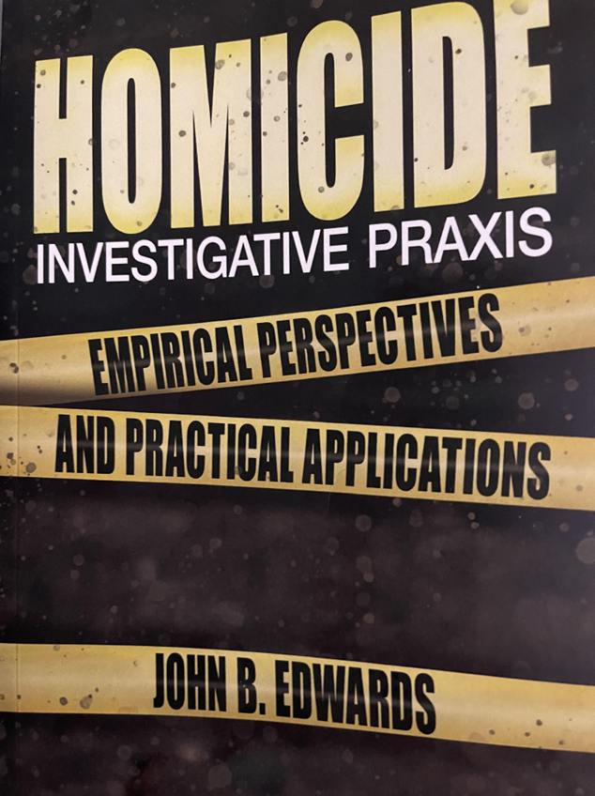
God Bless And Keep You All
“It’s a burden to command, and a blessing to have the opportunity.”
CONTACT INFORMATION:
Website: www.jbedwardsandassociates.com
JB Edwards and Associates
1206 Edgewater Drive
Claxton Ga. 30417 @JBEOpines
CONTACT: Anita M. Edwards (Scheduling)
912 618 9192 anitamedwards14@gmail.com
John B. Edwards
912 618 9193
jbedwards15@gmail.com Books are available on
Amazon and Kindle

